Slide 1
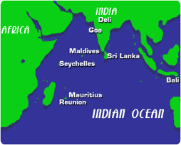
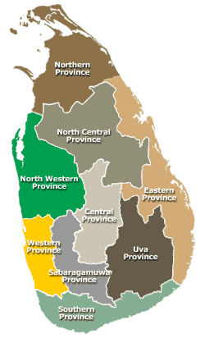
Sri Lanka
Sri Lanka Population 20 million, land area-62,705 sq. Km.

Slide 2
NCD Situation

Slide 4
Prevalence of Major NCD Risk factors
Risk Factor | Male | Female
*Smoking (Adults) | 22.8% | 0.3%
*Obesity (BMI>=25) | 19.6% | 30.4%
**Lipid Levels (Total Cholesterol) | 19.4% | 28.7%
***Hypertension (Systolic BP>140mmHg & Diastolic > 90mmHg) | 13% | 14%
Physical Inactivity (<600MET minutes / week) | 17.9% | 31.9%
Fruit & Vegetable Consumption(<5 fruits/vegetable servings) | 81.4% | 83.3%
Stress
Air pollution-Industrial & vehicular emissions, Rural areas- Closed kitchen
*Sri Lanka STEPS survey 2007
**Ragama Risk Factor Study 2007
***Katulanda et al 2005

Slide 5
Integration of Prevention & Control of NCD into Policies in the Government
Political Will-In the Presidential electoral manifesto NCD prevention through PHC development
National NCD Policy
National Policy & strategic framework on Injury Prevention & Management of Sri Lanka
Mental Health Policy
Sri Lanka was the first in the South-East Asia Region to ratify the WHO FCTC in 2006-enacted the Tobacco Act and establish NATA to implement the Act ,District Cells
Nutrition Policy
Healthy Canteen Policy-In collaboration with Ministry of Education

Slide 6
To establish & Strengthen National policies..........
In Health Master plan-2007-2016 NCD Prevention included
NCD Unit prepared:
The Mid Term Plan for Prevention of NCD 2010-2013
Yearly GOSL plan & WHO Biennium Plan
For NCD Prevention:
GOSL allocating 45 million SR(409,090 US$)annually
Treasury allocated 900 Million SR (8.1 Million US$) for PHC development

Slide 7
To promote Interventions To reduce Modifiable Risk Factors........
Health promotion activities-Bottom Top approach-Healthy school, Healthy Work Place, Healthy Village, Healthy Antenatal Clinic concept
Jaica Project in Polonnaruwa & Kurunagala Districts since 2008...
PEN project in Nuwaraeliya District since 2010..
Screening programmes in other Districts including outreach clinics-Adhoc manner
Last month distributed 86 Million for development of HLCs & guidelines, protocols, MIS developed
Human Resource Development-Diabetic Nurses, MO/NCD training
Mass Media campaign, Food labelling discussions started
Mechanism for coordination through Mo/NCDs

Slide 8
Organizational Structure-Health System Sri Lanka
Mi
Ministry of Health Care (Population-20 million)
Health Secretary
Director General of Health Services
Provincial Ministries (9)-
Provincial Secretary
Provincial Director of Health Services
Regional Directors of Health Services (25)
MO/NCD,Mo/Planning/Mo/MCH,RE/HEO
Preventive Health Services
Curative Health Services
Medical Officer of Health-Population75,000-150,000
General & Teaching Hospitals
Base Hospitals
District General Hospitals
District Hospitals
Public health Nursing Sister
Public Health Midwife-Population2,500-5,000
Public Health Inspector
Rural hospitals & CDs

Slide 9
To promote Partnership......
Conducted Multistake holder meeting at National Level
All the relevant committees for NCD prevention all the sectors included
Especially coordinated with Education Ministry for curriculum & Question papers development, implementation of healthy canteen policy
Media workshops , Media seminars arranged in all most all the events

Slide 10
Monitoring & evaluation of progress...
National Level-
National Health Council, NCD Steering committee headed by Secretary of Health, National Advisory body for NCD prevention(NABNCD) headed by DG of Health, Sub committees headed by Director /NCD
District level
District level NCD committees headed by RDHS
Central Level
Evaluation of MO/NCD through MIS & Review meetings
Surveillance
Risk Factor surveillance in 2007, IMMR & Vital Registration by registrars of Births & Deaths

Slide 11
THANK YOU

