Slide 1
NONCOMMUNICABLE DISEASES CONTROL PROGRAM IN INDONESIA
FATUM BASALAMA, MD, MPH
HEAD OF SUB DIRECTORATE CANCER DISEASE CONTROL
NCD
MINISTRY OF HEALTH, THE REPUBLIC OF INDONESIA
DIRECTORATE GENERAL DISEASE CONTROL AND ENVIRONMENTAL HEALTH

Slide 2
Indonesia
Consists of >17,500 islands.
Extending 5,120 Km from east to west, 1,760 Km from north to south.
Indonesia’s territory (land and sea): 5 million Km²
Total land area: ±1,9 million Km²
Divided into 33 provinces, and 480 districts
District divided into sub-districts
Sub-district divided into village/kelurahan and sub-village.
Population (2010): 237.6 million.
No. of Health Center (2009): 8,737
No.of Hospital (2008): 1,378

Slide 3
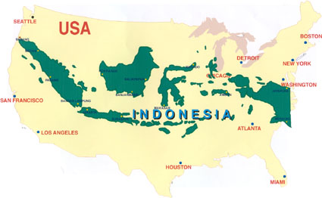

Slide 4
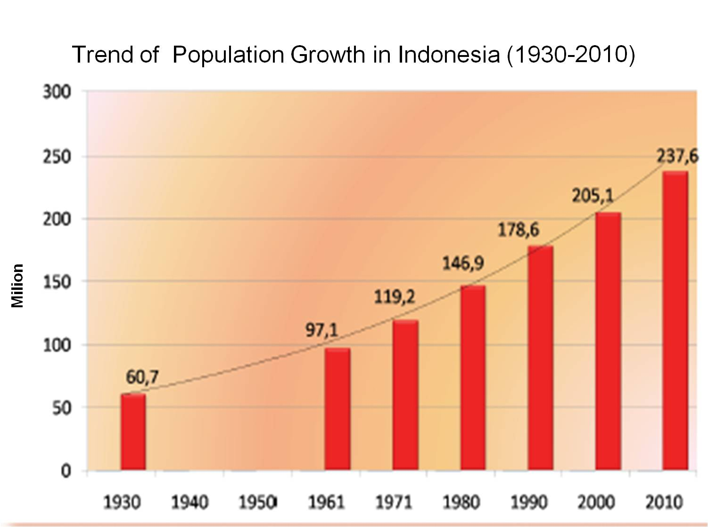
Trend of Population Growth in Indonesia (1930-2010)
Notes:
Ladies and Gentlemen,
This graph shows another challenge in public health service, namely the population. The population of Indonesia keeps increasing from time to time. The census in 1930 showed that the population of Indonesia was 60,7 million . In 1961, it was 97,1 million and in 1971 it was 119,2 million. The number become larger and larger, and in 2010 it is 237,6 million.

Slide 5
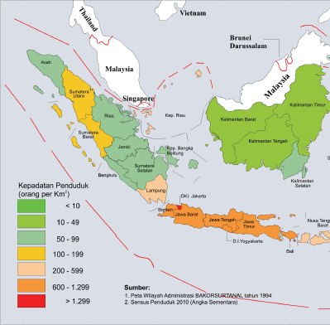
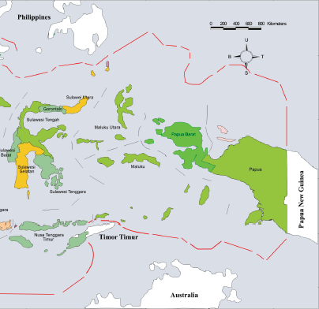
Population Density in Indonesia 2010
Notes:
This map shows the population density Indonesia. It can be seen - that there is an uneven distribution of population of the country. Population is concentrated in certain parts of the country – mainly the island of Java. Around 60% of the population of Indonesia live in Java. This is also another challenge in delivering public health service.

Slide 6
Distribution of Causes of Death, All Ages, Indonesia, 1995, 2001, 2007
HHS=Household Health Survey
BHR=Basic Health Research

Slide 7
Diseases control in Indonesia
Up to 2005 the name of the Directorate General which implementing disease control in Indonesia is the Directorate General of Communicable Disease Control and Environmental Health
Since 2006 the name changed to the Directorate General of Disease Control and Environmental Health
Directorate of Non-Communicable Diseases (NCD) Control started since 2006

Slide 8
MOH of RI Organization Structure
Ministry of Health
Secretary General
DG of Medical Services
DG of Farmacies& med-supp
DG of Disease Control & EH
DG of Public Health
Inspectorate General
Secretary of DG of DC & EH
Directorate of SESPIM
Directorate of DCDC
Directorate VBDC
Directorate of NCDC
Directorate of EH
Subdit Cardiovascular Disease
Subdit. DM & Other Metabolik Disease
Subdit. Chronic & degeneratif
Subdit Cancer
Subdit. Violence & Injury & Disability
Notes:
8

Slide 9
Program under Non-Communicable Disease Control Directorate
Cardiovascular Disease (CVD) Control Program
Chronic Disease and Other Degenerative Control Program
Diabetes and Metabolic Disease Control Program
Cancer Control Program
Accidents and Violence Control Program

Slide 10
Pattern of Causes of Death, All Ages in Indonesia, 2007
Causes of Death | % | Causes of Death | %
Stroke TB Hypertension Injury Perinatal/maternal DM Neoplasm/cancer Liver disease Ischemic Heart Disease Lower tract resp. disease Heart disease | 15,4 7,5 6,8 6,5 6,0 5,7 5,7 5,1 5,1 5,1 4,6 | Pneumonia Diarrhea Gastric ulcer Typhoid Malaria Meningitis/Encephalitis Congenital malformations Dengue Tetanus Septicemia Malnutrition | 3,8 3,5 1,7 1,6 1,3 0,8 0,6 0,5 0,5 0,3 0,2
Source: BHR, 2007
NCD: 59,5%; CD: 28,1%
Notes:
Ladies and Gentlemen,
This data shows the importance of Non Communicable Diseases as the cause of death in Indonesia. According to Basic Health Research of 2007, for causes of death due to Non Communicable Diseases, stroke is the leading cause of death in all ages (15.4%), followed hypertension (6.8%), injury (6.5%), diabetes mellitus (5.7%), neoplasm/cancer (5.7%), lower tract respiratory diseases (5.1 %), and heart disease (4.6%).

Slide 11
Prevalence of NCDs Cases
NCDs cases | %
Hypertension Stroke Heart disease Arthritis Asthma DM DM (urban population) Tumor/cancer Land traffic injuries | 31,7 0.83 7.2 30.3 3.5 1.1 5.7 4.3 25,9
Source: BHR, 2007
*>10 year old; #>15 year old; ** ≥15 year old (BHR, 2010)

Slide 12
Risk Factors
Risk factors | %
≥ Everyday servings salty foods ≥ Everyday servingd fatty foods <5 servings of fruits & vegetables Overweight & obese Lack of physical activity Emotional-mental disorder Alcohol use Smokers | 24.5* 12.8* 93.6* 19.1# 48.2* 11.6# 4.6* 34,7**
Source: BHR, 2007
*>10 year old; #>15 year old; ** ≥15 year old (BHR, 2010)

Slide 13
80% of smokers live in the developing countries
Tobacco as a cause 5.4 million deaths in the world (1 death every 6.5 seconds)
Indonesia → 300,000 deaths each year due to tobacco
Global Youth Tobacco Survey in Indonesia, 2007
20,3 % junior high school student smokes
INDONESIAN SMOKERS | BHR 2007 | BHR 2010
Smoking Prevalence (>15 Th) | 33,4% | 34,7%
Male Smokers(>15 Th) | 65,29% | 65,9%
Women(>15 Th) | 5,06% | 4,2%
Population exposed to cigarette smoke | 84,5 % | 76,1%

Slide 14
Proportion of start smoking by age groups INDONESIA-SUSENAS 1995, 2001, 2004 BHR 2007, 2010

Slide 15
Teenage Trend smoking prevalence
The prevalence of teenage smokers according to age group 15-19 years, by sex, Indonesia, 1995, 2001, 2004, 2007
Male
Female
Source: Susenas (1995, 2001, 2004) dan BHR 2007

Slide 16
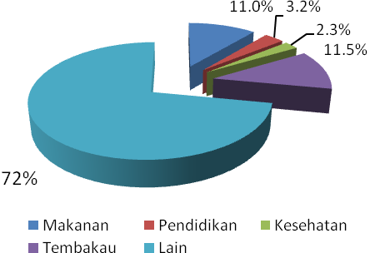
Monthly Expenditure by Households, Indonesia, 2007
Food
Education
Health
Tobacco
Other expenses

Slide 17
Study on Medical Expenditures and Burden of Major Tobacco Attributed Diseases in Indonesia, 2008(1)
The study has been conducted in 5 (five) Public General Hospitals in Java and Bali.
Financial data of hospitalized patients with major diseases related to tobacco have been collected.
Patients or their immediate family members have been interviewed on medical expenditures they have spent for out-patient care related to the diseases, that include among others: Coronary Heart Disease, Stroke, Lung Cancer and other Cancers, and Chronic Obstructive Pulmonary Disease (COPD)
Source: Soewarta Kosen, National Institute of Health Research Development, MoH, Indonesia, 2009

Slide 18
Study on Medical Expenditures and Burden of Major Tobacco Attributed Diseases in Indonesia, 2008(2)
The results show that for Indonesia in 2008 (a):
The average budget spent by individual smoker to purchase tobacco in 1 month was Rp. 216,000,- (~ 21.6 USD*); and the total budget spent by the Indonesian smokers in a month: 12.77 Trillion Rupiahs (~ 1.277 billion USD) and in one year: 153.25 Trillion Rupiahs (~ 15.325 billion USD).
The total health expenditures spent by the Indonesian people (14,904,226 cases) for diseases attributed to Tobacco amounted to 15.4 Trillion Rupiahs (~ 1.54 billion USD) for In Patient Services and 3.1 Trillion Rupiahs (~ 0.31 billion USD) for Out Patient Services.
In 2008, there were 602,350 deaths (311,572 males and 293,788 females) due to diseases attributed to tobacco or almost one third of the estimated total deaths in the same year.
*Rp. 10,000 ~ 1 USD

Slide 19
Study on Medical Expenditures and Burden of Major Tobacco Attributed Diseases in Indonesia, 2008(3)
The results show that for Indonesia in 2008 (b):
There were DALYs Loss of 13,066,230 (7,575,220 for males and 5,490,990 for females) or 25.5 % of Total Disability Adjusted Life Years Loss in the same year (51.250,04 DALYs Loss).
By applying the GDP per Capita in 2008 of US $ 1,420.00.; at the macro level, the DALYs Loss caused economic loss of 18.5 billion US Dollars.

Slide 20
Study on Medical Expenditures and Burden of Major Tobacco Attributed Diseases in Indonesia, 2008(4)
The economic loss in 2008 due to premature mortality, morbidity and disability is estimated at least in the amount of 166.5 Trillion Rupiahs (~ 16.65 billion USD) plus the cost of purchasing tobacco: 153.25 Trillion Rupiahs (~ 15.325 billion USD) plus the Medical Expenditures in the amount of 15.4 Trillion Rupiahs (~ 1.54 billion USD) for in-patient services and 3.1 Trillion Rupiahs for out-patient services), that is 338.75 Trillion Rupiahs (~ 33.875 billion USD)
That was much larger than the tobacco revenue obtained by the Government at the same year that was only 45 Trillion Rupiahs (~ 4.5 billion USD).

Slide 21
Strategic Program
Strengthening the legal aspect of prevention and
non communicable disease control.
Increasing the epidemiological surveillance and the early
detection (screening) of NCD risk factors.
Increasing the information, education and communication,
(IEC), partnership and active roles of the community of
prevention and NCD control.
Increasing the quality of non communicable disease
management.
Increasing the prevention and control of noncommunicable
disease program replication.

Slide 22
Noncommunicable Diseases Control Program
in Indonesia (1)
Policy
1. Increase the advocacy and socialization of
prevention and control of NCD
2. Strengthen the epidemiological surveillance
on risk factors and cases of NCD
3. Develop and strengthen information system on
prevention and control of NCD
4. Develop and strengthen the early detection
(screening) activities of NCD risk factor.
Notes:
22
22

Slide 23
Noncommunicable Diseases Control Program
in Indonesia (2)
Policy
5. Increase and strengthen the management, equalization
and the quality of screening’s equipment for NCD risk factors.
6. Increase the community’s access to service of NCD
risk factors early detection.
7. Increase the role of central government, local government and
community in doing the IEC related to risk factor’s non
communicable disease.
8. Increase the case management of NCD based on standard.
9. Develop and strengthen the community based of prevention and
control of NCD activities.
Notes:
23
23

Slide 24
Noncommunicable Diseases Control Program
in Indonesia (3)
Policy
10. Develop and strengthen networking of prevention and
control of NCD nationally and internationally.
11. Develop and increase the pilot project replication of
prevention and control of NCD from one or more
provinces and districts/cities to other provinces and
districts/cities.
12. Increase the monitoring of prevention and control
NCD activities.
13. Develop and strengthen the budgeting system for
prevention and control of NCD.
Notes:
24
24

Slide 25
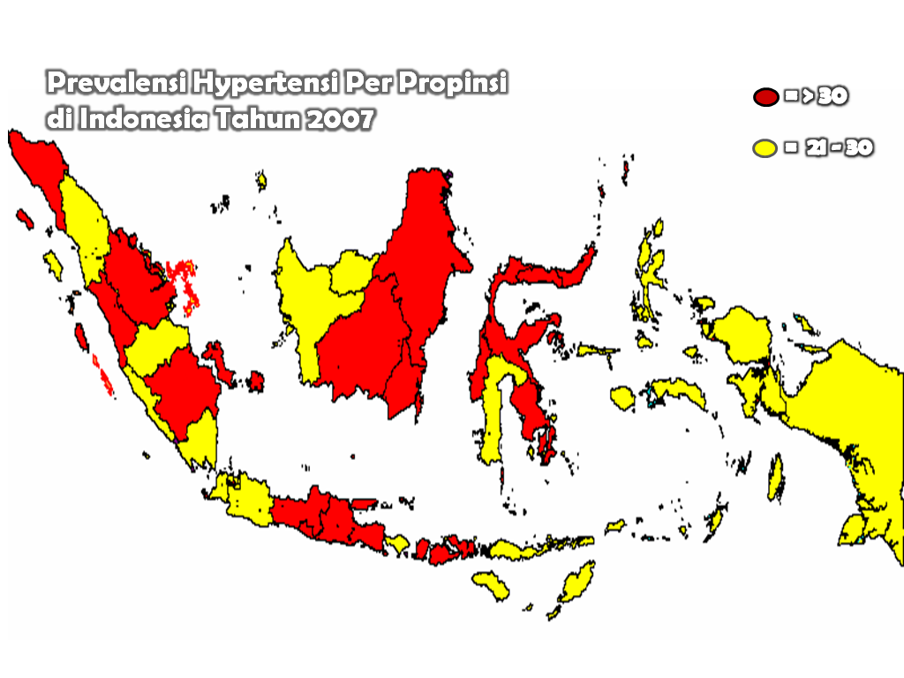
Cardiovascular Disease (CVD) Control Program
Map. Prevalence of hypertension in Indonesia
National:
Hypertension: 31,7%
Stroke: 0. 83%
Heart disease: 7,2%
Strengthening (2011)
- Salty and Fatty foods Regulation
- CVD Control Program in Pilgrims on Hajj
- NGO, Universities & CSR Roles
- Hypertension in Pregnant
- Basic Life Support

Slide 26
Cardiovascular Disease (CVD)
Hypertension
Prevalence of hypertension in 18-24 age group was reported 12.2%
Prevalence in female (31.9%) was higher than in male (31.3%)
Prevalence in rural (32.2%) was higher than in urban (30.8%)
The highest prevalence was in quintile 5 (33.0%).
Stroke
Prevalence in 18-24 age group was recorded 1.7%
There were no different in female and in male (8.3%, respectively)
Prevalence in urban (9.1%) was higher than in rural (7.8%)
The highest prevalence was in quintile 5 (9.3%).
Heart disease
Prevalence in female (8.1%) was higher than in male (6.2%)
Prevalence in rural (7.8%) was higher than in urban (6.1%)
The highest prevalence were in quintile 4 and 5 (7.3%, respectively).
Source: BHR, 2007

Slide 27
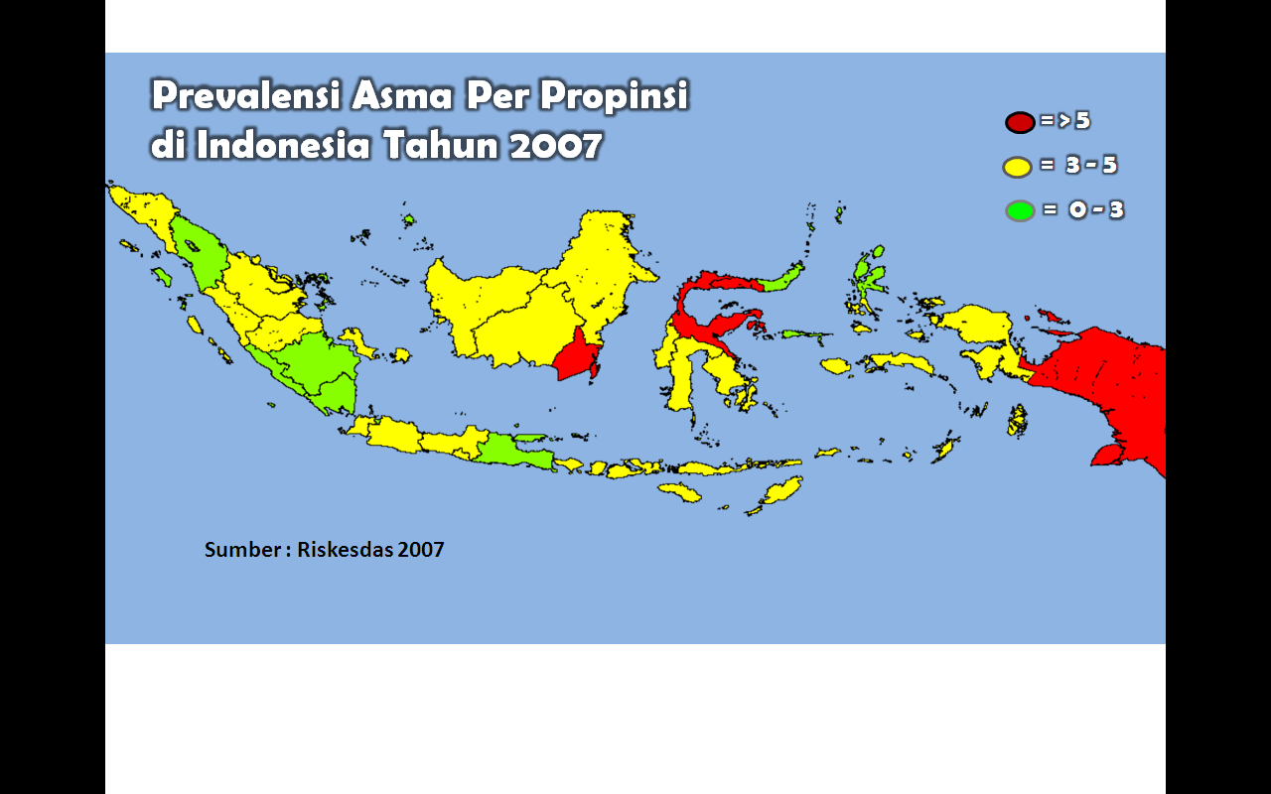
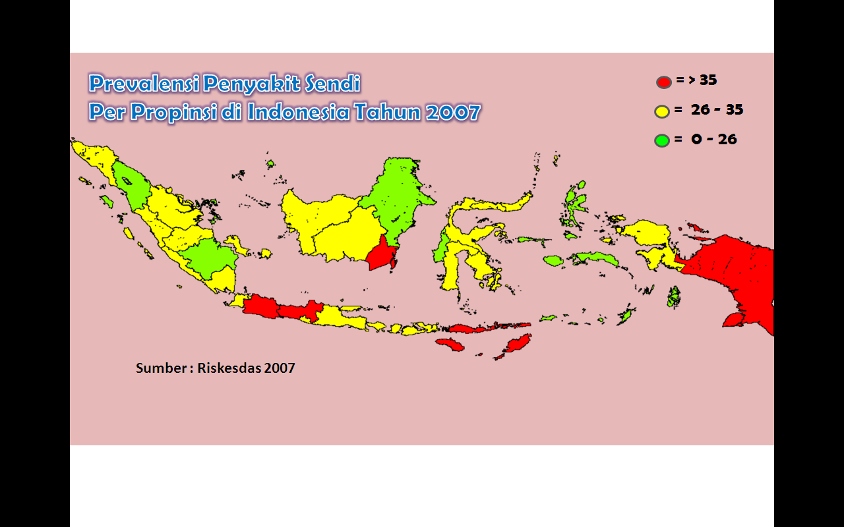
Chronic Disease and Other Degenerative
Control Program
Prevalence of asthma by province, 2007
Strengthen:
Control Program of: COPD, Asthma, Osteoporosis, Chronic renal disease
Develop Thalasemia, Rheumatoid arthritis
PAL (integrated with TB)
Replication of Free Smoking Area
Prevalence of arthritis by province, 2007

Slide 28
Chronic Disease and Other Degenerative
Arthritis
Prevalence in 18-24 age group was recorded 6.9%
Prevalence in female (32.2%) was higher than in male (28.2%)
Prevalence in rural (33.2%) was higher than in urban (25.8%)
The highest prevalence was in quintile 1 (31.5%).
Asthma
Prevalence in 15-24 age group was recorded 2.2%
There was no different in female and in male (3.5%, respectively)
Prevalence in rural (3.9%) was higher than in urban (2.8%)
The highest prevalence was in quintile 1 (3.9%).
Source: BHR, 2007

Slide 29
Tobacco control
Advocation and socialization to decision makers and stakeholders including the establishment of the “Mayor Alliance” for tobacco and NCDs prevention and control program;
Monitoring tobacco consumption, to identify the pattern and change of tobacco consumption
Regulation such as labeling of cigarette package, and free of smoking areas.
Notes:
In order to minimize the effect of tobacco to health, a Tobacco Control Program is conducted in Indonesia and belongs to the Non Communicable Disease Program . The program includes various activities, namely:
Health Promotion : promotion of Clean and Healthy Lifestyle.
Advocation & Socialization : advocation and socialization to decision makers and stakeholders.
Monitoring tobacco consumption : to identify the pattern and change of tobacco consumption.
Regulation : labeling of cigarette package, free of smoking areas, development of Government Regulation on
the Control of Addictive Substance,

Slide 30
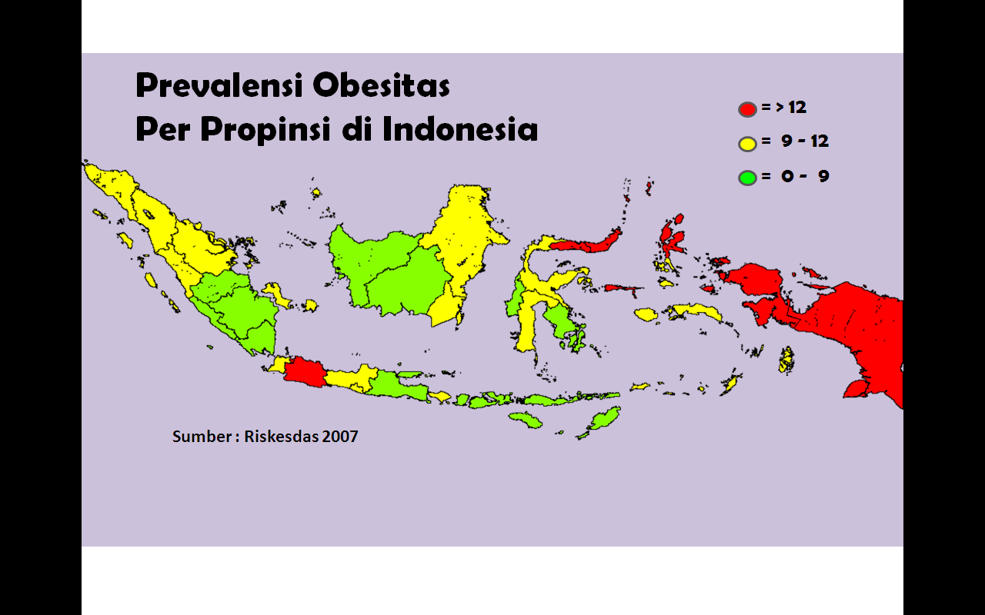
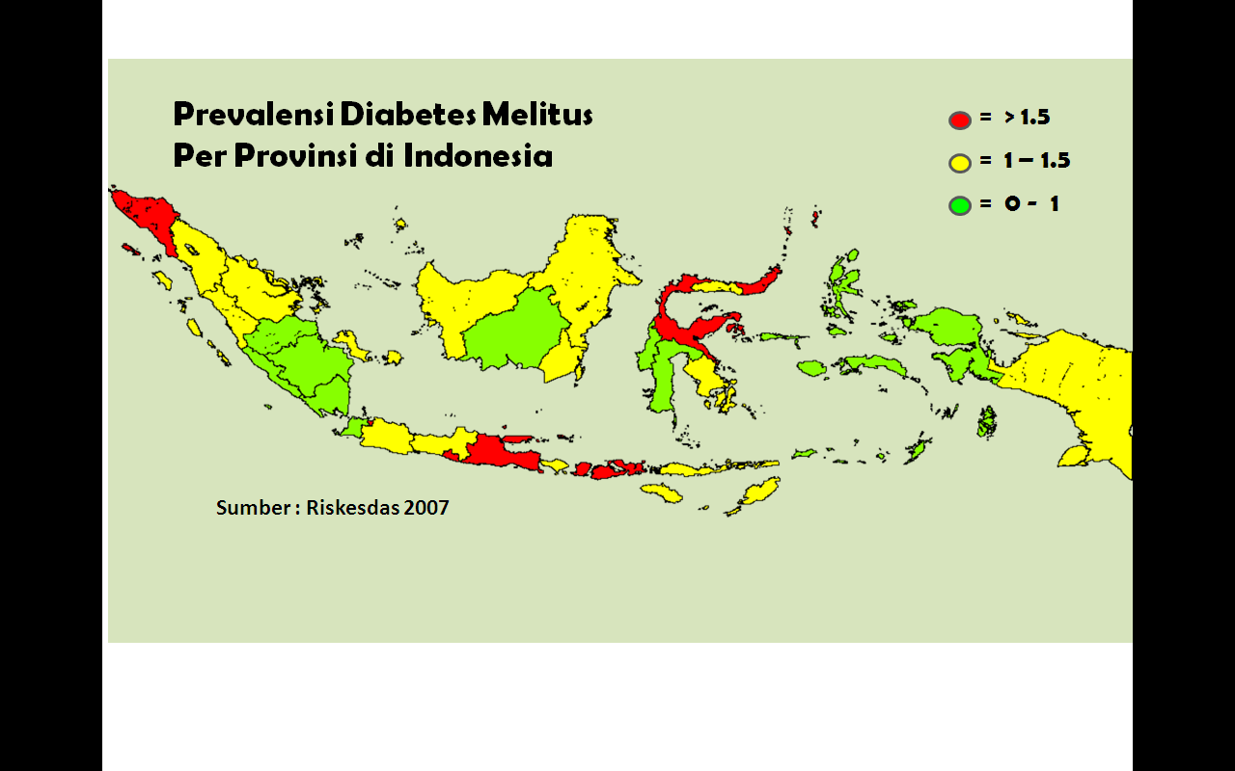
Diabetes Mellitus and Metabolic Disease
Control Program
Prevalence of obesity by province
Strengthening control program of Diabetes Mellitus and Obesity
Strengthening control program of Thyroid disease
Prevalence of Diabetes Mellitus by province

Slide 31
Diabetes Mellitus (Urban Area)
Prevalence in 15-24 age group was reported 0.6%
Prevalence in female (6.4%) was higher than
in male (4.9%)
The highest prevalence was in quintile 5 (7.1%).
Source: BHR, 2007

Slide 32
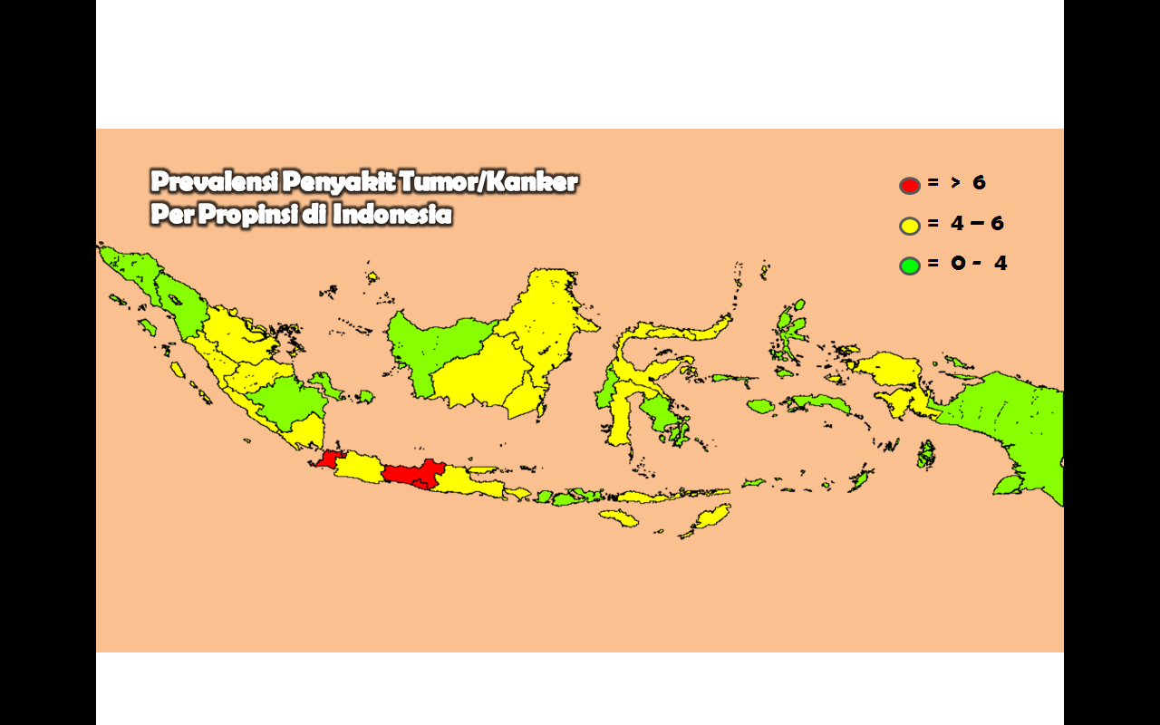
Cancer Control Program
Prevalence of tumor/cancer by province, 2007
Strengthening control program of Cervical cancer,
and Breast cancer
Strengthening control program of Lung cancer
Strengthening of Cancer Registry (community based)
Replication of VIA & CBE

Slide 33
Tumor/Cancer
Prevalence in 15-24 age group was recorded
2.4%
Prevalence in female (5.7%) was higher than
in male (2.9%)
Prevalence in urban (5.3%) was higher than
in rural (3.7%)
By quintile the highest prevalence was in
quintile 5 (5.9%).
Source: BHR, 2007

Slide 34
Integrated System for Comprehensive Cancer Control Program
Promotion & Prevention Controlling Cancer Risk Factors | Early Detection (Screening): VIA, CBE Early Diagnosis | Diagnosis & Treatment Follow Up and Rehabilitation (Pathology, Radiology, Nuclear Medicine, Radiotherapy, Chemotherapy, Surgery, Other (in progress) | Palliative Care Symptom control & management (Opiates and Radiotherapy) Psychosocial and spritual support Bereavement support for families and caregivers (in progress)
PREVENT | DETECT EARLY | TREAT & CURE | CARE
Ref.: PACT: Rev.17.0 2009-01-12

Slide 35
Results of VIA (“IVA”) and CBE Examinations in 12 Districts in Indonesia, 2007-2010
No. | District | No. of screened | No. of VIA positive | No. of suspected cervical cancer | No. of cervical cancer | No. of breast cancer
1. | Deli Serdang | 25,396 | 234 (0.92% | 0 (0.00%) | 18 (0.07%) | 2 (0.01%)
2. | Karawang | 31,774 | 534 (1.68%) | 118 (0.37%) | 22 (0.07%) | 272 (0.86%)
3. | Kebumen | 28,344 | 1,142 (4.03%) | 34 (0.12%) | 0 (0.00%) | 138 (0.49%)
4. | Gresik | 16,942 | 1,160 (6,85%) | 102 (0.60%) | 12 (0.07%) | 86 (0.51)
5. | Gunung Kidul | 5,594 | 136 (2,43%) | 16 (0.29%) | 0 (0.00%) | 12 (0.21%)
6. | Gowa | 4,416 | 128 (2.90%) | 80 (1.81) | 24 (0,54%) | 48 (1.09%)
7. | Pekalongan | 11,208 | 792 (7.07%) | 46 (0.41%) | 0 (0.00%) | 60 (0.54%)
8. | Malang | 2,686 | 240 (8.94%) | 16 (0.60%) | 8(0.30%) | 60 (0.54%)
9. | Wonosobo | 18,246 | 642 (3,52%) | 0 (0,0%) | 0 (0.0%) | -
10. | Trenggalek | 4,000 | 232 (5,80%) | 0 (0.0%) | 0 (0.00% | -
11 | Kediri T o t a l | 1,276 149,882 | 28 (2.19%) 5,268 (7,03%) | 2 (0.16%) 414 (0.55%) | 0 (0.00%) 84 (0.11%) | - 618 (0.83%)
Notes:
35
35

Slide 36
- Indonesia faces triple burden - Communicable disease still prevalence - NCD are increasing - Emerging & Re-emerging diseases - Government of Indonesia take NCD as an Important Public Health Problem - NCD Program in Indonesia consists of : - Advocacy - Community awareness - Capacity building - Surveilance & data collection - Screening - Disease management & control - Strengthen the regulation

Slide 37
THANK YOU
TERIMA KASIH

