Slide 1
Country policies and programs on NCD prevention and control in Uzbekistan
8th International seminar on the public health aspects of NCDs
Geneva and Lausanne, Switzerland
2-7 June 2014

Slide 2
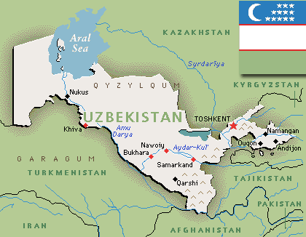
Brief country information
The total area of the country is ​​447.4 thousand km²
Population density is 63.4 people per km²
Agriculture provides more than 40% of the GNP. Cotton is the main agricultural product
Developed energy, chemical, oil and gas industries, and engineering industries
Rich natural resources of minerals, gas and gold.
8th International seminar on the public health aspects of NCDs
Geneva and Lausanne, Switzerland
2-7 June

Slide 5
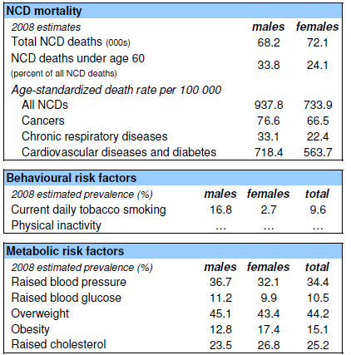
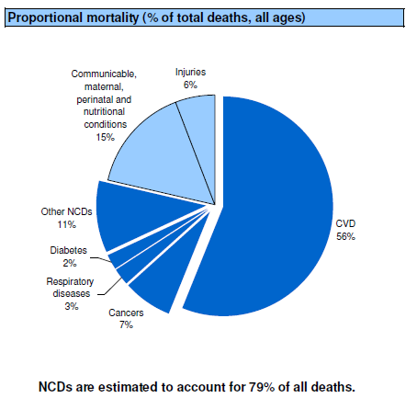
NCD country profile
8th International seminar on the public health aspects of NCDs
Geneva and Lausanne, Switzerland
2-7 June

Slide 6
Key achievements in tackling NCDs and risk factors
Developed comprehensive national NCD prevention and control strategy and action plan 2014-2020:
about ¾ of actions related to other sectors, and only ¼ - to health care system
includes adapted national targets in line with 9 global monitoring indicators for NCDs
signed by 25 ministries, state agencies, organizations, incl. NGOs
proposing establishing high-level Public Health Steering Committee lead by Deputy Vise-Minister
submitted for governmental approval
8th International seminar on the public health aspects of NCDs
Geneva and Lausanne, Switzerland
2-7 June

Slide 7
Key achievements in tackling NCDs and risk factors (2)
Adoption of the Law on tobacco and alcohol use restriction in 2012
Ratification of the WHO FCTC
Conduction of national STEPs and GYTS surveys 2014
Adapted WHO PEN protocols at national level
8th International seminar on the public health aspects of NCDs
Geneva and Lausanne, Switzerland
2-7 June

Slide 8
Main challenges
Failure to include considerable excise tax increase on tobacco and alcohol products (most possible due to UzBAT strong lobbying)
Failure in establishing Health promotion fund in order to ensure sustainable funding of Health promotion and NCD prevention (as 1% of revenue from tobacco and alcohol tax)
Weak intersectoral collaboration and not clear mechanisms of technical interaction
8th International seminar on the public health aspects of NCDs
Geneva and Lausanne, Switzerland
2-7 June

Slide 9
Main challenges (2)
Low awareness about NCD burden and “best-buys” in other sectors
Weak evidence-based policy making capacity
Weak NCD and risk factors surveillance system
Low research capacity in NCD, especially with economical aspects
8th International seminar on the public health aspects of NCDs
Geneva and Lausanne, Switzerland
2-7 June

Slide 10
Lessons learnt over the last 5 years
High political will is very important
National and international intersectoral workshops and events raise awareness and make easier technical collaboration
Evidence of cost-effectiveness and cost-benefits help to convince Ministries of Finance and Economy
Coordination mechanisms within UN and donor organizations should be well functioning
8th International seminar on the public health aspects of NCDs
Geneva and Lausanne, Switzerland
2-7 June

Slide 11
Next steps
Pilot projects on integrated care for PEN implementation in 2 regions with the link to HIS and P4P components
STEPs and GYTS results intersectoral launch meetings in October 2014 with policy making discussion
Work with the Ministry of Finance on excise tax increase for tobacco products and revenue modeling for Uzbekistan
Implementation of Healthy cities initiatives

Slide 12
Questions?
Strengthening the response to NCDs in Central Asia and Eastern Europe
Bad Gastein, Austria, 2-3 October 2013.

