Slide 1
Chronic NCDs in Sri Lanka :
Policy to Public Health approaches
Policies in place
Public Health approaches
Commitment & Implementation
Challenges
Demographic Transition
Epidemiological
Transition
NCD Burden
Social Transition
Economic Transition
Chandrika N Wijeyaratne
Chairperson NIROGI Lanka Project,
Convenor, Diabetes Prevention Task Force,
Sri Lanka Medical Association
June 2014, Lausanne

Slide 2
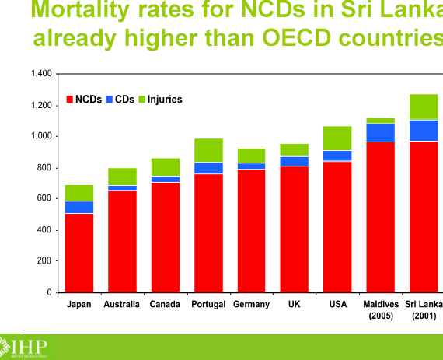
NCD burden is very high

Slide 3
Hospitalization trends due to Diabetes, Hypertension and IHD
Premaratne R et al. Hospitalisation trends due to selected non-communicable diseases in Sri Lanka, 2005-2010. Ceylon Medical Journal. 2005 June; 50( 2):51-4.

Slide 4
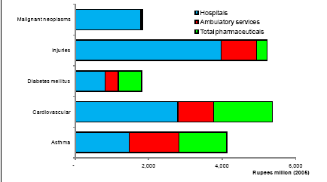
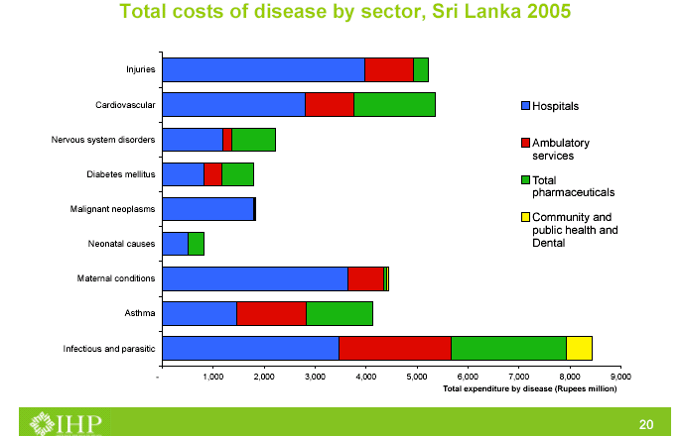
Cost Implications

Slide 5
Major risk factors
Although the traditional Sri Lankan diet is vegetable based, a large proportion of adults (82%) do not consume adequate amount of vegetables
Despite a modest consumption of fat (15%-18%), higher percentage of saturated fats included in diet
Daily intake of salt (10g) and added sugar (60g) based on food consumption data
Small proportion engaged regularly in recreational activity
Source : Sri Lanka STEPS Survey 2007

Slide 6
NCD Policy goal
to reduce the burden due to chronic NCDs by
promoting healthy lifestyles,
reducing the prevalence of common risk factors, and
providing integrated evidence-based treatment options for diagnosed NCD patients.
Scope
Cardiovascular diseases (CHD, CVD,, hypertension),
Diabetes mellitus
Chronic respiratory diseases
Chronic renal disease
Other NCDs including mental disorders, injuries and cancers - referred to in separate policy documents.

Slide 7
Policy objectives
To reduce premature mortality due to chronic NCDs by 2% annually over the next 10 years through expansion of evidence-based curative services, individual and community-wide health promotion measures for reduction of risk factors.

Slide 8
Strategy 1
prevent chronic NCDs by reducing level of risk factors in the population
smoking 23% (m)
alcohol 26%(m)
unhealthy diet 78%
physical inactivity 25%
overweight 25% (Risk factor survey 2006)
Social marketing program
Individual heath guidance for high risk groups
Non –health sector measures – NATA -
price increase for tobacco and alcohol

Slide 9
Strategy 4
Empower the community for promotion of healthy lifestyle for NCD prevention and control
Addressing the determinants of NCD
Pilot testing – Kurunegala and Polonnaruwa with the support of JICA
Metropolitan city – NIROGI Lanka

Slide 10
Strategy 9
Raise the priority accorded to NCD and integrate prevention and control of NCD into policies across all government ministries, departments and private sector organizations
Agriculture
Education
Trade
Sports

Slide 11
Primary health promotion settings
Kotte
Population: 97,000
Kolonnawa
Population: 197,000
5 Schools
5 Schools
5 Workplaces
5 Workplaces
5 Communities
5 Communities

Slide 12
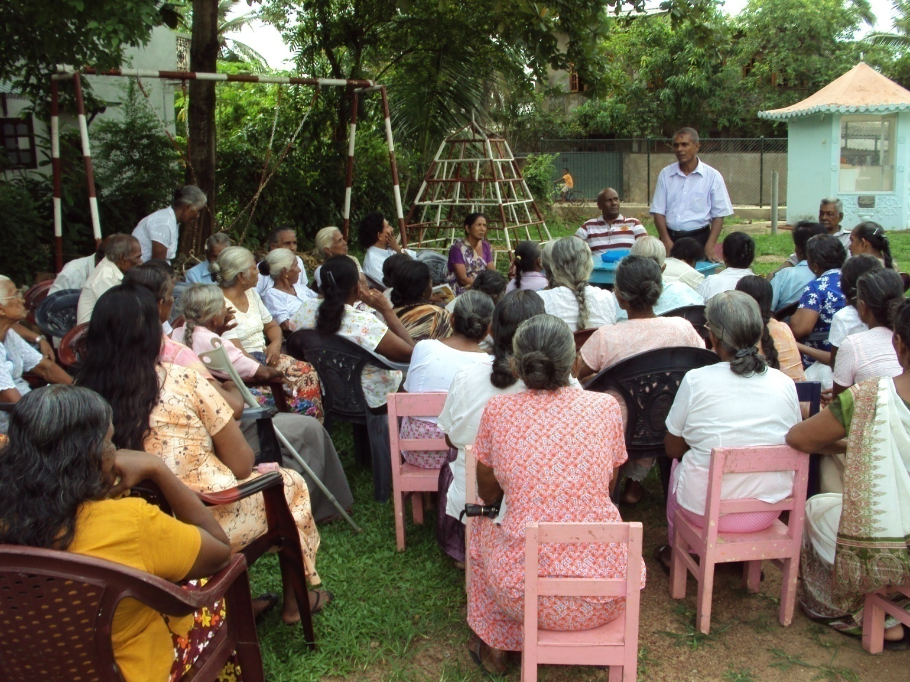
Regular meetings of HPF with participants

Slide 13
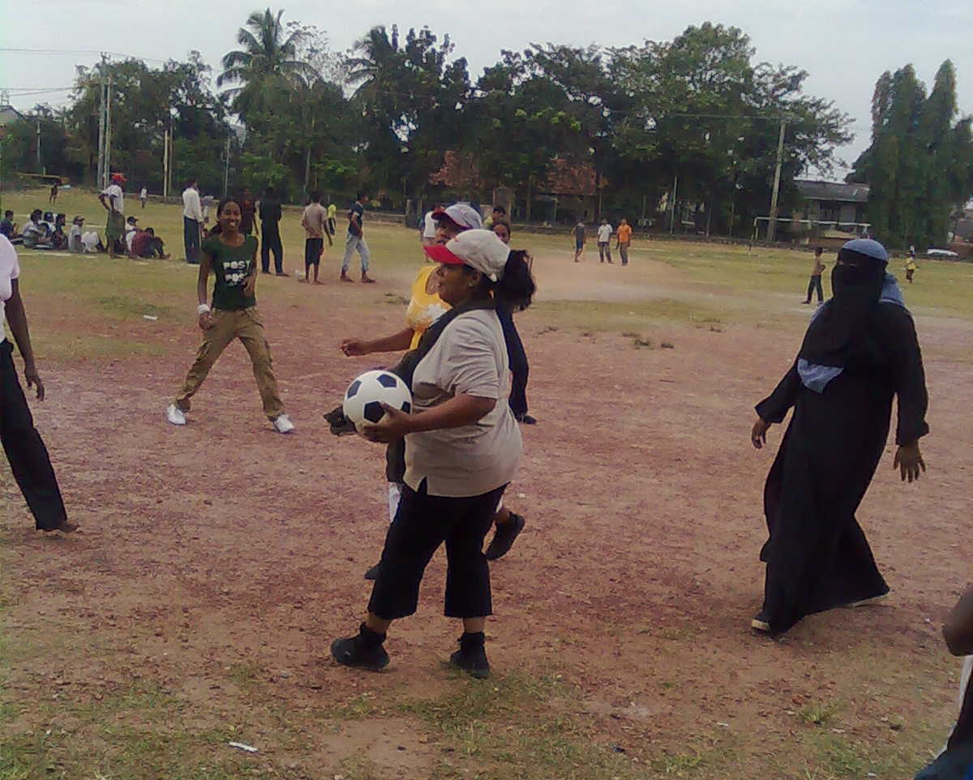
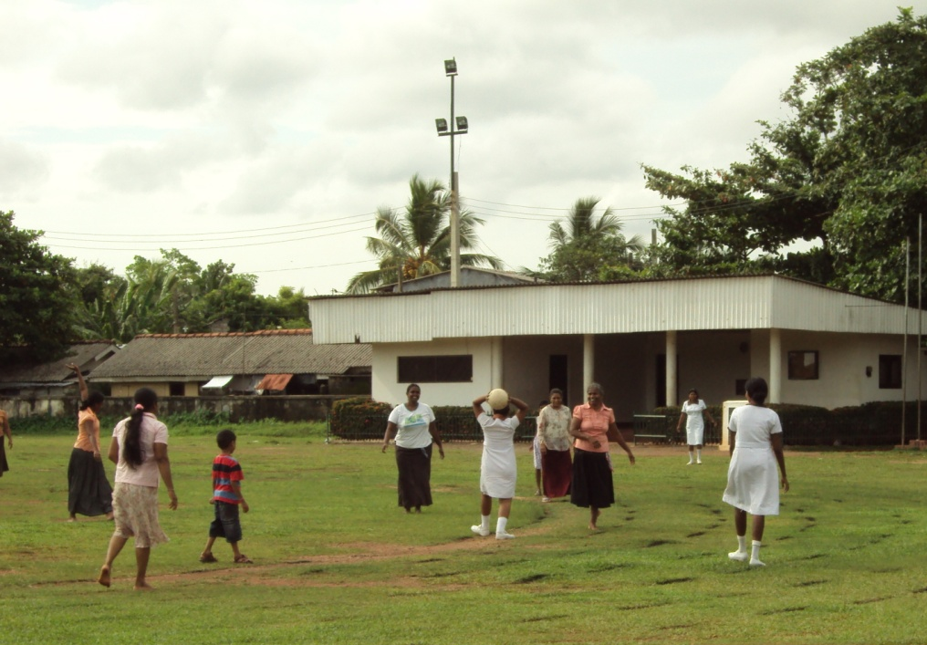
Activity-based HP
Change risk behaviour while addressing its
underlying determinants
Notes:
Trainers – field visits-

Slide 14
Key features of component 3
Interventions are led or owned by the participants rather than by ‘external experts’
More reliance on generating a process to change behaviour rather than on conducting ‘one-off’ activities
Address underlying determinants of behaviour
Emphasis on continuous monitoring of the outcomes using their own indicators, and the feedback used to guide the steps that follow

Slide 15
Lessons learnt
Applying the health promotion model to change behaviour is successful in semi-urban settings in SL
A substantial expansion by its rippling effect
A low cost model
Most gains in dietary changes, physical activity and mental wellbeing
Marginal gains in alcohol and tobacco use
Different approaches needed in different settings

Slide 16

Thank You
For your wonderful team effort
Notes:
16

