Slide 1
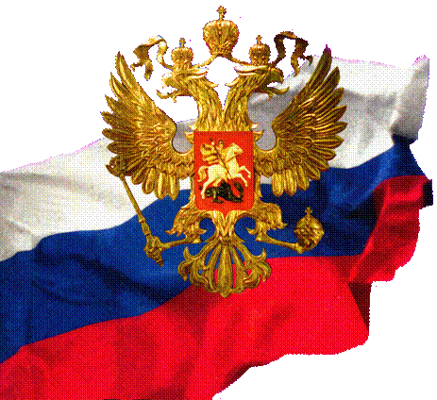
RUSSIAN FEDERATION
NON-COMMUNICABLE DISEASES – CURRENT SITUATION AND PREVENTION
2014

Slide 2
Chronic non-communicable diseases account for
76% of all deaths in the Russian Federation
Diseases of
circulatory system
23,7
Cancers
Chronic obstructive
pulmonary diseases
1,5
56,7
3,7
14,4
Diabetes
Others
APEC HWG project 01 13A “Workshop on CBI to Control NCD FR , Bali , Indonesia , April 29-30, 2014”

Slide 3
APEC HWG project 01 13A “Workshop on CBI to Control NCD FR , Bali , Indonesia , April 29-30, 2014”
Current demographic situation
of the Russian Federation
High mortality rates
(especially premature)
The difference between mortality rates (especially premature) from NCD observed in the Russian Federation and in developed countries of Europe, as well as in such economies of APEC reaches 3-7 times, depending on sex
Low life expectancy
Life expectancy at birth observed in the Russian Federation is 7 to 20 years shorter than in developed countries of Europe and in such economies of APEC, depending on sex

Slide 4
APEC HWG project 01 13A “Workshop on CBI to Control NCD FR , Bali , Indonesia , April 29-30, 2014”
Prevalence of chronic disease risk factors
in the Russian Federation
%
Data on the prevalence were extracted from different national and sub national surveys: GATS, epidemiological cardiovascular disease monitoring survey conducted in 12 regions of Russia, and others

Slide 5
EU-RF: health determinants and chronic diseases, Luxembourg, 16-17, 2013
Proportion of lost healthy life years
due to leading 4 selected risk factors
UW – underweight
H –hypertension
Аl - alcohol
%
US – unsafe sex
S - smoking
EM – Excessive body mass
18
16
14
12
10
8
6
4
2
UW
US
H
S
S
H
Al
EM
S
Al
EM
H
S
EM
Al
H
Al
S
EM
0
H
WORLD
JAPAN
USA
EUROPE
RUSSIA
Global Programme on Evidence for Health Policy; WHO, World health Report, 2002.
Notes:
It is no doubt that lifestyle and socioeconomic factors are more responsible for the premature death and healthy life years span rather than health care services. Here, a proportion of lost healthy life years due to leading 4 first selected risk factors is shown. In the world, tobacco occupies the 4 place after underweight, unsafe sex and blood pressure and is responsible for 4,1% healthy life years lost. In the US and developed countries of Europe, tobacco occupies the first place and is responsible for 12-13% of healthy life years lost followed by alcohol, excessive body mass index and blood pressure. In Russia, where tobacco occupies the third place, after blood pressure and alcohol it has even the greatest contribution to the healthy life lost – 13,6%.

Slide 6
Russian recent
legislation and regulation documents
Conception on the demographic policy in the Russian Federation (2006-2025)
Conception on the decrease of alcohol overuse and prevention of alcoholisms in population of the Russian Federation (2010-2020)
Government resolution “On financial provision of measures directed on promotion of healthy lifestyle in the Russian population including a decrease of tobacco and alcohol consumption” (N1237 issued in December 2010)
New revised legislations “On bases of health care of citizens in the Russian Federation”, “On provision of population with drugs”, “On obligatory medical insurance”

Slide 7
Russian recent
legislation and regulation documents
State Program of the Russian Federation “Public Health Development up to 2020” (issued in 2011)
Standards of treatment within primary care settings and hospitals
Official documents of the Ministry of Health of the Russian Federation “Rules of population screening” (N1006n, issued in December 3, 2013) and “Rules of follow-up in the primary care settings” (N1334n issued in December 21, 2013)
Law "On protection of public health from exposure to environmental tobacco smoke and the consequences of tobacco consumption”, reflects all main articles of WHO FCTC (N15, issued in June, 2013)

Slide 8
Implementation of FCTC articles in the Russian Federation will result in:
EU-RF: health determinants and chronic diseases, Luxembourg, 16-17, 2013
- decrease in smoking prevalence by 30% in 2020, and by 50% in 2055
- safe 3,7 millions lives:
increase taxes: more than 1 millions
tobacco free environmental: more than 1 millions
bans on advertising and promotion tobacco products: 730,000
effective anti-tobacco campaigns and comprehensive medical care:
more than 1.2 millions
Galina Ya Maslennikova, Rafael G Oganov, Sergey A Boytsov, Hana Ross, An-Tsun Huang, Aimee Near, Alexey Kotov, Irina Berezhnova, David T Levy
Russia SimSmoke: the long-term effects of tobacco control policies on smoking prevalence and smoking-attributable deaths in Russia
Tob Control published 12 July 2013, 10.1136/tobaccocontrol-2013-051011

Slide 9
State Program of the Russian Federation
“Public Health Development up to 2020”
(№ 2511-p, issued December 24, 2012)
First period : from 2013 to 2015
Second period : from 2016 to 2020
Targets – decrease
Total mortality (per 1,000 pop./yr.) up to 11,4
Mortality from cardiovascular disease (per 100,000 pop.) up to 622,4
Mortality from road and traffic injuries (per 100,000 pop.) up to 10,0
Mortality from cancers (incl. malignant) (per 100,000 pop.) up to 190
Target - increase
Life-expectancy at birth up to 74,3 years.

Slide 10
National project “Healthy Russia”
Education activities toward healthy lifestyle promotion and modification
Internet - FM radio advertising - Schools, other education, business settings - Printed materials - Out-door advertising - Telephone (on-line) inquiry service - Mass campaigns (non-smoking, healthy days…
Health Centers
502 centers for adult, 193 – for child
All regions (83) covered
What they do:
identification of individual risk
screening for major diseases
consultation on healthy lifestyles
planning out of bad habits
Who can use:
any citizen
themselves or recommended by doctor

Slide 11
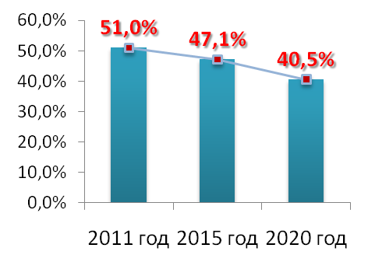
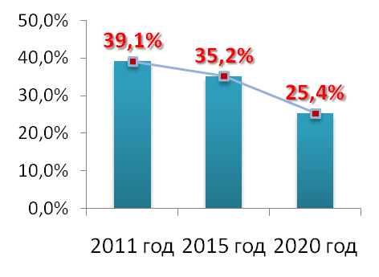
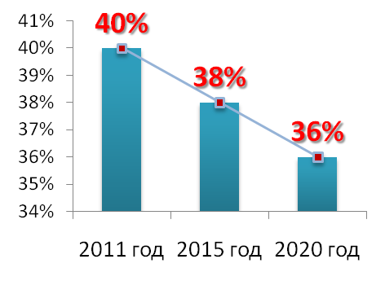
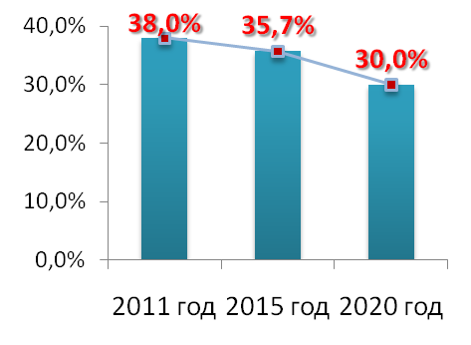
The National Program on NCD prevention:
NCD RF targets in adult population
The prevalence of tobacco use
The prevalence of salt intake
The prevalence of insufficient of fruit and vegetable consumption
The prevalence of hypertension
The prevalence of high cholesterol

