Slide 1
Swiss Centre for International Health
Health Systems Support Unit
7th International Seminar on public health aspects of NCD - Lausanne 3-8 June 2013
Strengthening health systems for the prevention and control of NCDs
Thursday 6 June 2013
Kaspar Wyss, Swiss Centre for International Health, Swiss TPH

Slide 2
Objectives of the session
Introduce the 6 health system building blocks of the WHO framework
Relate the health systems performance framework with NCD control, primary care services and the Package of Essential Noncommunicable (PEN) Disease Interventions
Discuss practical and concrete steps (options) to adjust health services delivery to NCDs, thereby aligning NCD control with health systems strengthening

Slide 3
Structure
Health systems and building blocks and their relations to PHC and NCDs
Relate the health systems performance framework with NCD control, primary care services and the Package of Essential Noncommunicable (PEN) Disease Interventions
Summary of critical aspects for NCD control and health systems strengthening

Slide 5
Global burden of disease (Murray et al. Lancet 2012)
Size of the problem
Increase from 43% (1990) to 54% (2010) of DALYs from NCDs
Major risk factors
  ageing population
  lower mortality of children < 5 years
  changes in risk factor exposure (globalization & urbanization of lifestyle/ environment)

Slide 6
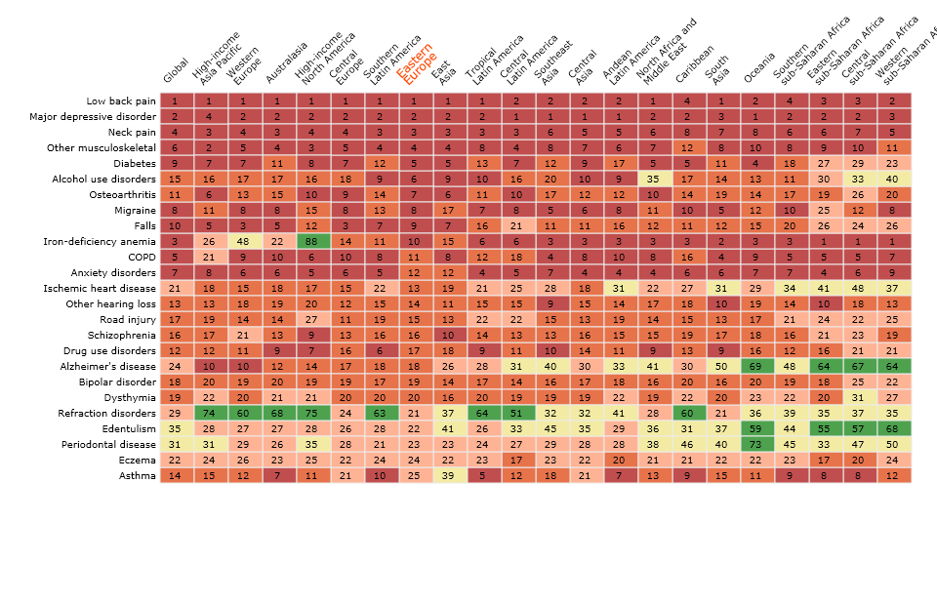
Years lost due to disability: leading causes by region

Slide 7
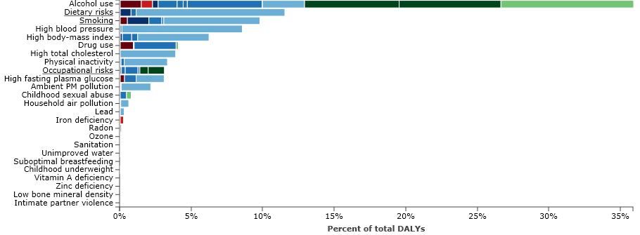
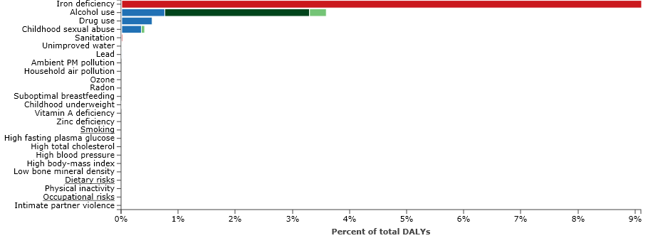
% DALY 2010; age group 15-49; Eastern Europe;
MEN
% DALY 2010; age group 5-14; Eastern Europe;
MEN & WOMEN (no gender difference)

Slide 8
Source: WHO 2005

Slide 9
NCD control and the role of health services
 | Non-health sector | Health services
Primary prevention of NCDs | Actors outside the health sector have an important role to play | Some role, for example in terms education and behavioural change
Secondary prevention | School health and others have limited role to play | Most interventions are health service related. PHC has an important role to play
Treatment/care of NCDs | Social sector has some a role to play | Most interventions are health service related with an emphasis on PHC

Slide 10
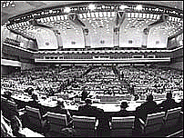

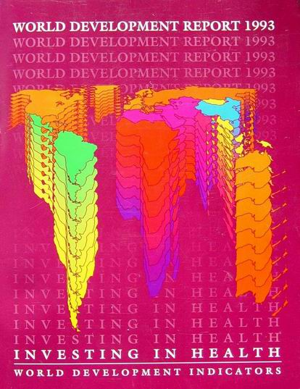



Global Strategies
Alma Ata – Comprehensive PHC – HFA 2000
1978
UNICEF Child Survival Revolution – Selective PHC
1982
WB WDR’93 Minimum Essential Health Interventions
UN Millennium Development Goals
1993
Commission on Macroeconomics and Health
2000
Global Fund for AIDS, TB, Malaria
2001
2002
2003

Slide 11




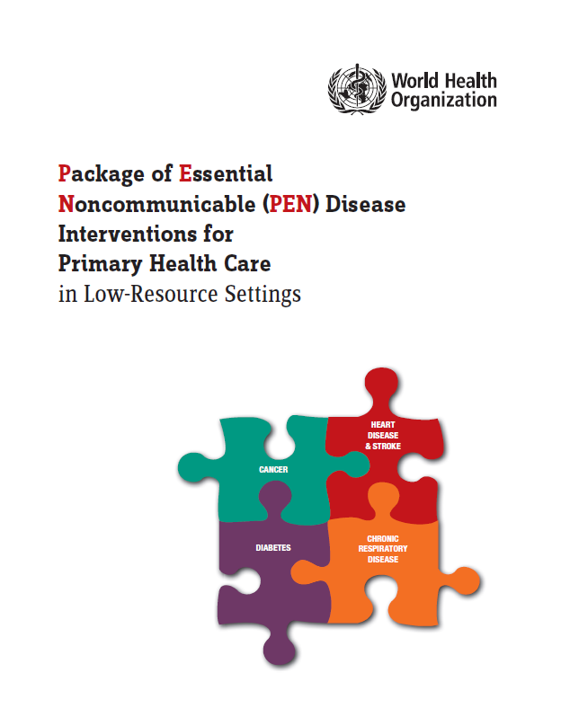
Foundations
2000
2007
2008
2009
2010

Slide 12
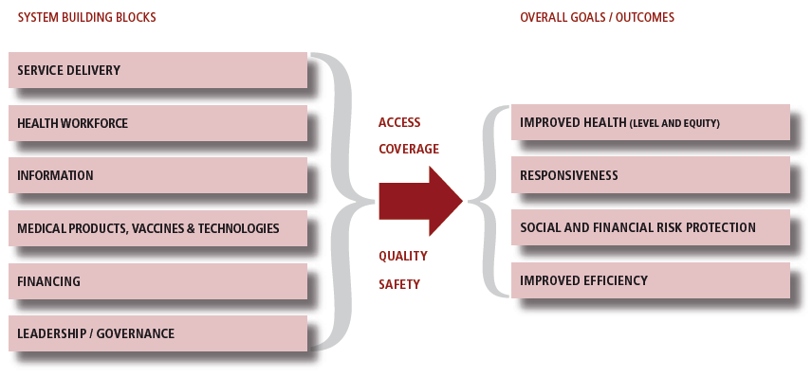
Relations between functions and objectives of a health system
Source: WHO, 2007

Slide 13
Dynamic architecture and interconnectedness of the health system building blocks
Source: WHO, 2009

Slide 14
Governance Functions according to WHR 2000
The ability to formulate strategic policy directions;
Ensure good regulation and tools for implementation (powers, incentives, and sanctions);
Generate necessary intelligence on health system performance in order to ensure accountability and transparency

Slide 15
Health System Governance Principles
(Siddiqi et al. 2009)
Strategic vision
Rule of Law
Participation and consensus orientation
Transparency
Responsiveness
Equity and inclusiveness
Effectiveness and efficiency
Ethics
Intelligence and information
Accountability
Notes:
Sameen Siddiqi et al (2007). Framework for Assessing Governance of the HS in Developing Countries: Gateway to Good governance.
Division of HS and Services Development, Mediterranean Regional Office, WHO, Cairo
-> development of analytical tool that permits a ‚diagnoses of the ills‘ in the governance at the policy and operational levels of the health system, and provides the basis for developing interventions for its improvement.
10 Principles, which they break down into domains and assessment level, so as to be able to tailor the research questions more finely.
15

Slide 16
Governance principles
Strategic vision:
  Do national health stewards set the long term vision for the nation’s health and the vision for how the health system will achieve this?
  What is the content of this vision?
  How does it speak to values of participation, ownership, equity and justice?
  Intended versus factual strategy?
Participation and Consensus orientation
  Policy set by MOH & which other stakeholders?
  Inter-disciplinarity?
  Devolution to local government?
  What is degree of participation and consensus with national vision and plans?

Slide 17
Governance principles
Accountability
  Does the legislature have the powers of a) financial and b) bureaucratic oversight?
  Is there an independent general auditor (Supreme Audit Institution) for the whole government and what is its authority?
  What horizontal accountability institutions (e.g. Ombudsman, Anti-corruption Agency, Human Rights Commission etc.) have been established and what is their authority and mandate?
  Do public agencies disclose information on their regulatory and other actions (e.g. procurement), and do they publish regular reports with financial statements?
  How does the MOH handle the press for new policies?
  How does the MOH handle the press when their problems are exposed in the media?
  Does an Ethics code for public officials and health workers exist?
  Can citizens bring charges against politicians and officials?
  Are citizens freely able to assemble and protest matters of public interest?

Slide 18
Three ways of moving towards universal coverage
Universal population coverage
Universal population coverage
Complete prepayment/
Complete prepayment/
No cost
-
sharing
No cost
-
sharing
Services &
Reduce
Benefits
Reduce
Extend
Extend
out
-
of
-
Essential
out
-
of
-
Essential
benefits
benefits
pocket
benefit
pocket
benefit
package
package
Extend
Extend
coverage
coverage
Public expenditure
on health
Prepayment/
Pooling
Population coverage

Slide 19
Characteristics of different health insurance mechanisms
No insurance | Private insurance | Social insurance | National insurance
Cash (out-of-pocket) | Household premiums | Employee premiums | General taxation | Collection method
None | Voluntary | Mandatory for workers | Mandatory | Legal status
None | Those able to pay | Workers only | Everyone | Pre-paid population
Regressive | Regressive | Neutral | Progressive | Fairness / equity
N/A | Yes | No (if working) | No | Adverse selection
N/A | Yes | Yes | Yes | Moral hazard (users)
N/A | Many | Some | Few | Copayments
19

Slide 20
Health financing for NCDs – key points
Reduce OOPs / increase pre-payment
  Systemic rather than disease-specific issue, however OOPs for chronic diseases / conditions particularly regressive and impoverishing because they endure over time (need more research showing the economic impact of NCDs on household budgets/incomes)
Use funds more efficiently and equitably:
  Identify 'best buys' for prevention and opportunities for positive synergies re: treatment in PHC
Raise sufficient funds for health
  Better articulation of and budgeting for core NCD packages / components
  Costing tool for scaling-up (evidence-based advocacy)
  Additional funding via sin taxes (e.g. alcohol, tobacco)

Slide 21
Financing and delivery - four basic health systems
1. Beveridge model
  Named after William Beveridge who designed the UK National Health Service
  Health care for all provided and financed by government from taxes
  Most facilities owned by government; most health workers employed by government
    E.g. UK, Cuba, Spain, New Zealand, Scandinavia
2. Bismark model
  Named after 19th century Prussian Chancellor
  Health care for all from non-profit insurance system financed jointly by employers and employees by payroll deduction
  Providers are private but tightly regulated
    E.g. Germany, France, Belgium, Japan, some Latin America

Slide 22
Financing and delivery - four basic health systems
3. National Health Insurance model (NHI)
  Combines Beveridge and Bismark
  Health care for all financed by a non-profit, single payer, government run insurance
  All employed citizens contribute
  All providers are private
  Tightly regulated with high cost control (single payer)
    E.g. Canada, South Korea, Taiwan
4. Out-of-Pocket (OOP) model
  Health care for few, financed only by and for those who can afford it
    E.g. Most of the rest of the world

Slide 23
Contribution of WHO PEN to Health System Building Blocks (2010)
Governance:
Assess needs and gaps and facilitate the use of available resources for prevention and control of NCDs efficiently and equitably
Support government efforts to drive the agenda towards universal coverage
Financing:
Prioritize NCD interventions to support raising of adequate funds for universal coverage
Facilitate phased- out provision of financial protection for NCDs.

Slide 24
Systems are increasingly fragmented
Medicines & Technologies building block – Tanzania 2007
ESSENTIAL
MEDICINES
ARVs
MALARIA
TB
OI
ARVs
Ped
REAGENT
Blood safety
(+ HIV test)
VACCINES
CONDOMS
CONTRACEPTIVES
MEDICAL
SUPPLIES
GOVERNMENT
BILATERAL DONOR
MULTILATERAL DONOR
NGO/PRIVATE
C
S
S
C
W
H
O
S
I
D
A
N
O
R
A
D
C
I
D
A
UN
I
TA
I
D
H
A
V
A
R
D
P
E
P
F
A
R
GLOBAL
FUND
CL
I
NTON
A
X
I
O
S
P
F
I
Z
E
R
GOVERNMENT
J
ICA
C
D
C
C
O
L
U
M
B
I
A
A
B
B
O
T
T
G
A
V
I
C
U
A
M
M
U
N
I
C
E
F
U
S
A
I
D
W
B
Source
Of Funds
Procurement
Agent/Body
TEC
&
CCT
C
L
I
N
T
O
N
H
A
V
A
R
D
MEDICAL
STORE
C
R
S
S
C
M
S
E
G
P
A
F
MOH
&
SW
A
X
I
O
S
U
N
I
C
E
F
J
I
C
A
C
O
L
U
M
B
I
A
A
B
B
O
T
T
G
A
V
I
C
U
A
M
M
CROWN
AGENTS
U
S
A
I
D
T
M
A
P
C
D
C
Point of 1st
warehousing
TEC &CCT
HOSPITAL
CRS
IMA
MEDICAL STORE
AXIOS
HEALTH FACILITY
COLUMBIA
HOSPITAL
CUAMM
Point of 2nd
warehousing
TEC &CCT
REGIONAL/DISTRICT
VACCINE STORE
ZONAL MEDICAL STORE
HEALTH FACILITY
HOSPITAL
Point of
Distribution
TEC &CCT
ZONAL BLOOD
SAFETY CENTRE
DISTRICT STORE
HEALTH FACILITY
PRIMARY HEALTH CARE FACILITY
HOSPITAL
PATIENT
And the supply-demand information for this is fragmented !

Slide 25
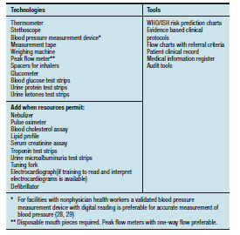
Essential tools and technologies for NCD at PHC
Source: WHO 2010

Slide 26
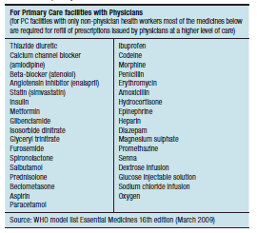
Core of medicine for NCD at PHC
Source: WHO 2010

Slide 27
Contribution of WHO PEN to Health System Building Blocks (2010)
Medical products and devices:
Define prerequisites for integrating a core set of essential NCD interventions into primary care
Develop an affordable list of essential medicines and appropriate technologies
Improve access to essential medicines.
Health information:
Provide templates to gather reliable health information of people

Slide 28
The start is not
Data
Finagle’s Law of information
“The data we have…
are not the data we want.”
“The data we want…
are not the data we need.”
“The data we need ….
are not available.”

Slide 29
Data / information | Knowledge (translation) | Understanding (guidelines) | (Policy) decisions
Problems / Needs |  |  | Which health system goal(s) or problem(s) should we focus on?
HMIS Surveys | Indicators to assess health systems performance | Evidence on indicators and alternative framings synthesised into a unique body of knowledge. | Inputs (e.g. shortage of specialised health workforce) Processes (e.g. lack of supervision) Output (e.g. coverage remains low despite massive investments)
Interventions / services / programmes |  |  | Which health system arrangements should we modify or introduce?
Reviews of effectiveness studies | Positive effects (benefits) of each policy or programme option | Evidence on options, positive effects, negative effects, cost-effectiveness… | Financial arrangements (e.g. introduction of universal coverage, conditional cash transfers)
Economic evaluations | Cost-effectiveness of options in relation to current financial burden and flows.
Implementation / management |  |  | Which implementation strategy for a new health system arrangement?
Reviews of effectiveness studies | Effects of appropriately targeted implementation strategies | Evidence on barriers and effects of strategies synthesised into a unique body of knowledge. | Patients (e.g. home based DOTS) Health workers (e.g. tasks shifting)

Slide 30
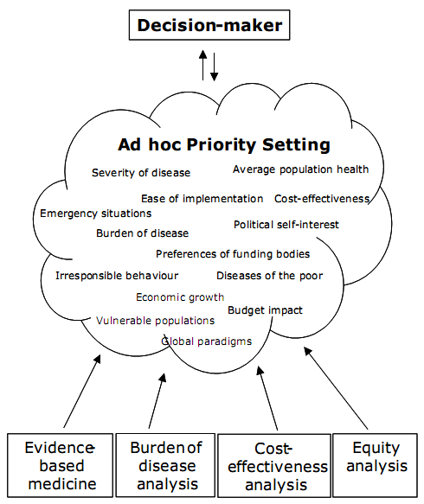
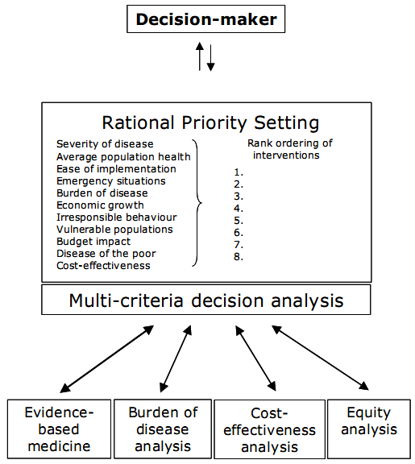
Ad hoc priority setting and rational priority setting
Source: Baltussen and Niessen (2006) Cost effectiveness and Resource Allocation 4:14-23.

Slide 32
Relevance of HR
Production of health services is labour intensive
HR as “the most important of the health system’s inputs”
HR accounts for a large proportion of health sector budgets (60-80%)
Costs of poor HR management are high (low productivity, poor retention)
HR are an important factor for quality of care, patient satisfaction, or in other words health outcomes

Slide 33
Human Resource distribution

Slide 34
Workforce composition

Slide 35
Performance and productivity of HRH
Challenge:
  Performance improvement (quality of services, equity) and staff retention under adverse conditions
Related key HRH problems:
  Low motivation, staff shortages, skill levels
Determinants for motivation:
  Financial and non-financial incentives,
  incl. HRM related Quality Management tools

Slide 36
Contribution of WHO PEN to Health System Building Blocks (2010)
Human resources:
Provide training material to enhance knowledge and skills for NCDs prevention and control
Audit performance

Slide 37
Vertical – Horizontal - Diagonal
Verticalisation of delivery
Hallmark | Year | ‘Ideology’ | What to deliver | How to deliver | To whom
‘Classic’ public health | Post II WW | Campaigns | Specific diseases | Campaigns | Whole population
Alma-Ata | 1978 | Universal Primary Health Care | Holistic package | Primary Health Care network | Whole population
Walsh and Warren | 1979 | Selective Primary Health Care | Selected interventions | Services; programmes | Whole population
UNICEF report | 1982-83 | Children’s revolution | GOBI-FF | Programmes | Target groups
Investing in Health | 1993 | Health Sector Reform | Cost-effective interventions | Reducing government role | Whole population
Global Health Initiatives, MDG | 2000 | Interventions | Disease specific programmes | Public-private partnerships | Target groups
 | 2000s | Health Systems strengthening | Organisational interventions | Reforms | The system
Notes:
‘Classic’: example of smallpox eradication.
What is GOBI?

Slide 38
How to deliver: decentralisation modes
Notes:
Discussion on the Swiss example.

Slide 39
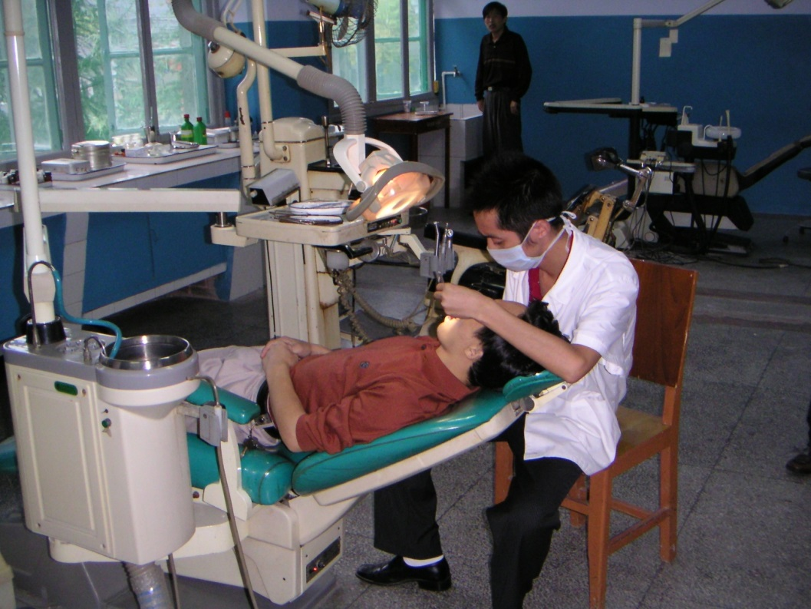
Broad range of health providers
Drug sellers and outlets
Pharmacies
Public providers
Referral hospitals (including university hospitals)
Regional hospitals
District hospitals
Primary care providers
Private non profit making providers
Private profit making providers

Slide 40
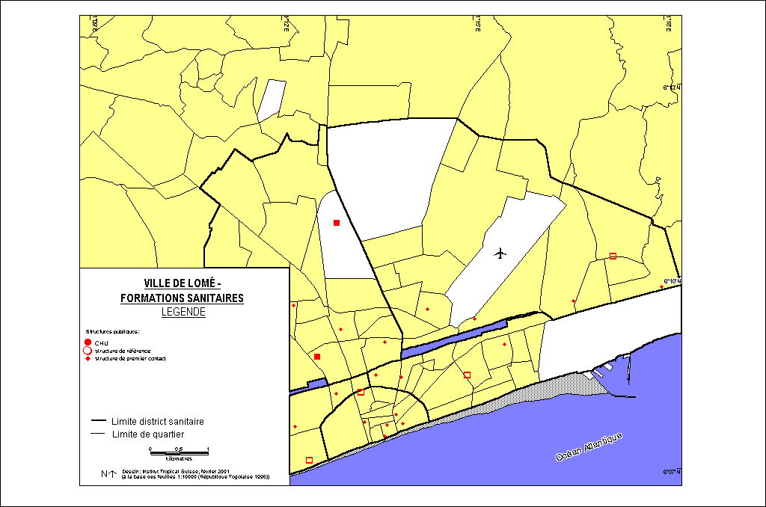
Providers

Slide 41
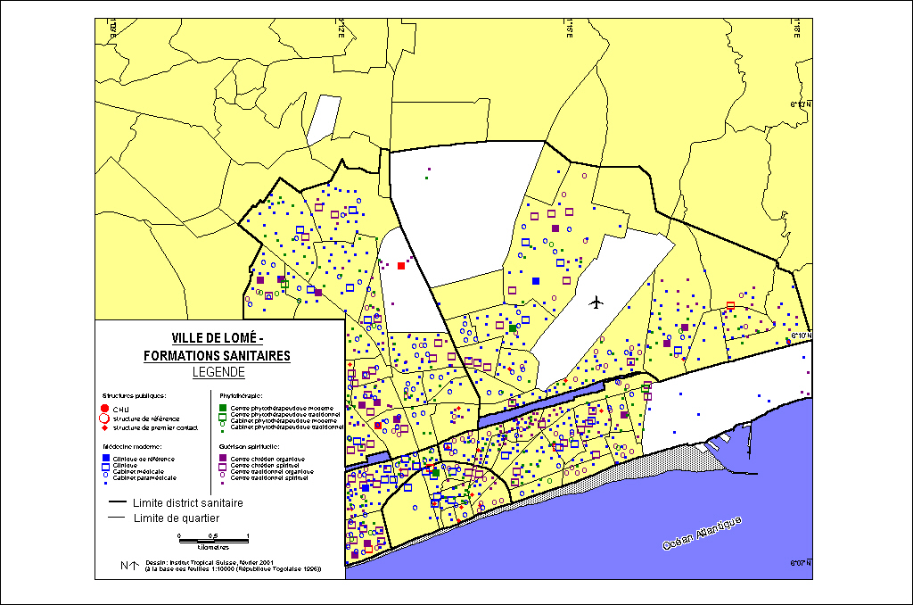
Providers

Slide 42
Source: WHR 2008

Slide 43
Contribution of WHO PEN to Health System Building Blocks (2010)
Service delivery:
Improve access to essential preventive and curative NCD interventions
Provide equitable opportunities for early detection
Define core set of cost-effective NCD interventions
Provide tools for their implementation
Improve quality of care
Improve gate-keeper function of primary care
Reduce costs due to hospital admissions and complications

Slide 44
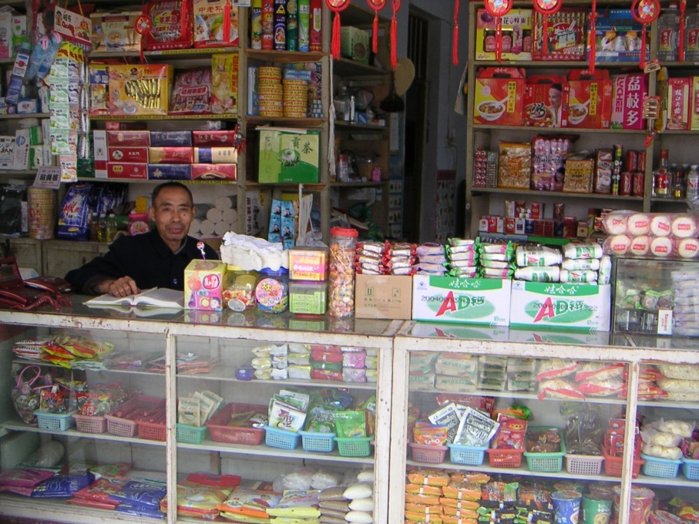
NCD and the role of primary care
Cost-efficient services
Allow to give weight to prevention and promotion
Allow to include the demand of the population and community participation (e.g. air quality, water, etc.)
Comprehensive approach
Personal relation between provider and patient
Cultural and geographical proximity
Continuity of services

Slide 45
Group work:
Analysis of options for aligning NCD control with health systems strengthening
Discuss practical and concrete steps to adjust heath services delivery to NCDs thereby focusing on primary care:
What is needed in terms of:
  Organization of service delivery
  Human Resources for Health
  Drugs and supply chains
  Financing
  Governance (and information)

Slide 46
Relations between functions and objectives of a health system
Source: WHO, 2007

Slide 47
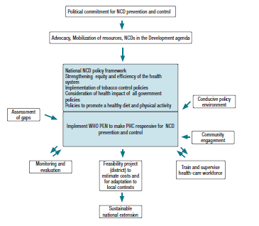
Source: WHO 2010

Slide 48
Key messages / conclusions (1)
PHC has an essential role to play for NCD control:
  Allow to give weight to prevention and promotion
  Personal relation between provider and patient
  Cultural and geographical proximity
  Continuity of services, comprehensive approach
Health systems strengthening relies on 6 building blocks which are interacting
  Governance
  Service delivery
  Medical products and technology
  Human resources
  Information
  Financing

Slide 49
Key messages / conclusions (2)
From acute episodic treatment to prevention/early intervention
    Screeing for NCD risks factors
Health systems need to be transformed to provide person-centred care with improved outreach and self-management to effectively manage risk factors, illness episodes, and multimorbidity over many years
    New form of service providers (e.g. community nursing)
Long-term care and risk management that includes follow-up at clinic and repeat prescriptions are a new idea for many patients and health staff
      Performance rewards?

Slide 50
Key messages / conclusions (3)
Importance of building health services that profile the risks of NCDs and multimorbidity in their population using for example HIV and/or TB services as a starting point
Practitioners need to be train and continuous medical education systems need to be set-up
PHC needs to be related to
  Social services
  Community development

