Slide 1
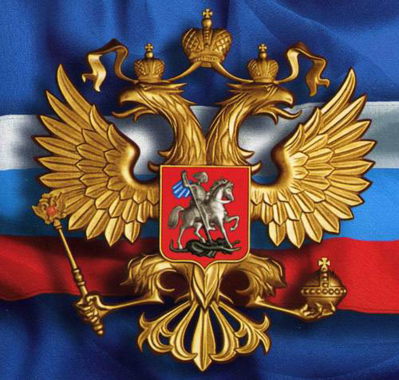
RUSSIAN FEDERATION
NON-COMMUNICABLE DISEASES – CURRENT SITUATION AND PREVENTION

Slide 2
Life expectancy in the Russian Federation
76,1
70,3
64,3
2011

Slide 3
The current situation. Challenges
Mortality structure in the Russian Federation (Rosstat, 2010)
cardiovascular disease,
cancer,
diabetes,
chronic pulmonary disease
80%
of the mortality causes
on persons under the age of 60, have 39.7% of all deaths

Slide 4
NCD risk factors
%

Slide 5
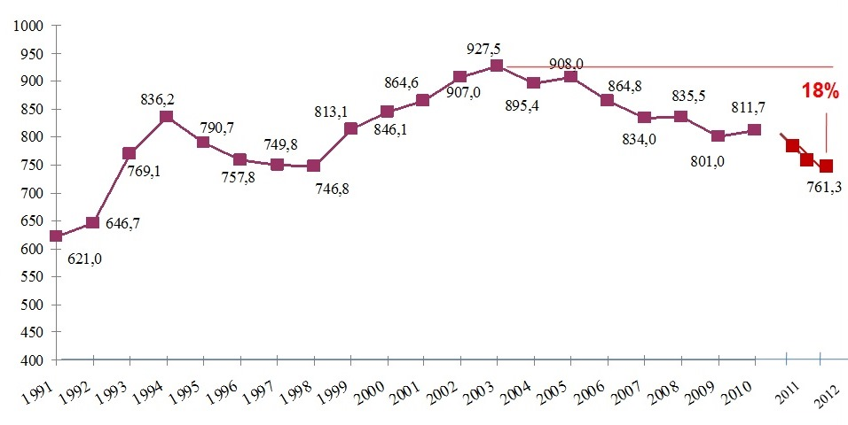
Dynamics of the mortality from diseases of the circulatory system
(Number of deaths per 100,000 population. Rosstat, 2013)

Slide 6
The mortality rates from diseases of the circulatory system
(100 thousand people)

Slide 7

New “Tobacco Law” in Russia
valid from June 1, 2013
3 stages - 2013, 2014 and 2015
smoke-free places, limiting the sale of cigarettes, increase price

Slide 8
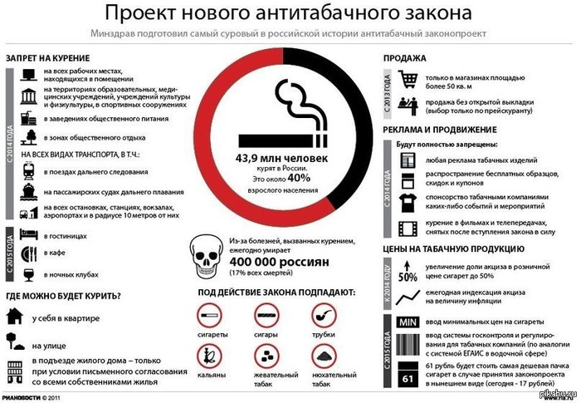

Slide 9
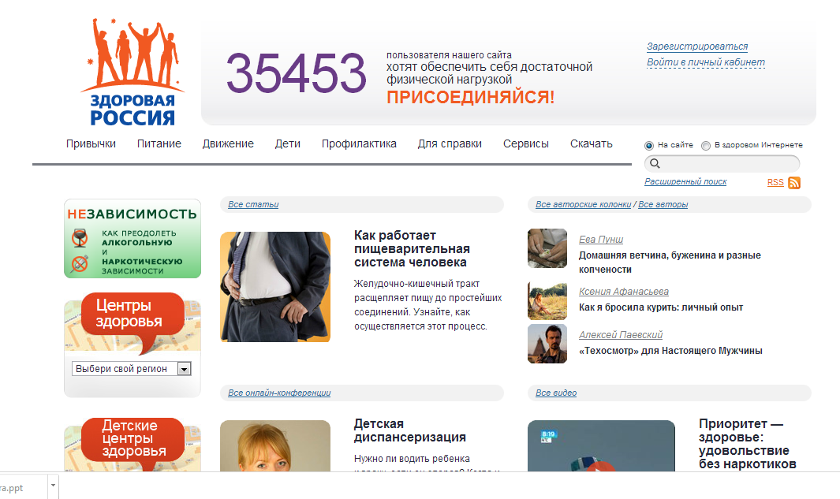
National project “Healthy Russia”

Slide 10
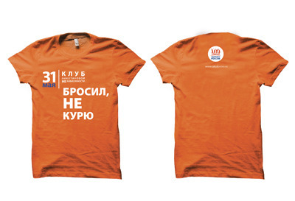




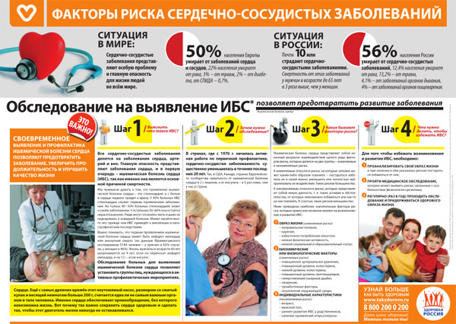

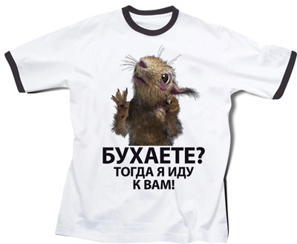

Slide 11

Health Centers
502 centers for adult, 193 – for child
All regions (83) covered
Who can use:
any citizen
themselves or recommended by doctor
What they do:
identification of individual risk
screening for major diseases
consultation on healthy lifestyles
planning out of bad habits
Dispanserisation (clinical examination)
active for the whole population
paid by the insurance
content varies depending on the age and sex
21 | 27 | 33 | 36 | 39 | 42 | 45 | 48 | 51 | 54 | 57 | 60 | 63 | 66 | 69 | 72 | 75 | 78 | 81 | 84 | 87 | 90 | 93 | 96 | 99
Д | Д | Д | Д | Др | Д | Др | Д | Др | Д | Др | Д | Др | Д | Др | Д | Д | Д | Д | Д | Д | Д | Д | Д | Д

Slide 12
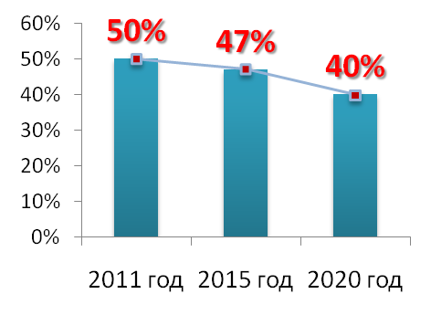
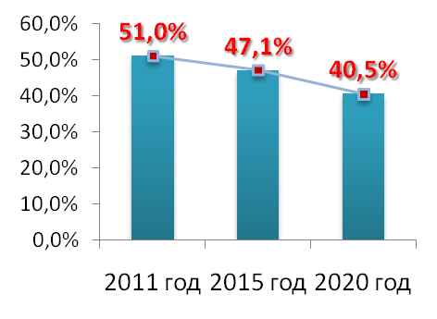
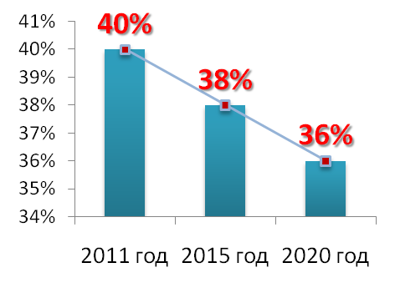
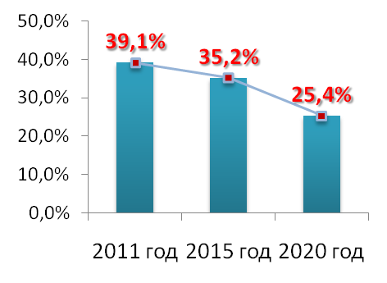
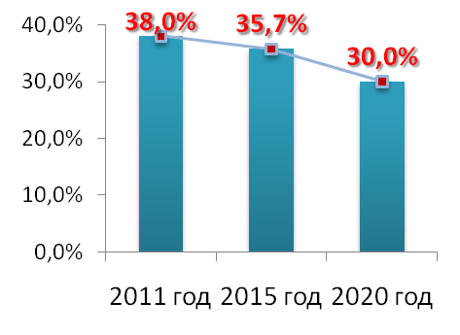
Prevention. Targets for 2020
(Ministry of Health of the Russian Federation)
Tobacco using
Salt intake in the adult population
Low consumption of Fruits, Vegetables
High blood pressure
Hyper-cholesterol

Slide 13

Thank you for your attention!

