Slide 1
Ncd’s overview in palestine
Dr. Ramez Dweikat
MD Diabetologist
Director of NCD’s Department
PHC & Public Health, MOH

Slide 2
NCD’s Burden In Palestine
STEPS survey 2010-2011(n: 6957,15 - 64 years)
Diseases
HTN 35.8%
T2DM 13.0 %
High Total Cholesterol 36.5%
Overweight 56.8%, Obesity 26.8%
Risk factors
Smoking 20.2%
Inadequate diet 85.9%
Inadequate physical activity 75.3%
No risk factor 1.0%, more than 3 RF’s 47.8%

Slide 3
In order to fight against NCD’s and their risk factors:
NCD’s department under primary health care has been established
National policy and strategic plan for prevention and management of NCD’s (2010 – 2015) has been conducted
focal points were assigned for:
NCD’s
Tobacco control
Elderly health
National multisectoral committees were constituted for:
NCD’s
Tobacco control

Slide 4
National committees consist of representatives from:
Ministry of Heath
Ministry of Education
Ministry of Finance
Ministry of Religion
Ministry of Information
Ministry of Women's Affairs
Ministry of Institutional Government
Supreme Council for Youth
Universities
NGO’s
UNRWA

Slide 5
Interventions to reduce tobacco consumption
Anti-tobacco legislation has been reviewed and a law has been accepted (2005)
Taxes on tobacco products have been raised significantly
All kinds of advertising for tobacco products are forbidden
Selling tobacco products to under-aged children and near schools is forbidden
National campaigns for tobacco cessation were done

Slide 6
Regarding improving the management of NCD’s in PHC
Palestine was the 1st country in the region and the 2nd in the world who started it implement the PEN (Package of Essential NCD interventions in primary care)
This package aims to integrate NCD’s management in primary health care with a comprehensive approach.
We started to implement the program as a Pilot in a small district called Salfeet which has 14 PHC clinics on 01/01/2013
Pilot period was accepted to be 6 months and will end by 30/06/2013, after then the program
will be expanded to the whole country

Slide 7
PEN advantages :
Comprehensive management for the major NCD’s (HTN, DM, Dyslipidemia, COPD)
Risk reduction for cardiovascular end points
Opportunistic screening for NCD’s for peoples who already have one or more risk factor
Better utilization of the limited recourses
Achieving equity and social solidarity

Slide 8
To support implementing PEN
New NCD’s patient file
New NCD’s patient register at clinics
New NCD’s database
New NCD’s reporting system
Were established

Slide 9
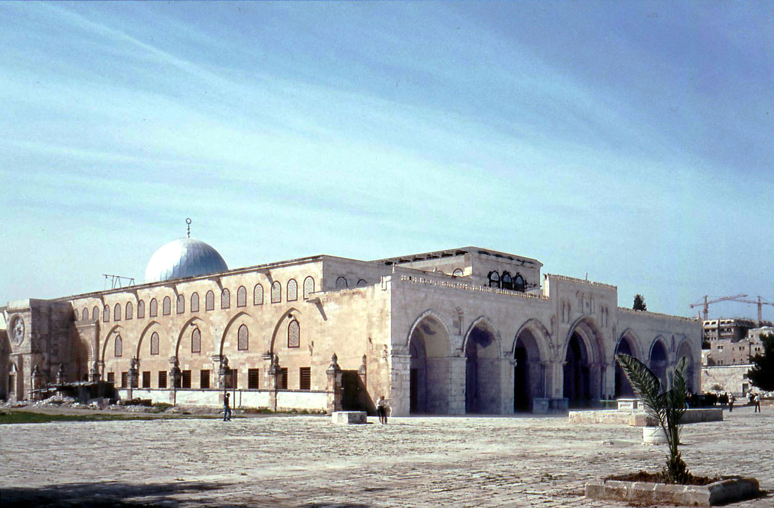
The Aqsa Mosque
Dom of The Rock

