Slide 1
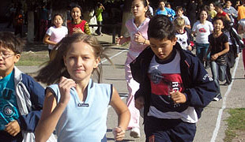


Global Commitment on NCD and Obesity Prevention
Dr Temo Waqanivalu
Team Leader
Population-based Prevention
Department of Prevention of Noncommunicable Diseases

Slide 2
Burden of NCD
- In 2012 38 million deaths were due to NCD
10%
Deaths in 2011
Age groups
Source: WHO Global Burden of Disease (2011)

Slide 3
Burden of NCD

Slide 4
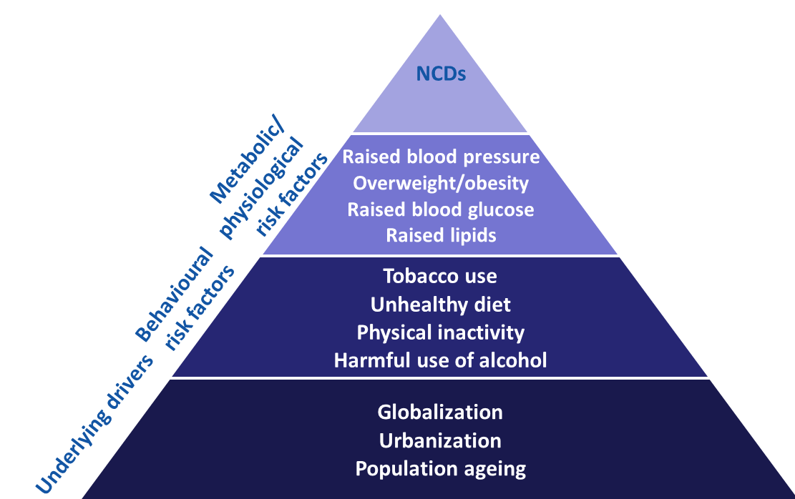
Causal factors for NCDs

Slide 5
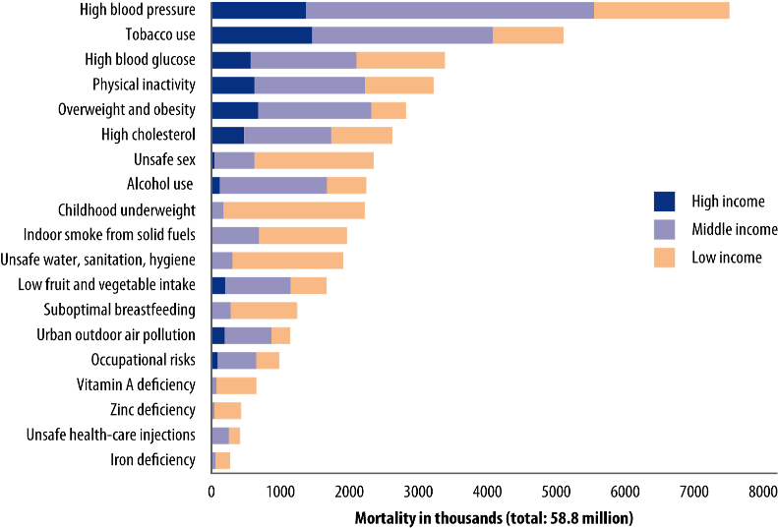
NCD risk factors and global mortality
Source: WHO's report on "Global health risks"
Notes:
60% of global death are due to non communicable diseases;
That includes 15% of the total number of deaths with occurs before the age of 60, and 27% of the total number which occurs before the age of 70.
High blood pressure is ranked 1th on global level
Physical inactivity is ranked 4th on global level (5.5%) – overweight/obesity 4.8% - unsafe sex 7th with 4 %.

Slide 6
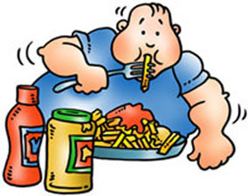
OBESITY
- abnormal or excessive fat accumulation that presents a risk to health
Environment
Behavior
Amino acids
Vitamins
Protein:
Carbohydrate
Endorphins
Nutrition
Exercise
Energy Balance

Slide 7
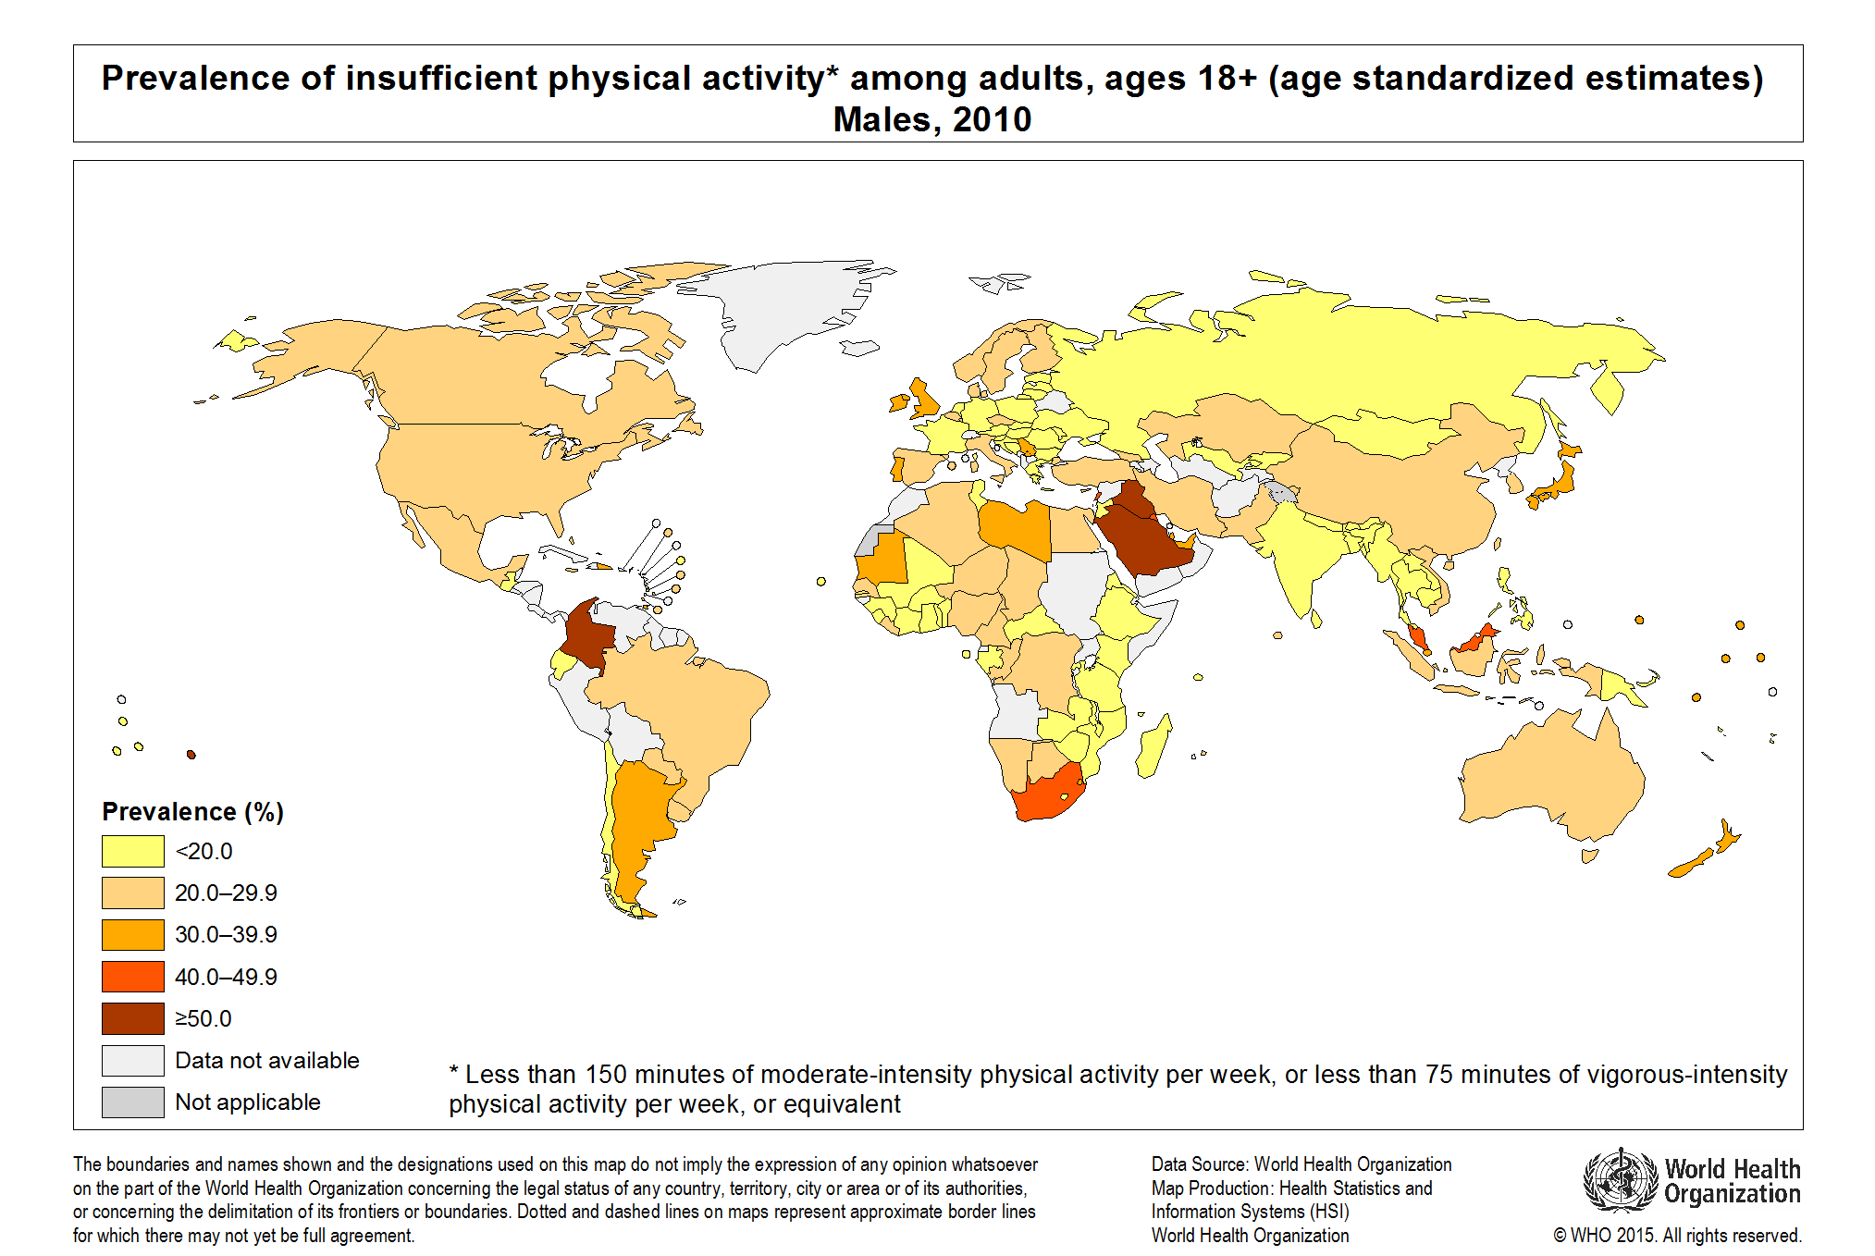
Prevalence of Insufficient PA
81% adolescent not active

Slide 8
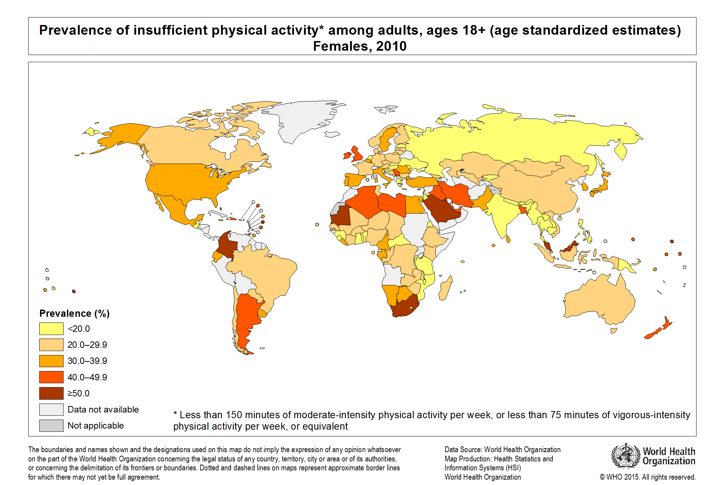
Prevalence of Insufficient PA
23% adults not active

Slide 9
Obesity PREVALENCE
Globally, in 2013 the number of overweight children under the age of five, is estimated to be over 42 million.
  Close to 31 million of these are living in developing countries.
11% Men
15% Women

Slide 10
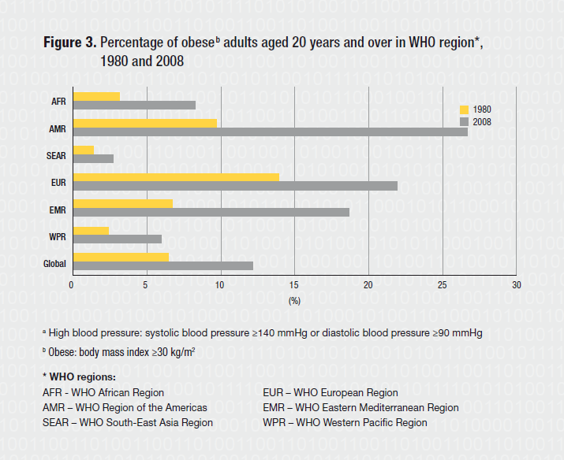
Overweight and obesity trend
World Health Statistics - 2012

Slide 11
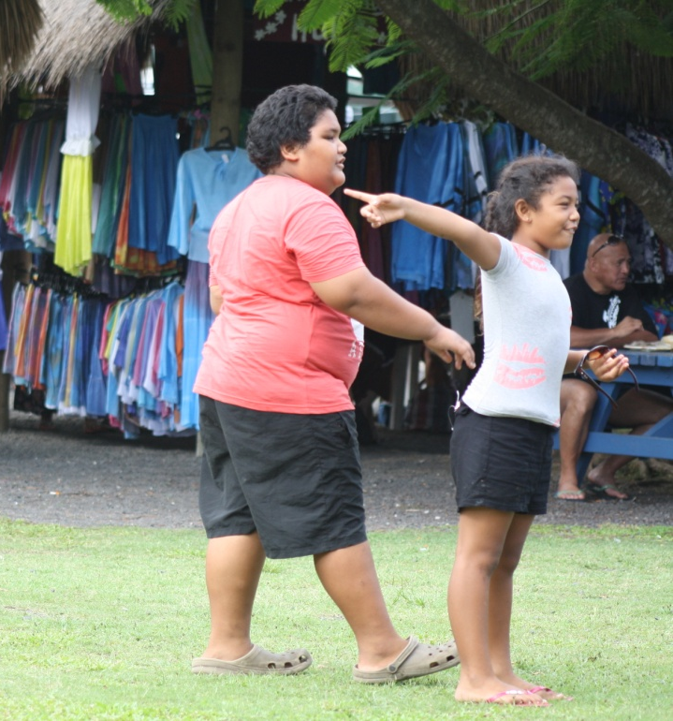
Childhood Obesity
An increasing problem in the Pacific with some coexistence of micronutrient def.
Definite risk factor for Adult Obesity & Diabetes
Increasing prevalence of Type 2 or adult-onset diabetes in children (7yrs)
We’re possibly facing the first generation who would die before their parents….
International Conference on Obesity

Slide 12
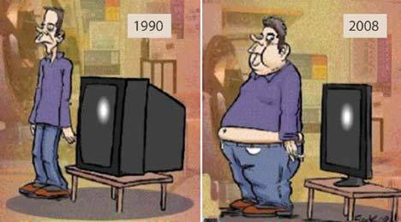
World Health in Transition

Slide 13
Causes/ Determinants
Changes in food systems
Rural to urban migration
Sedentary lifestyles
Competing priorities – work/life balance & school curriculum
Social
drivers
Diets
Food
Supply
Economic
drivers
Urbanization
Market liberalization & foreign debt investment
Increase in incomes
Impact
Food production based on intensive farming
Long product shelf-life
Supermarkets replacing wet markets
Year-round availability of food
Outcome
Convergence of diets
Affordability drives food choices
Increased intake of fat, sugar and salt
Changes in nutritional status towards overweight and obesity
Notes:
Nutrition transition: As incomes rise and populations become more urban, societies enter different stages of what has been called the nutrition transition.
Generally, diets high in complex carbohydrates and fiber give way to diets with a higher proportion of fats, saturated fats, and sugars.
These shifts in diet structure accompany demographic shifts associated with higher life expectancy and reduced fertility rates.
An associated epidemiologic transition also takes place as patterns of disease shift away from infectious and nutrient deficiency diseases toward higher rates of obesity, coronary heart disease, non-insulin dependent diabetes and some types of cancer.

Slide 14

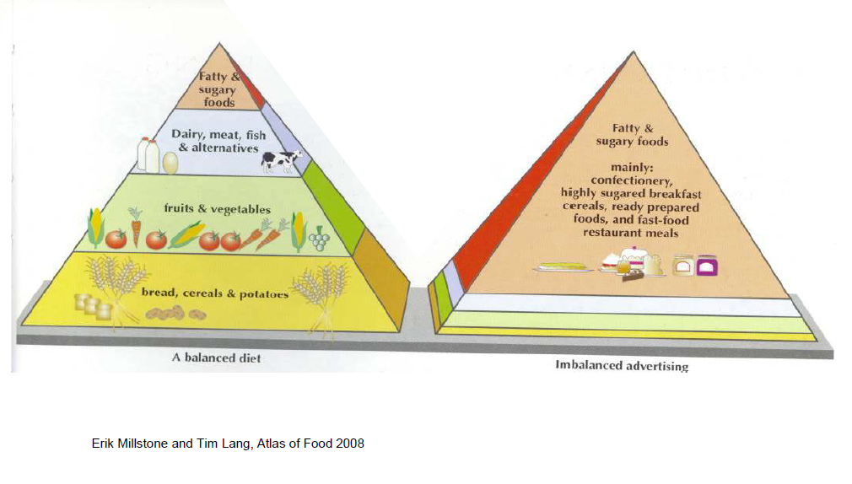
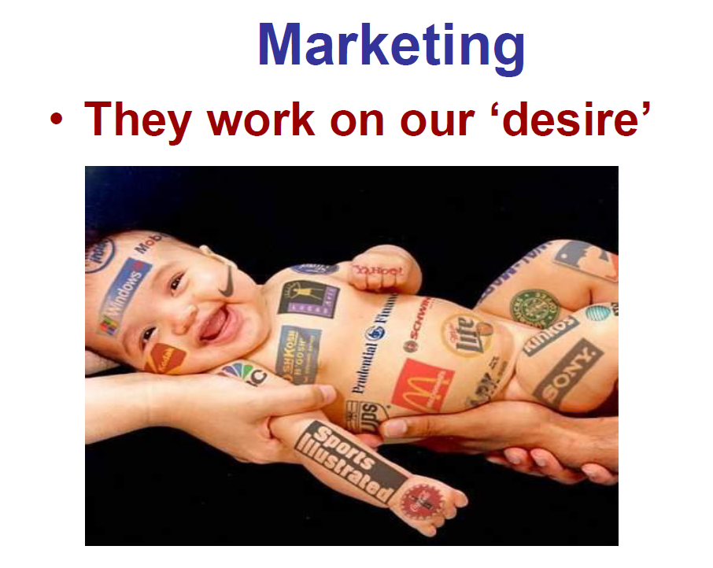
Marketing practices promote foods high in sugar, fat and salt
Notes:
Advertising practices are not in line with food-based dietary guidelines but do promote mainly foods high in sugar, fats and salt.
The WHA in May 2010 endorsed a Set of Recommendations on the Marketing of Foods and Non-alcoholic beverages, who are most targeted and vulnerable to the impact of marketing.

Slide 15
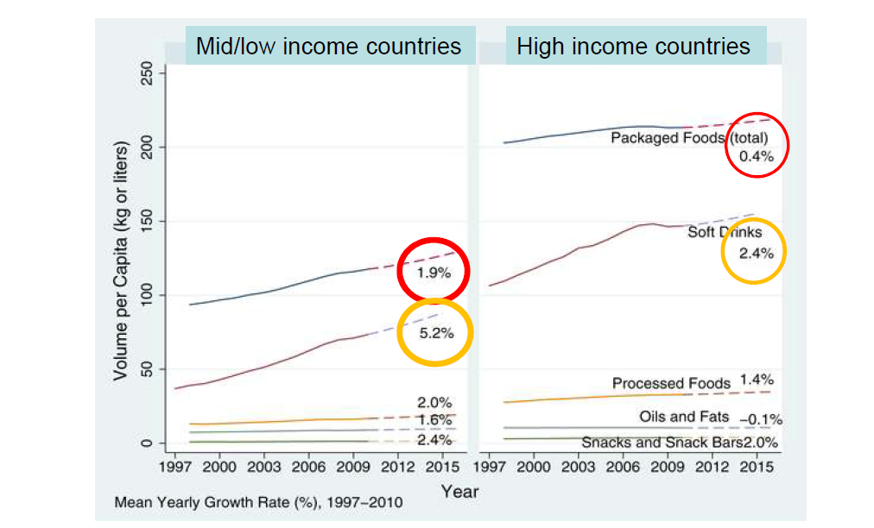
Ultra-processed food markets
Stuckler D, McKee M, Ebrahim S, Basu S (2012) Manufacturing Epidemics: The Role of Global Producers in Increased Consumption of Unhealthy Commodities Including Processed Foods, Alcohol, and Tobacco. PLoS Med 9(6): e1001235. doi:10.1371/journal.pmed.1001235
Notes:
Nutrition transition: As incomes rise and populations become more urban, societies enter different stages of what has been called the nutrition transition.
Generally, diets high in complex carbohydrates and fiber give way to diets with a higher proportion of fats, saturated fats, and sugars.
These shifts in diet structure accompany demographic shifts associated with higher life expectancy and reduced fertility rates.
An associated epidemiologic transition also takes place as patterns of disease shift away from infectious and nutrient deficiency diseases toward higher rates of obesity, coronary heart disease, non-insulin dependent diabetes and some types of cancer.
Much of the sugars, fat and salt consumed today are “hidden” in processed foods that are not usually seen as sweet, fat or salty.
For example, 1 tablespoon of tomato sauce contains around 4 grams (around 1 teaspoon) of sugar. A single can of sugar-sweetened soda contains up to 40 grams (around 10 teaspoons) of sugars

Slide 16
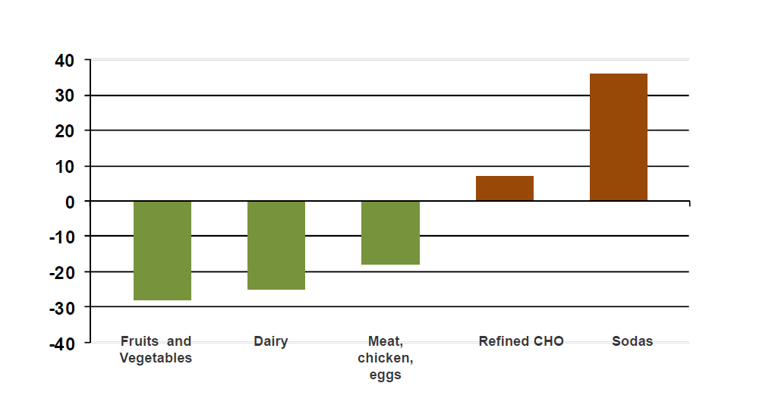
Dietary changes (% energy), Mexico 1984 - 1998
Fuente: Rivera J, Barquera S, Campirano F, Campos S, et al . Epidemiological and nutritional transition in (Mexico : Rapid increase of noncommunicable chronic disease and obesity. Public Health Nutr 2002; 5 (1a): 113-122.
Notes:
Much of the sugars, fat and salt consumed today are “hidden” in processed foods that are not usually seen as sweet, fat or salty.
For example, 1 tablespoon of tomato sauce contains around 4 grams (around 1 teaspoon) of sugar. A single can of sugar-sweetened soda contains up to 40 grams (around 10 teaspoons) of sugars

Slide 17
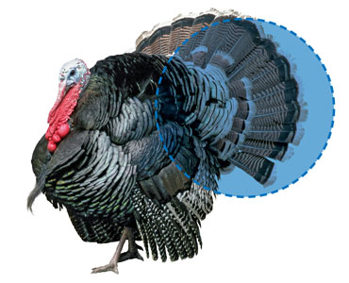
Causes/Determinants
Healthy Trade or Trading Health?
The WTO welcomed the nation, with a population of about 193,000 once Samoa agreed to end its ban on the fatty poultry scraps and impose import tariffs instead. That’s good news for U.S. turkey farmers, who will regain a market for the low-value trimmings that often end up in pet food, says Roman Grynberg, a trade official for the Pacific region until 2009.
For Samoa, one of the world’s most obese nations, the deal is a mixed blessing. “These are the contradictions we have to face—where health is compromised for the sake of trade and development,” says Palanitina Tupuimatagi Toelupe, Samoa’s Director general of health.
The U.S. food industry sees the issue differently. “We feel it’s the consumers’ right to determine what foods they wish to consume, not the government’s,” says James H. Sumner, president of the USA Poultry & Egg Export Council.
Bloomberg Business week Nov 22, 2011
Turkey tail

Slide 18
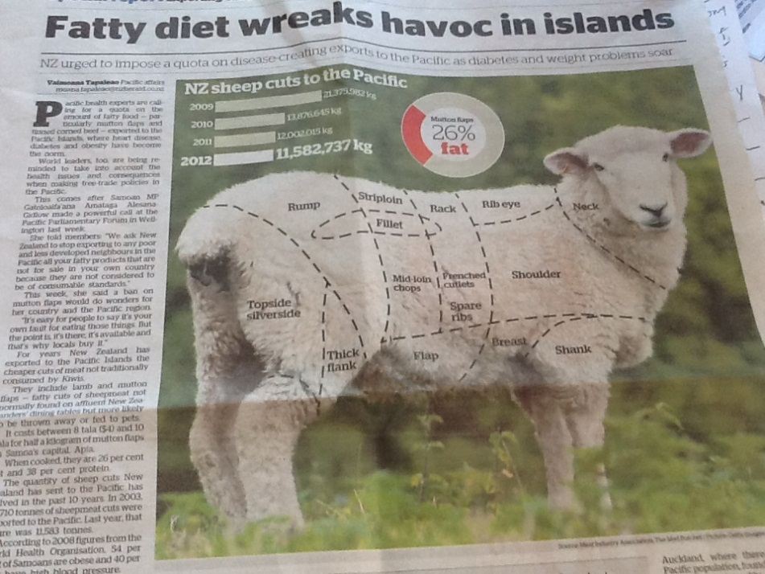
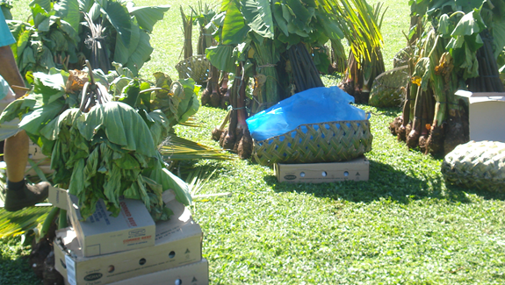
Healthy Trade or Trading Health?
Mutton Flap
We only sell 5% of mutton flap to the pacific, most goes to China
NZ Meat Industry
I have figured out that the only way to prevent myself from eating mutton flap is for it not to be served ….. Govt Leader

Slide 19
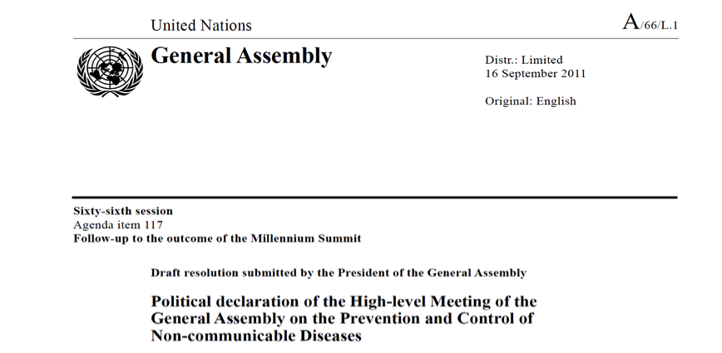


UN High Level Meeting on NCD Sept 2011
The General Assembly adopted by consensus the resolution titled "Political Declaration of the High-level Meeting of the General Assembly on the Prevention and Control of Non-communicable Diseases" (document A/66/L.1).

Slide 20
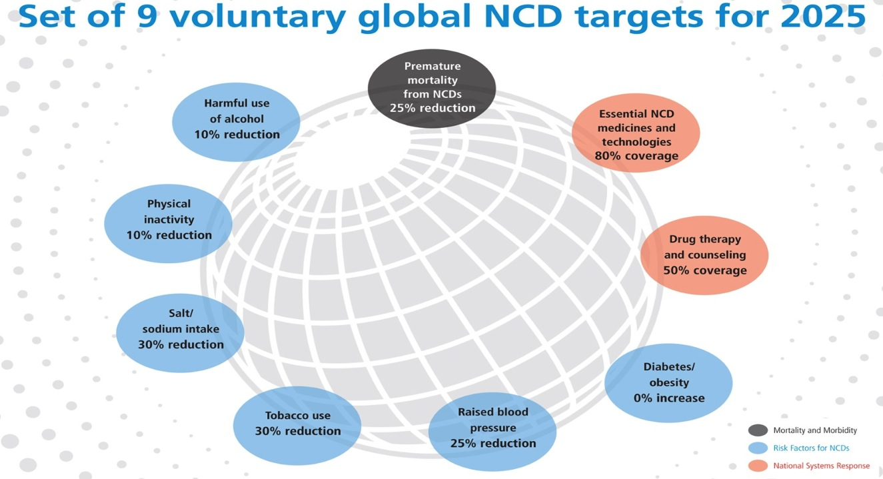
Notes:
Outcomes: mortality and morbidity
Exposures: biological and behavioural risk factors
National systems response
Member States have committed themselves to "consider the development of national targets based on national situations", building on the 9 voluntary global targets.
National targets can be more or less ambitious than the global ones and should be guided by:
- Current performance;
- Current level of exposure;
- Programmes planned and in place.
WHO is developing a Toolkit on NCD Surveillance, which will include a module on setting national targets and measuring results

Slide 21
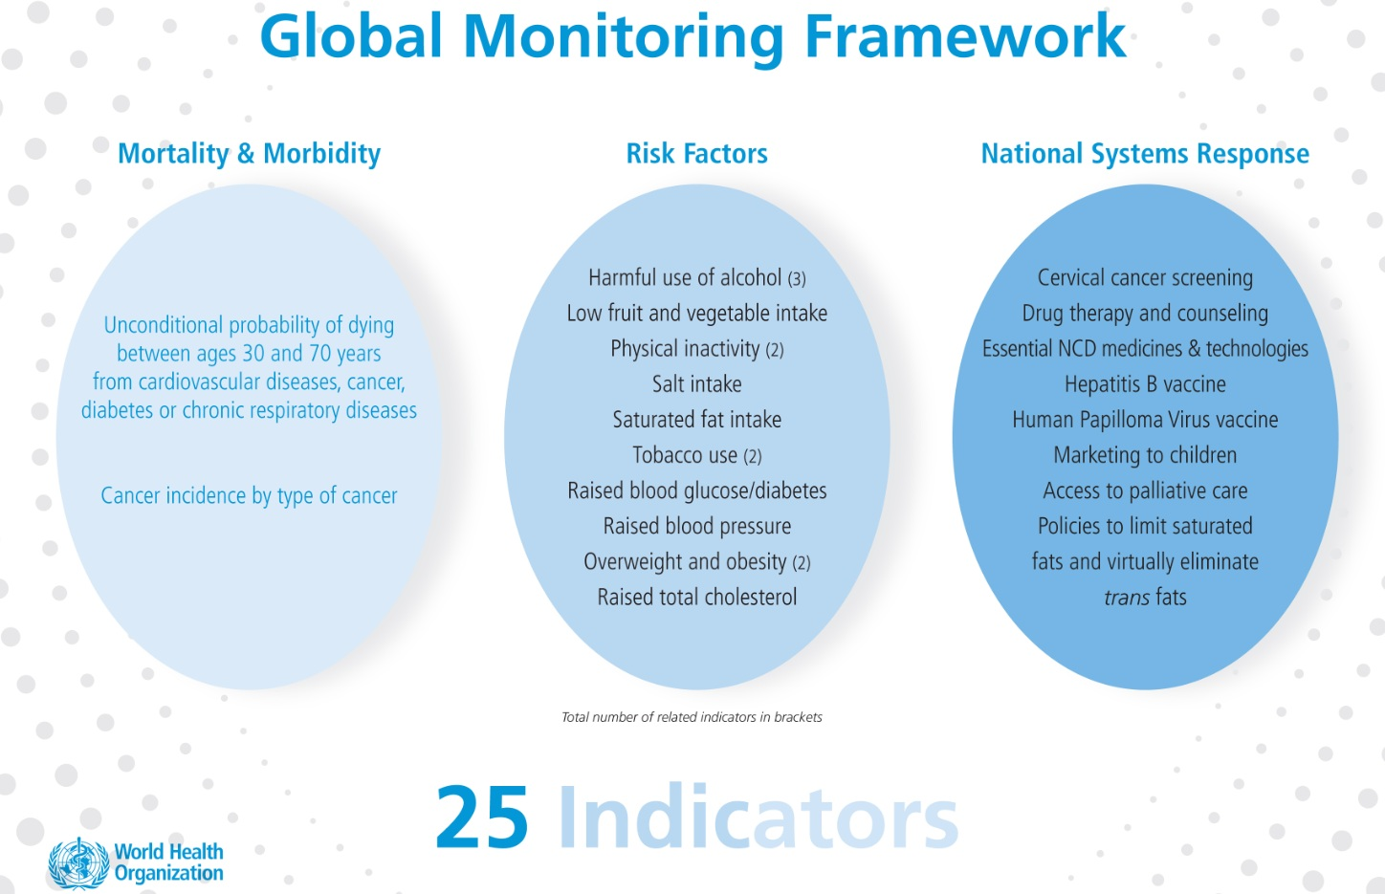
Global Monitoring Framework
Notes:
The WHO Global NCD Action Plan 2013-2020 also includes additional process measurements to assess the progress made in implementing the Action Plan between 2013 and 2020

Slide 22
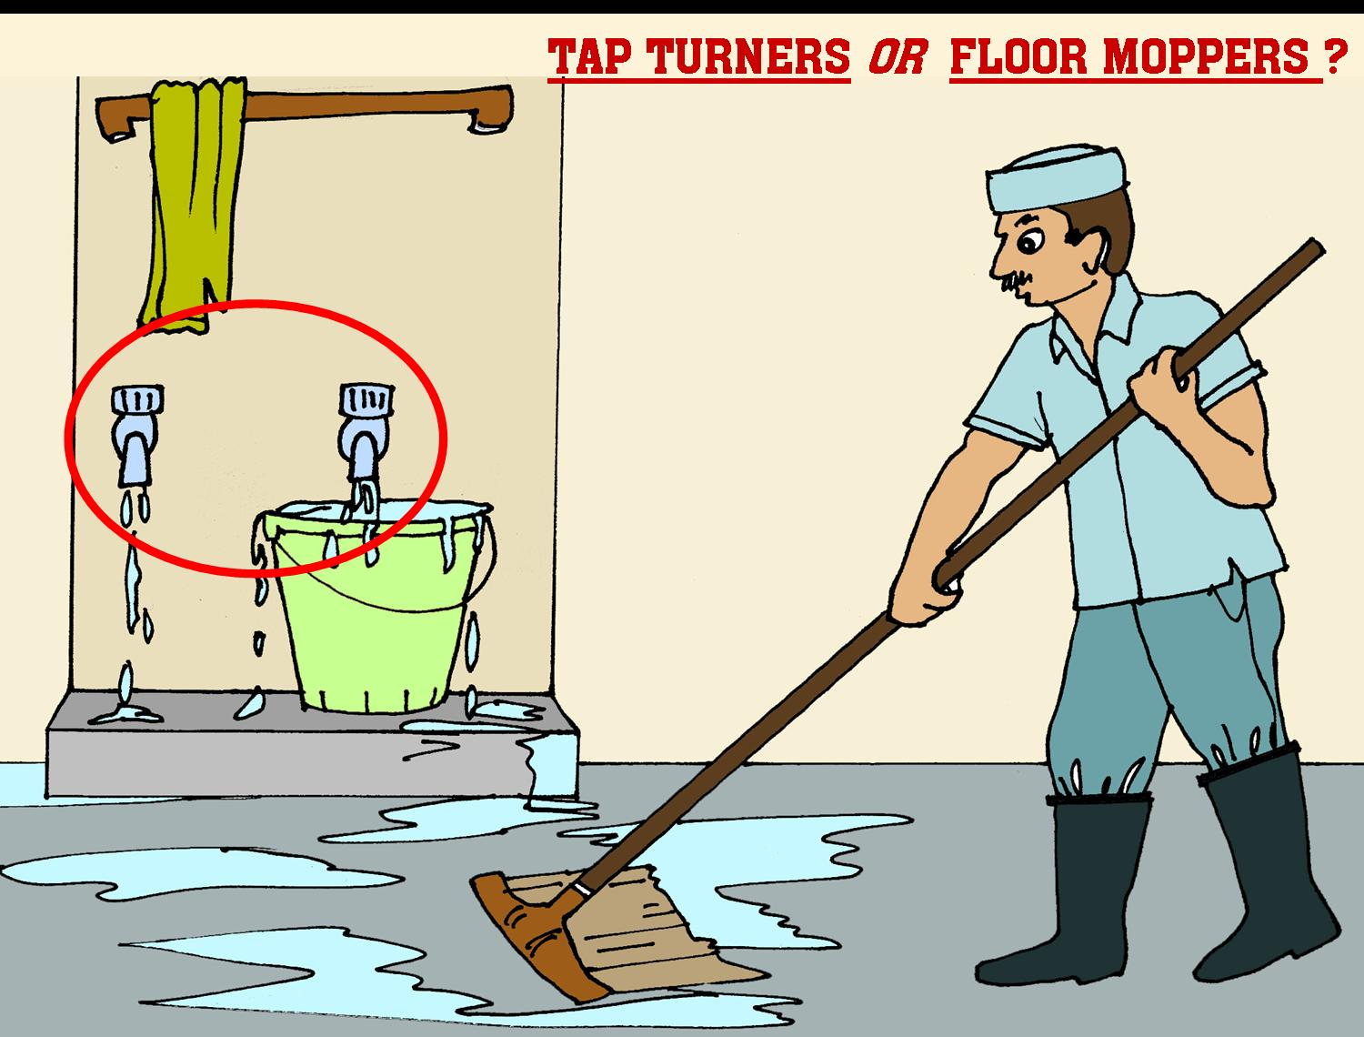
The Approach
Notes:
22

Slide 23

WHO Global NCD Action Plan 2013-2020
Sets out MULTISECTORAL policy options for member states
Agreed commitment by international partners and private sectors
Agreed actions by secretariat

Slide 24

PAHO Regional to National

Slide 25

The WHO Global NCD Action Plan 2013-2020
– Diet and Physical Activity
Notes:
Implementing the WHO recommendations on the marketing of foods and non-alcoholic beverages to children is crucial to achieving Objective 3 of the Global NCD Action Plan.

Slide 26
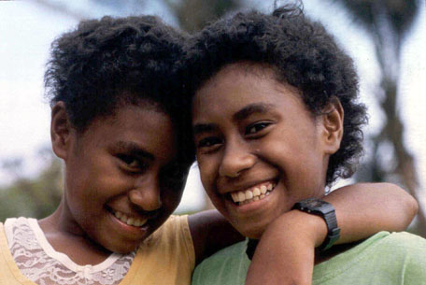
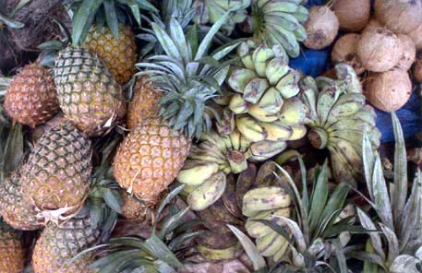
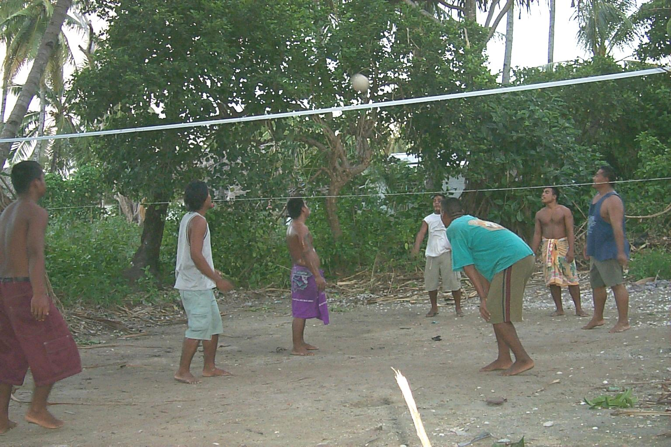
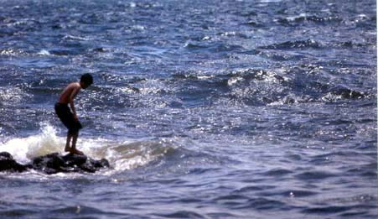
Healthy
Lifestyle
EARLY
EASY
EXCITING & ENJOYABLE
EVERYWHERE

Slide 27

Population Wide Policies
WHO Set of Recommendations on the marketing of Foods and non-alcoholic beverages to children; WHA 2010
12 recommendations
Main purpose: ….in order to reduce the impact on children of marketing of foods high in saturated fats, trans-fatty acids, free sugars, or salt."

Slide 28
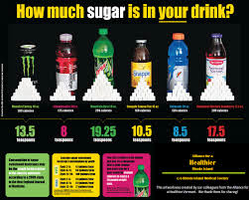
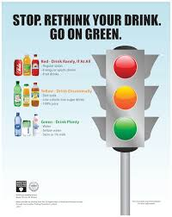
Fiscal policies
Prices influence consumption choices.
Public policies can influence prices through taxation, subsidies or direct pricing in ways that encourage healthy eating and lifelong physical activity.
Global Action Plan on NCDs 2013-2020: "As appropriate to national context, consider economic tools that are justified by evidence, and may include taxes and subsidies, that create incentives for behaviours associated with improved health outcomes, improve the affordability and consumption of healthier food products and discourage the consumption of less healthy options."
Notes:
A price change for one item can affect demand for that good as well as for goods that substitute for it (e.g. a tax on sugar-sweetened beverages may increase demand for beer) or that complement it
(e.g. a tax on salt may reduce consumption of vegetables).
Because poor consumers are more responsive to price changes than affluent consumers, tax and subsidy policies may have disproportional impacts on different population groups.
Many studies of the impact of food taxes are based on simulation exercises. A recent systematic review of 32 simulation studies in OECD countries found that taxes on soft drinks and foods high in saturated fats could reduce consumption and improve health outcomes (Eyles et al., 2012).
Studies of existing food tax policies in Europe and Northern America generally find that tax rates are too low to have a noticeable impact on consumption patterns.

Slide 29
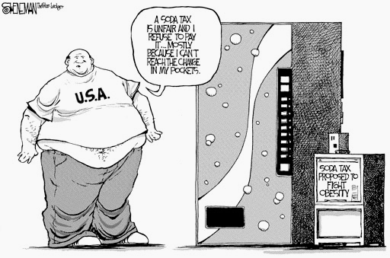

Fiscal Measures to address NCD & Obesity
Increase demand by countries
Several countries use fiscal measures, (e.g. Denmark, France, Hungary, USA, Mexico).
Increase revenue for government
Tax funds for health

Slide 30
Considerations for Fiscal Policy on Diet
EVIDENCE
There is enough evidence to get started
  Goal should be for improvement of Health (quality of foods, affect consumption behaviour, association with reduced morbidity and mortality) and economic benefits
  Fiscal Policy works to influence consumer behaviour at the point of purchase
  Best evidence is around SSBs so lets start there
  Enough evidence suggesting that specific excise is better than ad volarem or others
  Size of tax – at least 20% to effect consumption behaviour (and F & V in 10-30%)
  Earmarking of taxes need to be pursued as aligned with the health objective
  Perceived regressivity can be addressed by good tax design
  Subsidies alone don’t work and better combined with taxation
  Combined with Nutrition interventions such as public education

Slide 31
Policy Development process
Policy Development
Monitoring
Evaluation
Purchasing/ consumption
Industry challenges
Administrative challenges vs. simplicity
Public awareness, education and support incl Health
Key policy champions – young, female ministers?
Need systems in place to support and FUND longitudinal evaluation of the impact of fiscal price strategies on:
Purchasing/consumption, revenues, proximal health outcomes, longer-term health outcomes (e.g., obesity)
Design: What products included/exempt, type of tax measure
Situation Analysis
Evidence gathering (finance, health, industry)
Policy Rationale and Objective
Systems for monitoring revenue but also consumption behaviour
Consider Broader strategies (marketing)
Tax environment – learn from Tobacco

Slide 32
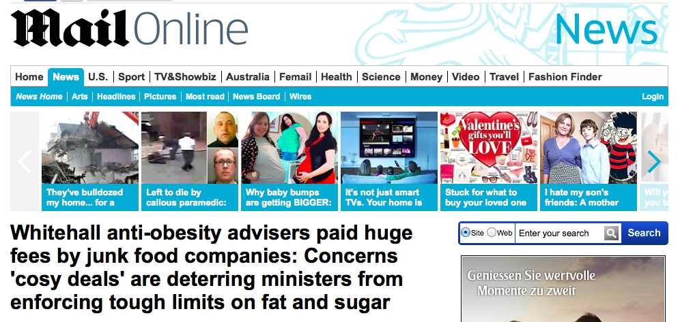
Fresh News

Slide 33
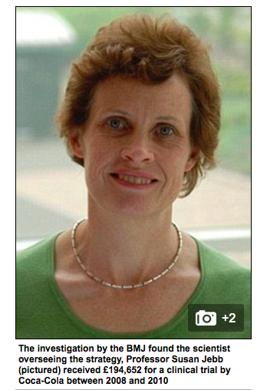
Influencers of Policies: UK
Responsibility Deal policy 2011, Government’s flagship strategy: food and drinks firms to voluntarily cut levels of sugar and fat.
Likened to ‘putting Dracula in charge of the blood bank’ by charities
Doctors argue legislation and not cosy deals will help solve the crisis
BMJ: scientist overseeing the strategy, Prof Susan Jebb, received £194,652 for a clinical trial by Coca-Cola between 2008 and 2010.
In total, £1.37million towards her research since 2004 from firms including Nestle cereals, Sainsbury’s and Unilever

Slide 34



Physical Activity Guidelines
Adults aged 18-64
At least 150 minutes of Moderate intensity PA spread throughout the week OR
at least 75 minutes of Vigorous PA spread throughout the week OR
an equivalent combination of those two
Bouts of at least 10 minutes.

Slide 35


Physical Activity Guidelines
Children and youth - aged 5-17
at least 60 minutes of moderate to vigorous intensity physical activity daily
> 60 minutes provide additional health benefits
Should:
  be mostly aerobic activity
  include vigorous intensity activities
  including muscle strengthening and bone health activities at least 3 times per week.
Notes:
35
In order to improve cardiorespiratory and muscular fitness, bone health, and reduce the risk of NCDs.
Muscle-strengthening activity = Physical activity that increases muscle strength, power, endurance, and mass (e.g. strength training, resistance training, endurance exercises)
Bone-strengthening activity = Physical activity to increase the strength of specific sites in bones that make up the skeletal system (promotes bone growth and strength) (e.g. running, jumping rope, lifting weights)

Slide 36
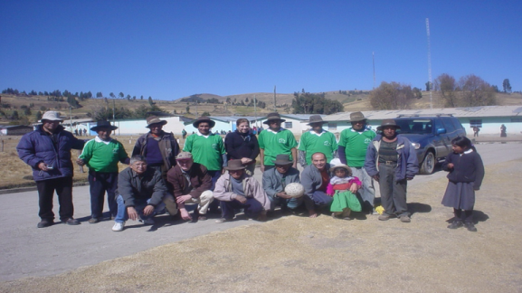

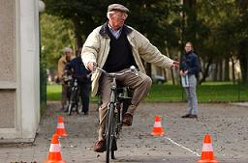
Physical Activity Guidelines
Adults aged +65
Same recommendations as for adults
Specific recommendations:
perform PA to enhance balance and prevent falls on 3 or more days/ week.
Muscle-strengthening activities on 2 or more days a week.
be as physically active as their abilities and conditions allow.
Notes:
Balance training = Static an dynamic exercises that are designed to improve an individual's ability to withstand challenges from postural sway or destabilizing stimuli caused by self-motion, the environment, or other objects.
36

Slide 37
Areas of Actions ?
Advocacy, Marketing and Mobilisation
- Agenda Setting, across sectors
Settings
Transport
Urban Planning
Sports
Natural Environment

Slide 38



Sport and Physical Activity
: Marketing and Mobilisation
Notes:
Dr. VL:

Slide 39
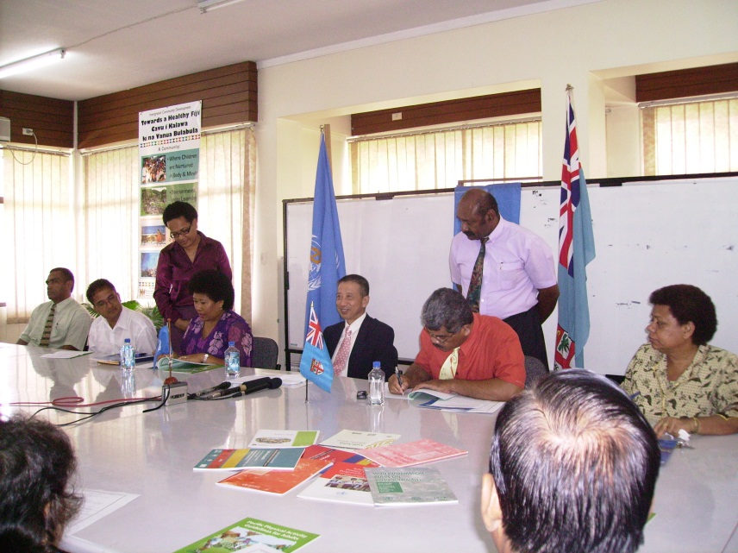
Community Settings: Healthy Schools
Memorandum of Understanding b/w MOH and MOE signed by respective secretaries in April 2009
Shift to education
National Policy: Fruit and Water Day
Local implementation : Pilot schools to initiate or build on current work

Slide 40

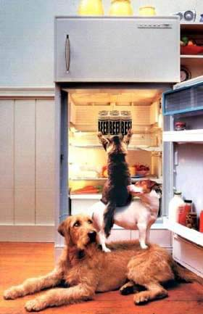

Multisectoral approach
- From collaborators to Partners

Slide 41
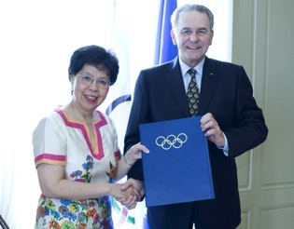

Partnerships : Global
WHO & IOC 2010:
Memorandum of Understanding IOC-WHO
" …agree to join efforts and to cooperate…to promote healthy lifestyles, physical activity and sport for all among the communities."
WHO & UNESCO 2015:
Quality Physical Education Policy Package

Slide 42






WHO tools

Slide 43
Statements
"The critical lesson from tobacco is waiting too long - 50 years from the first evidence. There would not be one minister of health who doesn't now appreciate the importance of tobacco control. Obesity is out of control and there is sufficient evidence to convince governments to take urgent action. Unless nations move now to rein in expanding waistlines we will have missed the boat. (WHO at ICO, Sydney Sept. 2006)

Slide 44
Thank you

