Slide 1
Epidemiologic transition, global burden of disease, and emergence of NCDs
Pascal Bovet, MD, MPH
Institute of Social and Preventive Medicine (IUMSP), University of Lausanne
9th WHO-IUMSP International Seminar on the Public Health Aspects of NCDs
Lausanne, 4 - 8 May 2015

Slide 2
The health transition: predicting disease in populations along socio economic development
The Global Burden of Disease: provides comparable information on disease burden, burden of diseases attributable to risk factors, and estimation of cost-effectiveness of interventions
Limitations of the models

Slide 3



Portraying the epidemiological situation is a necessary step to inform NCD prevention and control programs
Ongoing situation
Opportunities (what works)
Selected recommendations (prioritization)
Operationalization

Slide 4
Health transition (Omran): shift from communicable diseases to NCDs in populations along socio-economic development
Bovet & Paccaud. Cardiovascular Disease and the Changing Face of Global Public Health :A Focus on LMICs. Public Health Reviews, 2012;33:397-415

Slide 5
Two main engines of the health transition in populations: epidemiologic transition and demographic transition
Socio-economic development
Industrialization & urbanization
economic, social & environmental changes
↑ nutrition
↑ technology for health care
↓ mortality
(↓ infant mortality)
followed by
↓ fertility
↑ public sanitation, housing
wealth & changes in environment exposures
⇒ adoption of risk behaviors
+ Heath care transition
↑ old persons at risk of developing NCDs
increasing and aging populations
↑ levels of RFs:
fat, calories, tobacco,
sedentary habits
↑ NCD
↓ infectious diseases

Slide 6
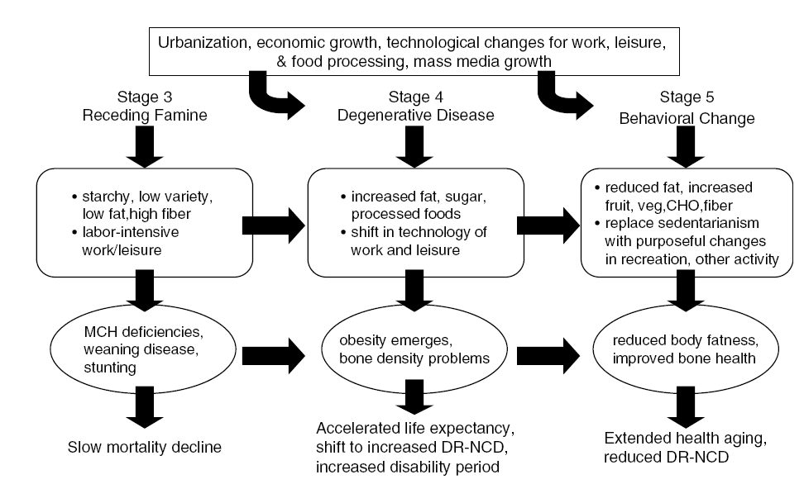
Nutrition transition: socio-economic development does not imply detrimental diet and unfavorable NCD patterns
DR-NCD: diet related non communicable diseases
Popkin et al. The nutrition transition: worldwide obesity dynamics and their determinants. IJO 2004;28, S2–S9.

Slide 7
Developed
Demographic transition:
ageing and increasing populations in LMICs
Men
Women
1960
Developing
2000
2040
Kinsella K & Wan H. U.S. An Aging World. Census Bureau, International Population Reports, P95/09-1: 2008. Washington, DC, 2009.

Slide 8
Essentials of the Global Burden of Diseases project (GBD)
Started as collaboration between WHO, WB and Harvard SPH since 1990s
Institute of Health Metrics, ~500 collaborators in 50 countries, huge funding
Standardized framework integrating all available epidemiological information on morbidity and mortality worldwide
291 diseases, 1160 clinical sequelae, 67 risk factors, disability weights (DALY)
Estimates are made internally consistent (DisMod)
Assumptions on weights, discount of future events, expected life expectancy
Common single metric to quantify health status (DALY)
→ Comparable estimates across different diseases and different risk factors
→ Consistent measure for use with different intervention analyses
Allows to assess to which extent diseases could be avoided in different populations/regions, i.e. informs on priorisation of interventions

Slide 9
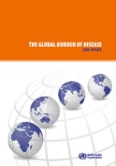
Global Burden of Diseases: global mortality, 2004-2030
30
Intentional injuries
Other unintentional
25
Road traffic accidents
Other NCD
20
Deaths (millions)
Cancers
15
10
CVD
Mat//peri/nutritional
5
Other infectious
HIV, TB, malaria
0
2004
2015
2030
2004
2015
2030
2004
2015
2030
High-income
countries
Middle-income
countries
Low-income
countries

Slide 10
Higher NCD mortality rates in LMIC vs. HIC, age 15-59
Eastern
Double burden of disease
Global Burden of Disease 2004 Update: WHO 2008 (http://www.who.int/healthinfo/global_burden_disease/2004_report_update/en/)

Slide 11
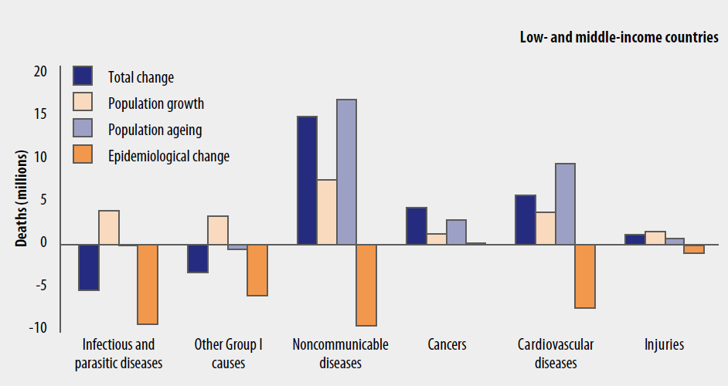
Overall secular trends in NCDs in LMICs are largely driven
by the increasing and aging population (estimates for 2004-2030 )
Abegunde et al. Lancet, 2007

Slide 12
Showing GBD estimates: need to distinguish total mortality (“burden”) vs. age-adjusted mortality
Total number of deaths (burden)
Increase is inevitable as populations increase and get older
  Implies increasing volume for health care over time
  Increase of total burden even if prevention programs are effective
Age-adjusted rates
Underlie risk = informs on the changing epidemiology of NCDs
  Age-adjusted NCD mortality can decrease, even in LMICs
  Efficacy of programs/policy to be assessed by changes in age-standardized rates of NCD/risk factors (not by the total NCD burden)

Slide 13
GBD between 1990 and 2013 : total burden of NCDs increases in most countries but age-adjusted rates decrease in many countries
Lancet 2015
Notes:
Global, regional, and national age–sex specific all-cause and cause-specific mortality for 240 causes of death, 1990–2013: a systematic analysis for the Global Burden of Disease Study 2013
GBD 2013 Mortality and Causes of Death Collaborators*
Summary
Background Up-to-date evidence on levels and trends for age-sex-specifi c all-cause and cause-specifi c mortality is
essential for the formation of global, regional, and national health policies. In the Global Burden of Disease Study
2013 (GBD 2013) we estimated yearly deaths for 188 countries between 1990, and 2013. We used the results to assess
whether there is epidemiological convergence across countries.
Methods We estimated age-sex-specifi c all-cause mortality using the GBD 2010 methods with some refi nements to improve
accuracy applied to an updated database of vital registration, survey, and census data. We generally estimated cause of
death as in the GBD 2010. Key improvements included the addition of more recent vital registration data for 72 countries,
an updated verbal autopsy literature review, two new and detailed data systems for China, and more detail for Mexico, UK,
Turkey, and Russia. We improved statistical models for garbage code redistribution. We used six diff erent modelling
strategies across the 240 causes; cause of death ensemble modelling (CODEm) was the dominant strategy for causes with
suffi cient information. Trends for Alzheimer’s disease and other dementias were informed by meta-regression of
prevalence studies. For pathogen-specifi c causes of diarrhoea and lower respiratory infections we used a counterfactual
approach. We computed two measures of convergence (inequality) across countries: the average relative diff erence across
all pairs of countries (Gini coeffi cient) and the average absolute diff erence across countries. To summarise broad fi ndings,
we used multiple decrement life-tables to decompose probabilities of death from birth to exact age 15 years, from exact age
15 years to exact age 50 years, and from exact age 50 years to exact age 75 years, and life expectancy at birth into major
causes. For all quantities reported, we computed 95% uncertainty intervals (UIs). We constrained cause-specifi c fractions
within each age-sex-country-year group to sum to all-cause mortality based on draws from the uncertainty distributions.
Findings Global life expectancy for both sexes increased from 65·3 years (UI 65·0–65·6) in 1990, to 71·5 years
(UI 71·0–71·9) in 2013, while the number of deaths increased from 47·5 million (UI 46·8–48·2) to 54·9 million
(UI 53·6–56·3) over the same interval. Global progress masked variation by age and sex: for children, average absolute
diff erences between countries decreased but relative diff erences increased. For women aged 25–39 years and older than
75 years and for men aged 20–49 years and 65 years and older, both absolute and relative diff erences increased.
Decomposition of global and regional life expectancy showed the prominent role of reductions in age-standardised death
rates for cardiovascular diseases and cancers in high-income regions, and reductions in child deaths from diarrhoea,
lower respiratory infections, and neonatal causes in low-income regions. HIV/AIDS reduced life expectancy in southern
sub-Saharan Africa. For most communicable causes of death both numbers of deaths and age-standardised death rates fell
whereas for most non-communicable causes, demographic shifts have increased numbers of deaths but decreased agestandardised
death rates. Global deaths from injury increased by 10·7%, from 4·3 million deaths in 1990 to 4·8 million in
2013; but age-standardised rates declined over the same period by 21%. For some causes of more than 100 000 deaths per
year in 2013, age-standardised death rates increased between 1990 and 2013, including HIV/AIDS, pancreatic cancer, atrial
fi brillation and fl utter, drug use disorders, diabetes, chronic kidney disease, and sickle-cell anaemias. Diarrhoeal diseases,
lower respiratory infections, neonatal causes, and malaria are still in the top fi ve causes of death in children younger than
5 years. The most important pathogens are rotavirus for diarrhoea and pneumococcus for lower respiratory infections.
Country-specifi c probabilities of death over three phases of life were substantially varied between and within regions.
Interpretation For most countries, the general pattern of reductions in age-sex specifi c mortality has been associated
with a progressive shift towards a larger share of the remaining deaths caused by non-communicable disease and
injuries. Assessing epidemiological convergence across countries depends on whether an absolute or relative measure
of inequality is used. Nevertheless, age-standardised death rates for seven substantial causes are increasing, suggesting
the potential for reversals in some countries. Important gaps exist in the empirical data for cause of death estimates
for some countries; for example, no national data for India are available for the past decade.
Funding Bill & Melinda Gates Foundation.
Published Online
December 18, 2014
http://dx.doi.org/10.1016/
Correspondence to: Prof Christopher J L Murray,
2301 5th Avenue, Suite 600,
Seattle, WA 98121, USA
cjlm@uw.edu
An interactive fi gure with these data is available at http://vizhub.healthdata.org/le. Changes in life expectancy as a result of specific causes were decomposed from the difference between all-cause lifetables and cause-deleted lifetables (mortality set to zero for a specific cause). Because all changes in life expectancy are based on cross-sectional lifetables, the cause-specific changes add up to the total change in life-expectancy. NTDs=neglected tropical diseases.

Slide 14
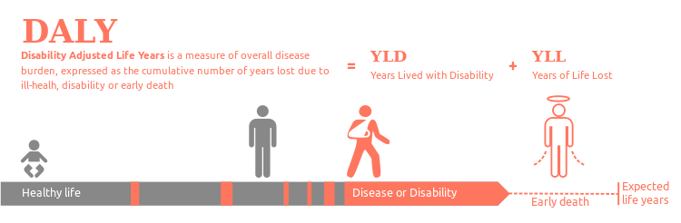
Disability adjusted life year (DALY) is the metric used to assess the burden of disease in populations
http://en.wikipedia.org/wiki/Disability-adjusted_life_year
Notes:
Common metrics to ascertain budren of disease due to e.g. mental disease, cancer or injury
To allow comparison of disease burden between countries or regions

Slide 15
Methods for assessing disability
Ratings scales: visual analogue (place various health states on line with 0=equivalent to death and 1=perfect health)
Standard gambles: offer 2 alternatives: normal health for x years vs. poor health for condition C for y years (cave: possible bias by gamble like/dislike but others find it the reference as it is based on von Neuman-Morgenstern axioms of expected utility)
Time-trade off: 2 choices and alter time until one is indifferent between 2 choices
Person trade-off: would a decision-maker prefer to save x people with health state a vs. y people with state b (cave: sometimes problem for persons to make choices for others)
Issues: types of respondents (health professionals, public, decision makers); adaptation (function), coping (changing expectations & norms) & adjustment (shift of valuation to those possible)

Slide 16
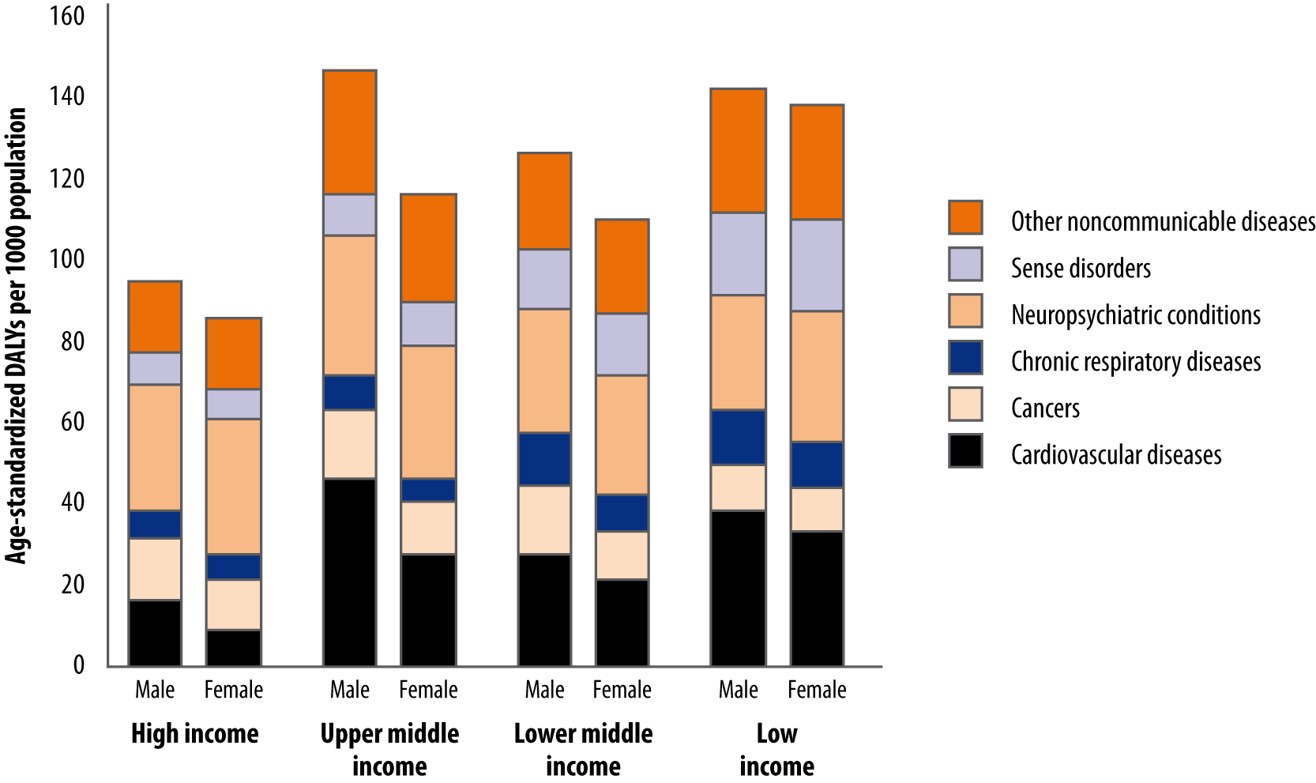
Age-standardized DALYs by regions (GBD 2004): large share of “main NCDs” but also large share of neurodegenerative conditions
DALYs “favor” diseases that start early in life (i.e. that span on many years with disability)
Global Burden of Disease 2004 Update: WHO 2008 (http://www.who.int/healthinfo/global_burden_disease/2004_report_update/en/)

Slide 17
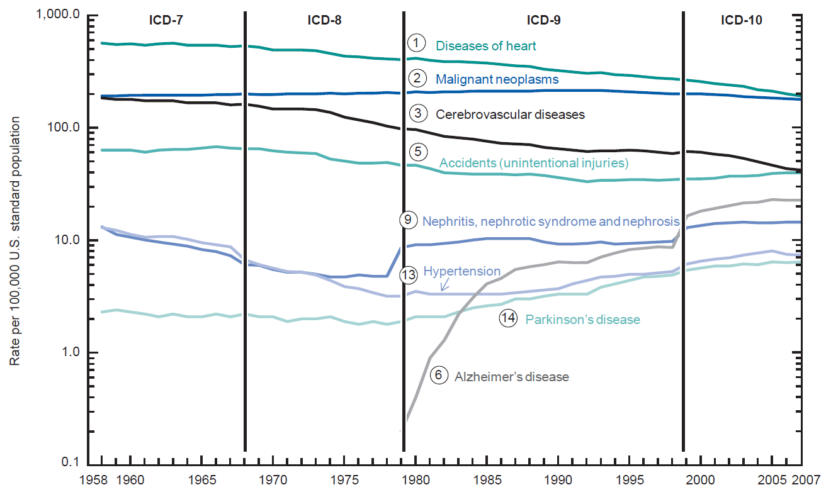
Late stage of transition: decrease of CVD, plateau of cancer, and sharp rise of neuro-degenerative diseases (age-adjusted death rates, USA, 1958-2007)
Jiaquan Xu J et al, Division of Vital Statistics Deaths: Final Data for 2007 National Vital Statistics Reports. Vol 58, Nb 19 May 2010

Slide 18
A most important contribution of GBD:
Relating disease burden to risks
An alternative way of looking at ill health is to consider risks for disease, rather than diseases themselves
A single risk factor may underlie several diseases; e.g. tobacco for CVD, cancer and prenatal conditions
Information on risk is crucial to inform which health interventions could curb diseases (while information on diseases does not tell explicitly what to do to tackle these diseases)
“Risk factor levels of today are diseases of tomorrow”

Slide 19
Risk factors analyzed in GBD (implicitly: interventions exist to reduce these risk factors in the population)
Child & maternal under-nutrition
Child and maternal underweight
Iron deficiency anaemia
Vitamin A deficiency
Zinc deficiency
Suboptimal breastfeeding *
Term IUGR *
Other nutrition-related risks & inactivity
High blood pressure
High cholesterol
High blood glucose *
Overweight and obesity
Inadequate fruit and vegetable intake
Physical inactivity
Addictive substances
Smoking and oral tobacco use
Alcohol use
Illicit drug use
* Subsequent analysis
Sexual and reproductive health risks
Unsafe sex
Non-use and ineffective use of contraception
(unwanted pregnancy)
Environmental risks
Unsafe water, sanitation, and hygiene
Urban air pollution
Indoor smoke from household solid fuel use
Lead exposure
Global climate change
Occupational risks
Risk factors for injury
Carcinogens
Airborne particulates
Ergonomic stressors
Noise
Other selected risks to health
Contaminated health care injections
Child sexual abuse

Slide 20
A few risk factors of NCDs account for a very large share of the total burden of diseases worldwide (deaths in this figure)
World Health Report, WHO, 2002
Notes:
L’etude GBD a aussi permi de voir les deces (ou DALY) “due” aux facteurs de risque
On voit le role majeur de HBP, tbabac, chol, surpoids, activie physique, etc
Ceci dans tous les pays
Ceci montre le potentiel de “preventabilite” et sur quels facteurs il faut agir

Slide 21
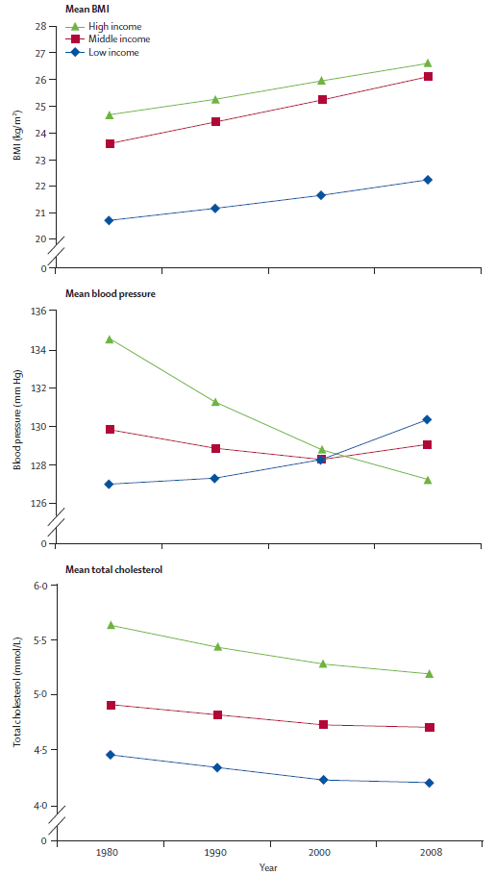

Divergent trends in BMI, BP and TC in LMICs and HICs (GBD)
BMI
Mean BP
Farzadfar F et al. Trends in serum total cholesterol since 1980: systematic analysis of health examination surveys and epidemiological studies with 321 country-years and 3.0 million participants. Lancet 2011;377:578-86.
Finucane MM et al . Trends in BMI since 1980: systematic analysis of health examination surveys and epidemiological studies with 960 country-years and 9.1 million participants. Lancet 2011;377:557-67.
Danaei G et al. Trends in systolic BP since 1980: systematic analysis of health examination surveys and epidemiological studies with 786 country-years and 5.4 million participants. Lancet 2011;377:568-77.
Editorial: Annand & Yusuf. Stemming the global tsunami of cardiovascular disease. Lancet 2011
Mean cholesterol
1980 1990 2000 2008
Notes:
"Understanding the reasons for the contrasting changes in obesity, blood pressure, and total cholesterol will provide useful insights that could help to mitigate the adverse effects of the epidemic of obesity more rapidly than the necessary societal and structural changes needed to reverse the prevalence of obesity itself." and "[...] directly controlling blood pressure, total cholesterol, and smoking will lead to rapid and substantial reductions in cardiovascular disease rates even while obesity (and diabetes) might be increasing.12,13 Therefore focusing on controlling these three risk factors (blood pressure, total cholesterol, and smoking) will rapidly and to a large extent reduce cardiovascular disease globally within a few years, while we continue our efforts to stem and ultimately reverse the tide of obesity, which will need more prolonged and societal-based interventions over decades

Slide 22
Coherent estimates linking incidence, case-fatality, remission, and prevalence (DisMod) to add to 100% mortality and actual prevalences of sequelae in populations
Susceptible for case disease
S(t)
m
dS(t)/dt = -(I+m)S(t)
dC(t) = iS(t)-(r+f+m)C(t)
dM(t)/dt = m(S(t)+C(t)
dD(t)//dt = (C)t
(by sex, age and region)
Death from other cause
m
i
r
f
Death from case disease
Case with specific disease (t)
Develop coherent estimates over 40 person years
The Global Burden of Disease, WHO, Harvard, World Bank, 1996

Slide 23
Challenges with GBD estimates
Limited quality of data in several regions (e.g. mortality in LICs)
Issues on assumptions (age weights, disability, discount, LE, RF)
DALYs give high weight to diseases occurring early in life
Use of increasingly complex analyses, replicability of estimates
Ownership of data and analyses (knowledge is power)
Yet, GBD estimates are crucial to provide comparable information on disease burden, avoidable diseases burden, and estimates of cost-effectiveness of interventions
GBD estimates have been instrumental to put NCDs in the global agenda in LMICs
Notes:
Projections based on 4 variables (time-demography, income, education, smoking): should other variables be considered?

Slide 24
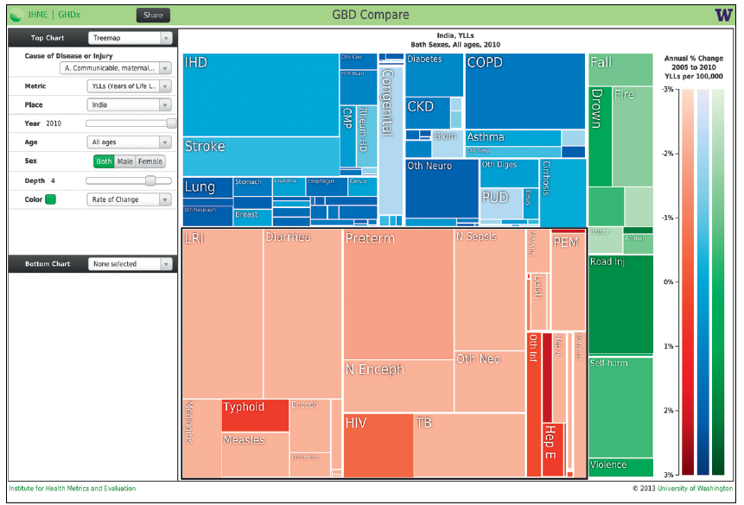
Screenshot of an output from GBD Compare showing a treemap of YLLs in India in 2010
Murray et al. Lancet 2013
Notes:
Communicable, maternal, neonatal, and nutritional causes are coloured red; non-communicable causes are blue; and injuries are green. The shading of each colour
can be altered to convey information about rates of change from 1990 to 2010, or the size of uncertainty intervals; in this figure, shading is according to rates of
change. In some cases the labels for the boxes are not visible, but hovering over each rectangle provides full detail. This figure illustrates how, despite substantial
reductions in mortality of children younger than 5 years and adults, communicable, maternal, neonatal, and nutritional disorders still account for 50·4% of YLLs.
Results are for the fourth level of disease disaggregation.10 YLLs=years of life lost due to premature mortality.

Slide 25
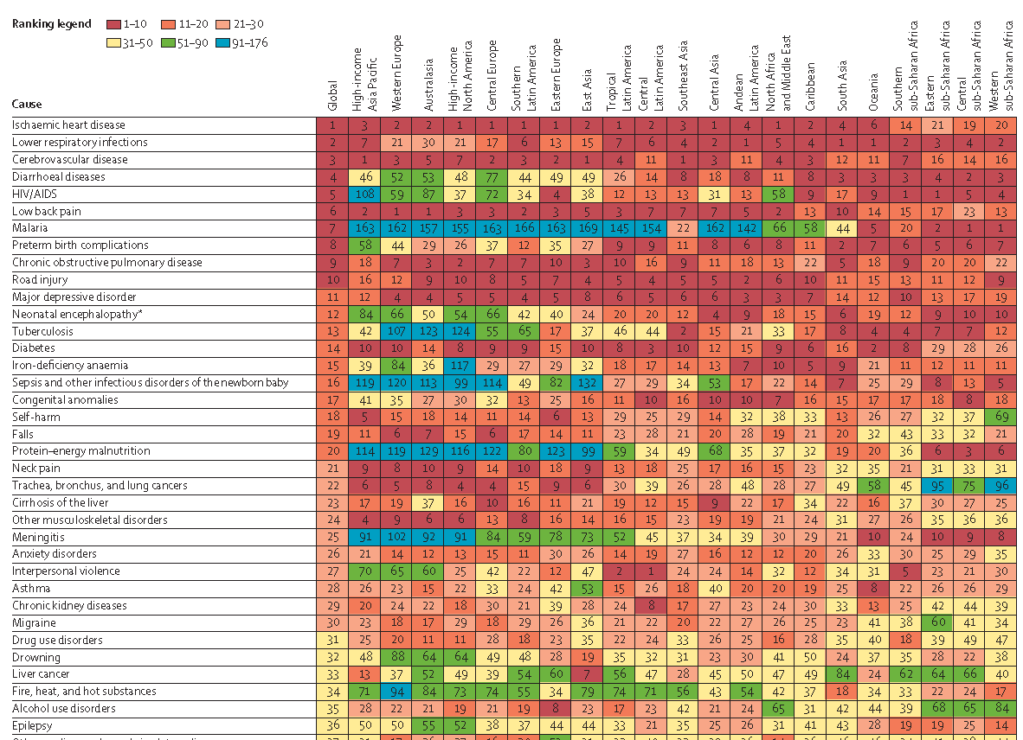
Ranking of leading causes of DALYS by regions, 2010
IHD
Resp Dis
Stroke
Diarhea
AIDS
Low back pain
Malaria
Preterm birth cpl
Road injury
Depression
etc
Murray C et al. Disability-adjusted life years (DALYs) for 291 diseases and injuries in 21 regions, 1990–2010: a systematic analysis for the Global Burden of Disease Study 2010. Lancet 2012; 380: 2197–223.

Slide 26
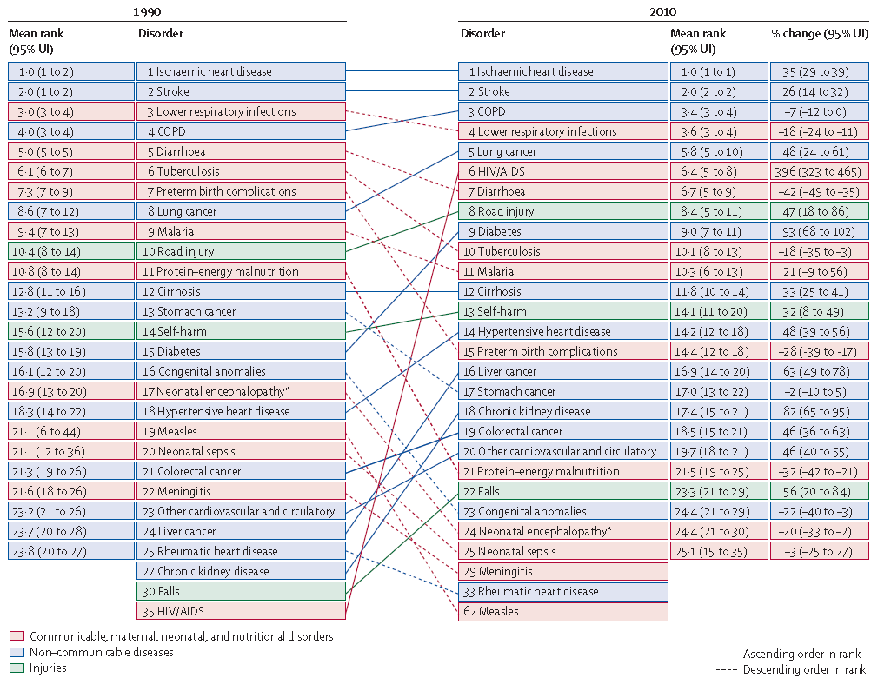
Global death ranks for top 25 causes in 1990 and 2010,
and percentage change between 1990 and 2010
This figure is available online at http://healthmetricsandevaluation.org/gbd/visualizations/regional

Slide 27
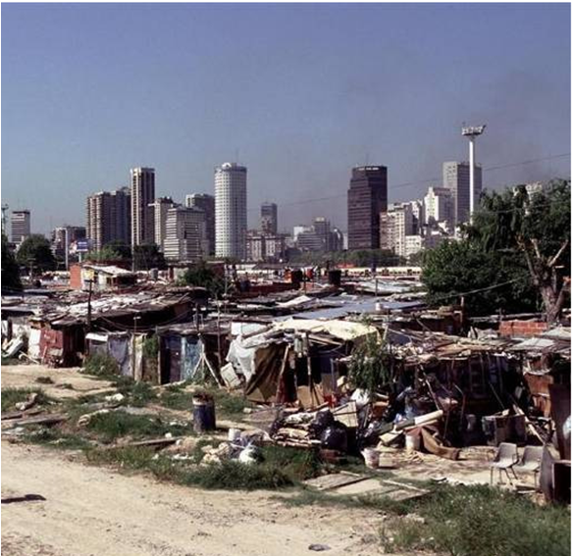
Health transition and GBD models predict trends at macro level, not at micro levels
A tale of two cities:
It is not urbanization itself, but the kind of urbanization that affects health

Slide 28

Health transition and GBD trends estimates are great tools to predict health situation in populations and planning response
I skate where the puck will be
Wayne Gretsky
« Greatest hockey player
of all time »
Notes:
Nicknamed "The Great One", Gretzky was called "the greatest player of all time" in Total Hockey: The Official Encyclopedia of the NHL.[3] He is generally regarded as the best player in the history of the NHL,[4][5] and has been called "the greatest hockey player ever" by many sportswriters,[6] players,[7] and coaches. Upon his retirement on April 18, 1999, he held forty regular-season records, fifteen playoff records, and six All-Star records.[8] He is the only NHL player to total over 200 points in one season—a feat he accomplished four times. In addition, he tallied over 100 points in 15 NHL seasons, 13 of them consecutive. Gretzky's jersey number, 99, has been retired by all teams in the National Hockey League.

Slide 29

Large toll of premature NCD deaths in all regions, including LMICs
25 million
premature deaths <70 yrs
20 million
6.1M
15 million
10 million
6.0M
1.9M
1.9M
0
High-income countries
Upper middle-income
Lower middle-income
Low-income countries
Group III - Injuries
Low-income countries
Group II – Other deaths from NCDs
Group II – Premature deaths from NCDs (below the age of 70), which are preventable
Group I – Communicable diseases, maternal, perinatal and nutritional conditions
Notes:
29
Le rapport mondial sur l’ampleur des maladies paru en 2008, montrait qu’en plus de la charge des maladies transmissibles dans les pays, environ 6 millions et 8 millions de décès prématurés dus aux MNT sont survenus dans les pays à ressources faibles et à ressources modérés respectivement, comparés aux 2 millions dans les pays à ressources élevées.

Slide 30
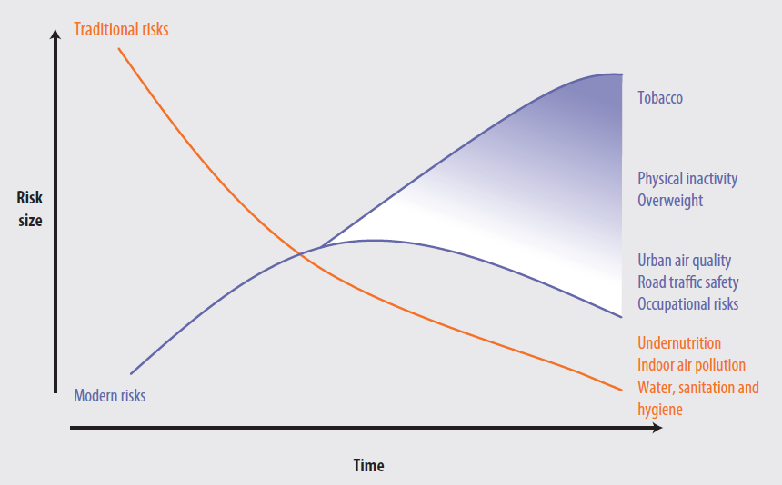
Estimates of GBD are useful to inform on potential health gains.
The transition from traditional to modern risks will largely depends on the public health policies response implemented by countries
Global health risks: mortality and burden of disease attributable to selected major risks. WHO 2009

Slide 31
Conclusions
GBD is an innovative method to assess the burden of disease worldwide in a comprehensive, comparable and consistent manner
As life expectancy rises, mortality rates are not sufficiently informative, particularly for NCDs: need to include non-fatal health outcomes in policy debates (DALYs)
DALY is a single metric integrating mortality & morbidity allowing direct comparison of global BOD (priority areas, cost-effective interventions, etc)
Several challenges: lack of data in several regions, assumptions (DALYs)
Continuous attempt to improve methods/results (eg updates in 2004/2010)
Emphasis on both diseases (“risk factors of yesterday”) and risk factors (“disease of tomorrow”) to guide policy and interventions
GBD helped put NCDs on agenda as NCDs rank high in all regions and NCD can be prevented
Implications for NCD (global NCD agenda) described in lecture on prevention of NCDs

Slide 33
Changing socio-economic structures underlie changes in behaviors (epidemiological transition, nutrition transition)
Shift from a preindustrial agrarian economy to industrialization
  Less physical activity
  Higher availability of cheap processed foods (fat, sugar)
  But also more varied foods available to all in modern societies
Profound changes in household technology (less PA)
  Food availability: canning, refrigeration, freezing, radiation, packaging
  Food preparation: fossil fuels, electricity, appliances (cooker, mixers)
Shift in leisure activities
  Time spent for viewing television leads to sedentary habits
  Marketing of processed foods alters consumption patterns
  But also more time for leisure PA in modern societies
Adapted from Popkin B. The nutrition transition and obesity in the developing world. Nutr J 1991;131:871-73

Slide 34
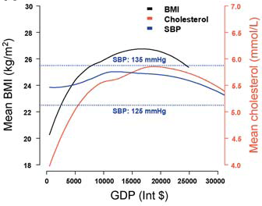
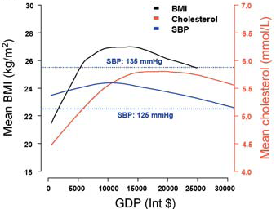
Bell shape of levels of BMI, SBP, and cholesterol according to a country’s development (GDP)
Males
Females
Ezzati E et al. Rethinking the ‘‘diseases of affluence’’ paradigm: Global patterns of nutritional risks in relation to economic development. PLoS 2005;2;e133
Notes:
Background
Cardiovascular diseases and their nutritional risk factors—including overweight and obesity,
elevated blood pressure, and cholesterol—are among the leading causes of global mortality
and morbidity, and have been predicted to rise with economic development.
Methods and Findings
We examined age-standardized mean population levels of body mass index (BMI), systolic
blood pressure, and total cholesterol in relation to national income, food share of household
expenditure, and urbanization in a cross-country analysis. Data were from a total of over 100
countries and were obtained from systematic reviews of published literature, and from national
and international health agencies.
BMI and cholesterol increased rapidly in relation to national income, then flattened, and
eventually declined. BMI increased most rapidly until an income of about I$5,000 (international
dollars) and peaked at about I$12,500 for females and I$17,000 for males. Cholesterol’s point of
inflection and peak were at higher income levels than those of BMI (about I$8,000 and I$18,000,
respectively). There was an inverse relationship between BMI/cholesterol and the food share of
household expenditure, and a positive relationship with proportion of population in urban
areas. Mean population blood pressure was not correlated or only weakly correlated with the
economic factors considered, or with cholesterol and BMI.
Conclusions
When considered together with evidence on shifts in income–risk relationships within
developed countries, the results indicate that cardiovascular disease risks are expected to
systematically shift to low-income and middle-income countries and, together with the
persistent burden of infectious diseases, further increase global health inequalities. Preventing
obesity should be a priority from early stages of economic development, accompanied by
population-level and personal interventions for blood pressure and cholesterol.

Slide 35
Main engines of the health transition
Demographic transition: lower mortality (esp. from infectious diseases, large gains in youth) leads to increase in life expectancy and larger proportions of older adults in the population
Epidemiologic transition: shift from infectious and nutritional disorders to chronic lifestyle-related disorders as dominant health problems
Social gradient: larger NCD burden shifts from initially affluent urban populations (early adopters of new lifestyles) to poorer population segments (lower education, low purchasing power favoring intake of cheaper energy dense foods, lower access to health services)
Transition in health services (differential access to, and use of, preventive and curative health services)

Slide 36
The health transition and GBD: some conclusions
Link between social changes, demographic changes and disease patterns
Patterns vary between region and country
Transition to NCDs results from success in controlling infectious diseases
Increasing NCD burden is inevitable when populations are aging
Double burden of disease (infectious and NCDs) in many LMICs
Patterns of NCD evolve over time (from CD -> CVD -> Cancer -> Neurodegen.)
Need to reduce risk factors (& of NCDs) faster than increasing aging of populations to contain (hopefully reduce) the total numbers of NCD deaths
Transition model provides rationale for prospective planning, also when epidemiological data are not available locally or NCDs are not yet predominant
Good news : later transition stages predicts reduced rates of the “big four” lifestyle-related NCDs (conditional to appropriate policy/health care response)

Slide 38
Outline
The health transition
The driving engines
Demographic transition
Epidemiological transition
Global burden
  Methods
  Trends of diseases
  Fractions of burden attributable to avoidable risk factors
Conclusions
(Implications on global NCD agenda to be seen in lecture on NCD prevention)

Slide 39
Objectives
Describe the principles and different stages of the epidemiological transition, underlying driving engines, and implications for health policy
Describe the underlying overall methods and selected global results of the global burden of disease project
What the participant will have achieved as a result of participating in the session
Be able to describe the main engines driving the epidemiological transition
Be able to articulate the overall methods used in GBD and some findings of the global burden of disease, particularly in terms of non communicable diseases (both in terms of burden attributable to diseases and to risk factors)

Slide 40
The epidemiologic transition (health transition)
Described in the 1970s (Omran, later Olshansky, Ault)
  Relationship between socioeconomic development and health
  Shift from communicable diseases and nutritional deficiencies to non-communicable diseases (NCDs)
  Classification of 4 stages relating socioeconomic situation and disease patterns
Framework to understanding current and future health patterns and needs
  Relevance for low and middle income countries (LMICs) experiencing early stages of health transition
  Model for health planning, particularly where available data are scarce
Omran AR. The epidemiologic transition: a key of the epidemiology of population change. Milbank Mem Fund Q 1971;49:509-538
Olshansky & Ault. The fourth stage of epidemiologic transition: the age of delayed degenerative diseases. Milbank Mem Fund Q 1986;64:355-91

Slide 41
The 4 stages of the health transition
Stages
Socio-
Life
Main characteristics
Broad disease categories
economic
expec-
development
tancy
(proportionate mortality)
1*
Age of pestilence
+
(LIC, rural SSA)
~30
Infectious diseases
CVD: 5-10% of all †
Nutritional deficiencies
Related to nutrition/infection:
RHD; cardiomyopathies)
2*
Age of receding
++
30-50
Improved sanitation
:
CVD: 10-35%
pandemics
(LIC-MIC)
↓
infections,
diet
Hypertensive heart disease,
(salt),
aging
stroke, sequels of RHD
3*
Age of degen.
+++
50-55
aging,
lifestyles
CVD: 35-65%
and man-made
(MIC, countries
related to high SES:
Obesity, dyslipidemias, HBP,
diseases
in transition)
sat fats, sugar,
Inactivity, smoking)
→
IHD, stroke,
often at early age
4**
Age of delayed
++++
>70
↓
risk behaviors
CVD <50% (delayed stroke and
degenerative
(western
in the population
IHD, CHD, aging population
diseases
countries)
(prevention and health
& better treatment
promotion) and
new
treatments
LIC: low income countries; MIC: middle income countries; SSA: Sub Sahara Arica; IHD: ischemic heart disease; CVD: cardiovascular diseases
Omran. The epidemiologic transition. Millbank Mem Fund Q 1971 ;49 :509-38
Olshansky & Ault. The 4th stage of the epidemiological transition. Millbank Mem Fund Q 1986 ;64 :355-91

Slide 42
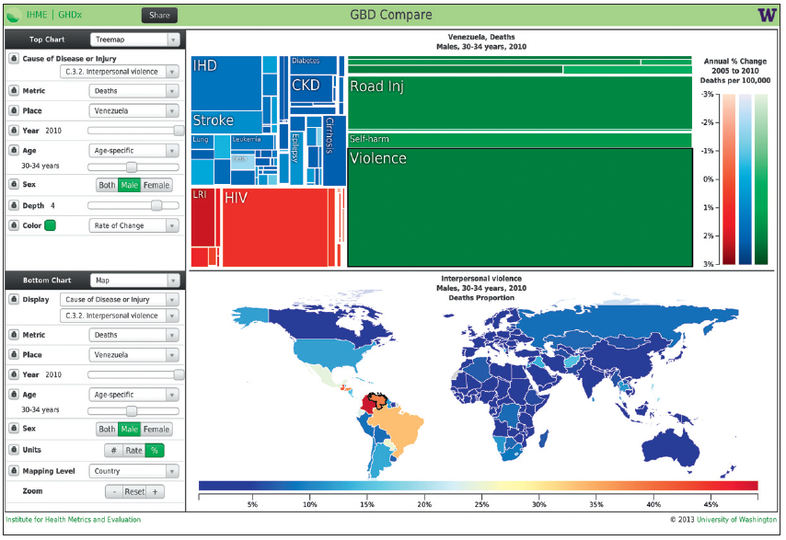
Screenshot of an output of “GBD Compare” showing treemap of deaths (here men 30–34 years in Venezuela) and proportion of deaths due to violence in this age group worldwide
Murray et al. Lancet 2013

Slide 43
Emergence and decline of CVD: different stages of health transition along different socioeconomic development stages
Rates of CVD:

Slide 44
Health transition: contrasting secular changes in proportionate mortality in Latin America, 1970 - 1995
infectious
cancer
CVD
perinatal
injury
Guatemala
Mexico
other
Chile
Uruguay
Uauy et al. J Nutr 2001

Slide 45
Proportions of disability adjusted life of years lost (DALYs) by main disease causes and regions
Mathers et al 2003

Slide 46
Are NCDs diseases of affluence? World income percentiles and age-standardised death rates for NCD and CD
CDs et al.
NCDs
WHO

Slide 47
Demographic transition (Mauritius, 1890-1990): decrease of mortality followed by decrease of fertility

Slide 48
Demographic transition, Mexico, 1900-2010
↑ health needs could be anticipated decades earlier
Need for planning more relevant now as resources are decreasing if equal coverage to be kept
Bobadilla et al. In Jamison ed. Disease Control Priorities in DC. Oxford UP, WB, 1993

Slide 49
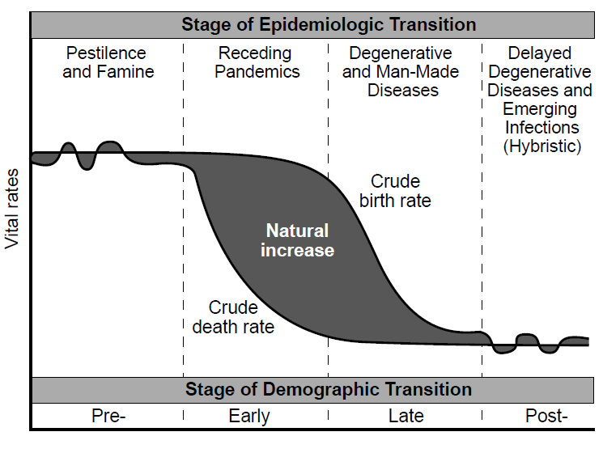
Demographic/epidemiologic transition framework
and aging

Slide 50
Heterogeneity of social and economic development among countries and over time underlie different models of demographic transition
Classical (or Western) model
  mostly economical and social factors, started in 18th-19th century
Accelerated model (Japan, Eastern Europe)
  started later but evolved quicker
Delayed (or contemporary) model (most developing countries)
  rapid decrease in overall mortality (mainly ↓ child deaths) but less (delayed) decrease in birth rates, hence explosive population growth
  important role of public health and medical interventions (treatment, contraception, abortion)
Omran, Millbank Mem Fund Quart, 1971;49,215
Notes:
difflérer

Slide 51
Models of demographic transition
Western
Accelerated (Japan, FSE)
Delayed (Most LDC)
Population
Birth rate
Death rate
UK
Japan
Sri-Lanka
↓ Mortality
↓ Fertility
(↓ birth rate)
↑ Population
↑ Age population
Mortality and birth rates driven to various extents by socio-economic development, public health & medical interventions
Omran, Millbank Mem Fund Quart, 1971;49,215

Slide 52
Globalization favors lifestyle transition (good & bad changes)
Trade liberalization (of world markets) and urbanization
  Nutrition transition: ↑ fats, ↑ sugar (‘coca-colanisation’), ↓ complex carbohydrates
  Supply larger than demand fuels competition & promotion (large portions, “all you can eat”, etc), reduces cost of $/calorie (fats, sugars): favors consumption
  ↑ tobacco (marketing, low cost)
  But also allows for more varied foods (last stage of health transition)
Information & communication technologies
  Global advertising & promotion of unhealthy lifestyles
  But also allows promotion of potentially healthy behaviors and healthy products
Urbanization and accelerated migration of populations
  Acculturation facilitates adoption of both unhealthy & healthy lifestyles
  Increased incomes allow for potentially healthier diet and healthy PA activities
NCDs/CVD are transmitted diseases whose vectors are commercial & advertising practices

Slide 53
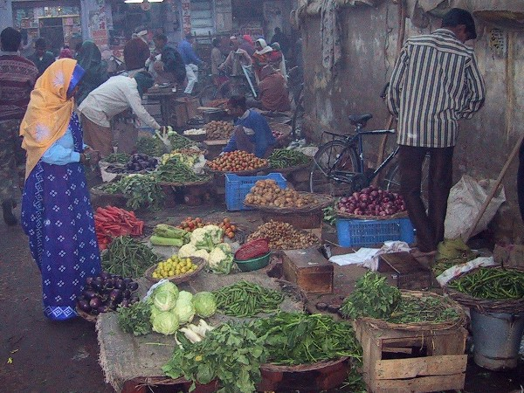

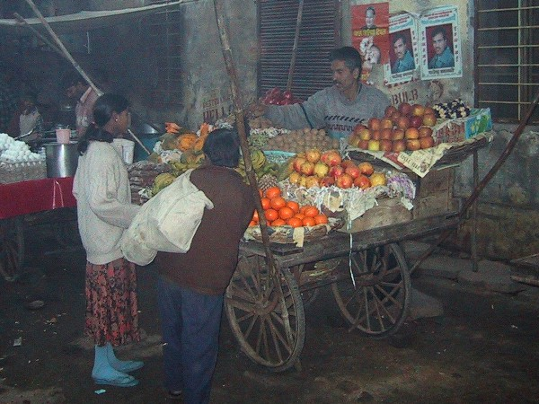

From traditional to modern food marketing ....

Slide 54
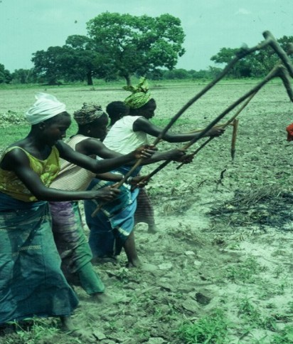

From ancient to modern work ….

Slide 55
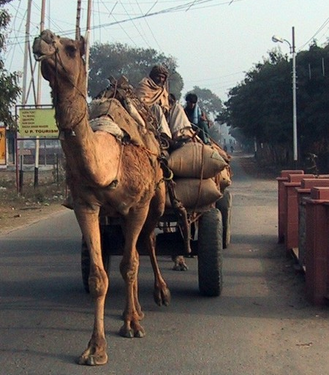
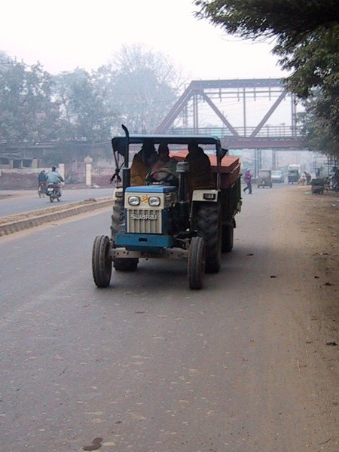



From traditional to modern transportation ....

Slide 56

Source: Die Zeit. Nr. 15, 1. April 2004, S. 44

Slide 57
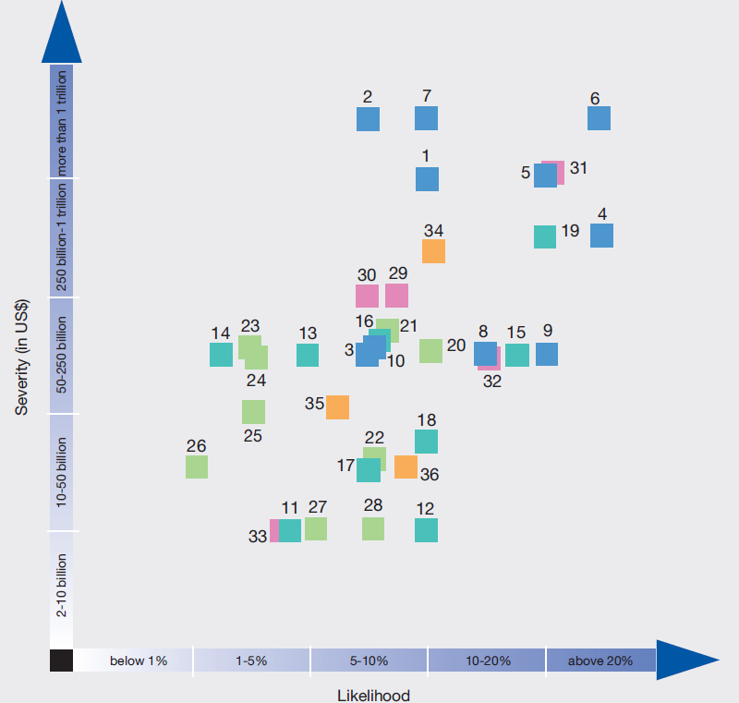
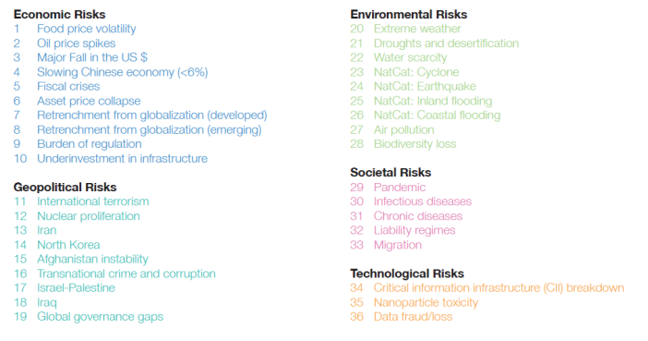
Impact of global societal problems according to economic loss and likelihood: high macro-economic impact of NCDs
Economic risks
Food price volatility (1)
Oil price spikes (2)
Slowing Chinese economy (4)
Fiscal crisis (5)
Asset price collapse (6)
Retrenchment from globalisation (7)
Geopolitical risks
Global governance gaps (19)
Afghanistan instability (15)
Transnational crime (16)
Environmental risks
Extreme weather (20)
Droughts & desertification (21)
Societal risks
Pandemics (29)
Infectious diseases (30)
NCD (31)
Liability regimes (32)
Technological risks
Information infrastructure breakdown (34)
Data fraud/loss (36)
NCDs
Inf.dis.
Pandemic (29)
Severity ($US billion)
Likelihood (%)
World Economic Forum: Global Risk Assessment 2010
http://www.weforum.org/pdf/globalrisk/globalrisks09/global_risks_2010.pdf
Notes:
Crise finacniere

Slide 58
Burden of disease and health expenditures by regions:
the '90/10 desequilibrium’
Murray et al. National health expenditures. WHO, 1994

Slide 59
The challenge of the health transition is not whether it will occur at all in the developing countries but whether we respond in time to telescope the transition and avoid the huge burden in young and middle age adults.
The question is not whether we can afford to invest in NCD prevention and control in the developing countries, but whether we (developed and developing countries) can afford not to!

Slide 60

The primary determinants of disease are mainly economic and social, and therefore its remedies must also be economic and social.
Medicine and politics cannot and should not be kept apart.
Geoffrey Rose
The Strategy of Preventive Medicine, 1992
Notes:
1
60
4

Slide 61
Global Burden of Disease

Slide 62

Global burden of disease: web site of the Institute for Health Metrics and Evaluation (IHME)
www.healthmetricsandevaluation.org/gbd

Slide 63
Global Burden of Disease and Risk Factors 2004
Objective 1: Estimates of burden of disease, injuries, and risk factors for 1990 and 2005 within 21 regions using consistent and comparable methods, assumptions, and data sources
Objective 2: Create simplified analytical tools to facilitate national burden estimates and policy use, and create curricula and training tools to teach the application and interpretation of GBD
Launched in September 2007 with an announcement in the Lancet
40-50 expert working groups for different diseases, injuries, and RF
Attempt to have comprehensive set of risks for major disease groups (CVD, selected cancers, major childhood diseases, etc)
Results to be published in 2010 and subsequently
Ezzati, personal communication

Slide 64
Sources for GBD estimates of mortality and causes of death
Mortality level
  Vital registration and census
  Surveys
  Demographic models
Causes of death
  Vital registration with certification of cause of death
  Sample registration systems
  Verbal autopsies
  Household surveys
  Population surveillance systems

Slide 65
Assessing cause of death: principles of ICD coding
Coarsest level: ICD divided in 17 chapters = mixture of 1) etiologies (infection, neoplasm), 2) organ system (digestive) and 3) injuries
Changes over versions (stroke: disease of CNS -> Circulatory System)
‘Final’, ‘underlying’ and ‘related’ causes of death (e.g. death from liver cancer caused by HBV, MI in patient with hypertension and diabetes)
Rule for selection: «the disease or injury which initiated the sequence of events which led to death»
Often ‘underlying cause’ unless ‘senility’, ‘ill-defined conditions’, ‘trivial conditions’, ‘linked conditions’, ‘early and late stages of disease’, ‘late effects’, ‘old pneumonia, influenza & maternal conditions’, and ‘errors and accident of medical care’
In reality, each ICD version is a political document reflecting the political power of different groups to manipulate the coding of particular causes (eg, ICD10: maternal causes & HIV)
‘Ill defined causes’ changed much lately: potential for bias in trends (1980s, Mexico: 30% CVD deaths attributed to ‘ventricular dysrythmias’)
Harvard Center for Population and Development Studies

Slide 66
Introduction 1
DALYs attempt to capture the overall disease burden
 | Prevalence Incidence | Mortality rates Maternal Infant Perinatal Under five Overall
DALYS
*
Notes:
Quality Adjusted Life Years (QALYs) = Number of fully healthy years lost to a particular disease or risk factor

Slide 67
Composante «incapacité» : Identifier un nombre limité de séquelles majeures, leur épidémiologie et leur taux d’incapacité
483 séquelles identifiées pour 107 conditions
  par exemple, 5 complications du diabète: diabète per se, rétinopathie, neuropathie, pied diabétique, amputation
Déterminer la survenue, durée, incidence, prévalence, et taux de décès pour chaque séquelle (par âge, sexe, région)
Estimer les taux d’incapacité résultant de ces séquelles: estimer un facteur de pondération entre 0 (santé parfaite) et 1 (même gravité que décès)
Murray & Peto, Lancet 1997

Slide 68
Assessment of disability
Before GBD, no method to compare disability in different diseases
Weight from 0 (disability ~death) and 1 (perfect health)
Different ‘trade-off ’ methods (expert panels, e.g. with analog scales, ranks, time trade-off , etc)
Large consensus between 8 panels in different panels (r >0.9)
Lancet, 1997; 349:1350

Slide 69
Seven disability categories
Lancet, 1997; 349:1350

Slide 70
Duration of YLD and YLL is scaled to standard expected years of life lost (for LE 82 W,80 M)
SEYLL = life expectancy at each age is a standard estimated duration of life expected at each age
Standard rates are from Coale and Demeny Model level 26 (used in BOD)
World Health Report 1997; GBD study, WHO & WB, 1996.
McKenna MT et al U.S. Burden of Disease–Past, Present and Future. Ann Epidemiol 2009;19:212–219
Notes:
Disability-Adjusted Life Expectancy (DALE), an indicator
in which period life expectancy is corrected for the
number of years lived with disability, adjusted for the
severity of disability (black area in Fig. 3da concept similar
to the Quality-Adjusted Life Years [QALYs]);
YLD, gray area, the equivalent years of life lost due to
disability, and
YLL, the dotted area, the years of life lost.
U.S. Burden of Disease–Past, Present and Future
MATTHEW T. MCKENNA, MD, MPH, AND ARMINEH ZOHRABIAN, PHD
PURPOSE: To review the history and challenges of ‘‘burden of disease’’ studies, how these are dependent
on robust epidemiologic data as well as complex conceptual constructions, and to identify the public health
policy issues these studies can most usefully inform.
METHODS: The emergence of the concept of the ‘‘burden of disease’’ in the public health literature is
reviewed, with a focus on the results of an analysis of data from the United States that used the methodology
presented in the Global Burden of Disease Study.
RESULTS: The systematic analysis of public health mortality data to identify major health problems was
conducted by Graunt in 16th-century London. He found that many of the predominant sources of mortality
were not the focus of public attention. Today, despite refinements in epidemiologic measurement methods
designed to capture the impact of non-fatal health conditions, there are similar incongruities between the
major public health problems and expenditures on prevention interventions.
CONCLUSIONS: Controversies surrounding the interpretation of ‘‘burden of disease’’ studies are not
new. Particularly in developed countries, these studies appear more useful for setting research priorities
rather than allocating resources to support prevention efforts. Such investigations are not possible without
ongoing support for systematic collection and analysis of descriptive epidemiologic data.
Ann Epidemiol 2009;19:212–219.

Slide 71
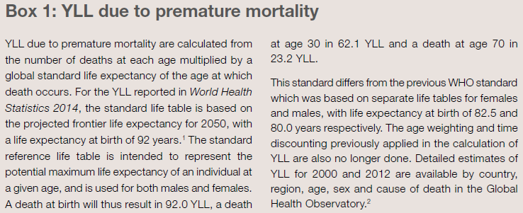
DALYs: which projected life expectancy? 92 ?
World Health Statistics 2014
Notes:
1 WHO methods and data sources for global burden of disease
estimates 2000–2011. Global Health Estimates Technical
Paper WHO/HIS/HSI/GHE/2013.4. Geneva: World Health
Organization; 2013 (http://www.who.int/healthinfo/statistics/
GlobalDALYmethods.pdf?ua=1, accessed 11 March 2014).
2. Global Health Observatory [online database]. Geneva: World
Health Organization (http://apps.who.int/gho/data/node.
main.686?lang=en, accessed 6 March 2014).

Slide 72
Age weighting: value of a year of life is different at different ages in some versions of the GBD
Age weighting: C*x*exp(-βx)
with β=0.04; C=0.1658
World Health Report 1997; GBD study, WHO & WB, 1996

Slide 73
Discount rate on future life largely underlie potential benefit of future interventions (early version of GBD = 3%)

Slide 74
Calculation of DALYs in GBD
DALYs = YLL (years of life lost) + YLD (years lived with disability)
Parameters: a= age at death; r = discount rate; b = parameter for age weighting; C =: constant; L= standard expectation of life at age a.
For GBD: r=0.03; b=0.04; C=0.166; K=1. Life expectancy=82.5 y (W), 80 y (M)
Murray. The Global Burden of Disease. WHO, Harvard, WB, 1996

Slide 75
GBD: modeling trends in mortality and disability
4 distal determinants explain large variance in age-, sex-, and cause-specific mortality: income per capita, human capital (education), smoking intensity, and time
Regression equations for GBD estimated for 98 detailed causes from registration data from 67 countries
Ln M a,k,i = C a,k,i + β1*lnY + β2*lnHC + β*3T
M= mortality for age group a, sex k, and cause i;
Y= GDP per capita; HC=human capital (yrs of school); T= time
World Health Report 1997; GBD study, WHO & WB, 1996

Slide 76
Attributable fractions associated with risks
AF = (m ^{i} - m ^{i} _{ne}) / m ^{i} (m: mortality; ne: non exposed; i: cause i)
Attributable burden (for a RF) = Σ AF_{j} * B_{j,} where
  AF = P * (RR-1) / [ P * (RR-1) + 1] (hence need for P_{exp} & RR)
For some RFs (e.g. smoking, OH), importance of time lag: distinguish
1) current burden of premature death and disability due to past exposure (i.e. attributable burden) and
2) future burden due to current exposure (i.e. avoidable burden)
Avoidable (future) burden can be more important than preventable (current) burden for health planning
Avoidable burden in GBD study is the difference between currently observed BOD and BOD that would be observed if past levels of exposure had been equal to a specified “optimal” distribution of exposure

Slide 77
49% decrease in age-adjusted mortality for stroke and MI between 1989 and 2010 in Seychelles
Stringhini S et al. Declining stroke and myocardial infarction mortality between 1989 and 2010 in a country of the African region. Stroke 2012;43:2283-88.

Slide 78
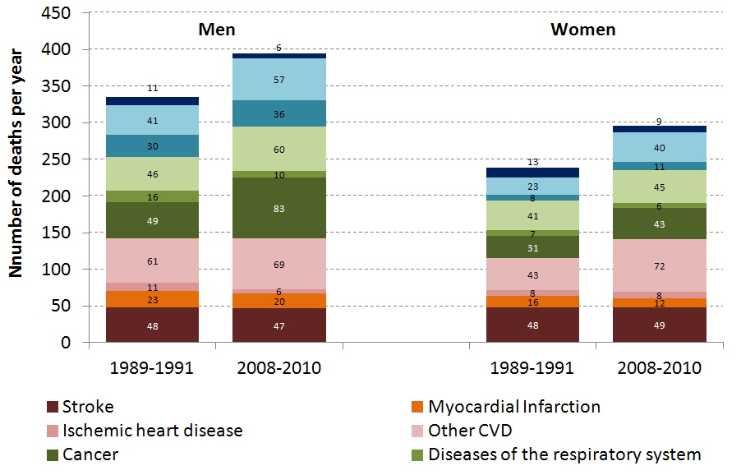
Trends in number of total and CVD deaths, Seychelles 1990-2010 (vital statistics)
Stringhini S et al. Declining stroke and myocardial infarction mortality between 1989 and 2010 in a country of the African region. Stroke 2012;43:2283-88.

Slide 79
Global Burden of Disease: mortality worldwide, 2004
Total: 52 million deaths
NCD: 35 million (60%)
CVD: 17.5 million
Cancer: 7.5 million
Chronic respiratory disease: 7.5 million
Diabetes: 1.1 million
HIV: 3 million
TB: 1.6 million
Malaria: 0.8 million
NCD
Infectious diseases
WHO Global Report "Preventing chronic diseases: a vital investment". WHO, Geneva, 2005 http://www.who.int/chp/chronic_disease_report/en
Notes:
52million deaths , 17 million due to CVD

Slide 80
Mortality: global projections, 2004-2030
30
Intentional injuries
Other unintentional
25
Road traffic accidents
Other NCD
20
Deaths (millions)
Cancers
15
10
CVD
Mat//peri/nutritional
5
Other infectious
HIV, TB, malaria
0
2004
2015
2030
2004
2015
2030
2004
2015
2030
High-income
countries
Middle-income
countries
Low-income
countries

Slide 81
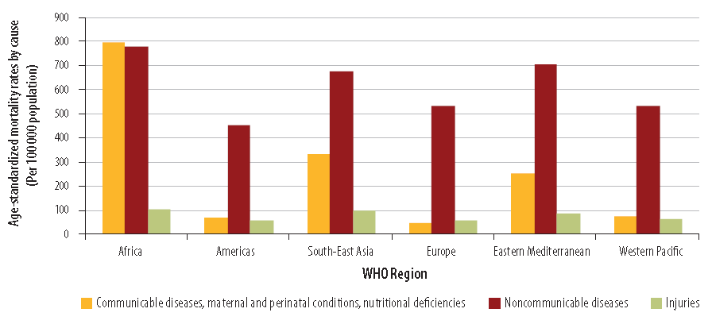
Age-standardized mortality rates by cause, WHO regions, 2008
WHO, World Health Statistics 2013. 2013: Geneva
Marquez PV Farrington JL. The Challenge of Non-Communicable Diseases and Road Traffic Injuries in Sub-Saharan Africa: AN overview. World Bank, 2013

Slide 82
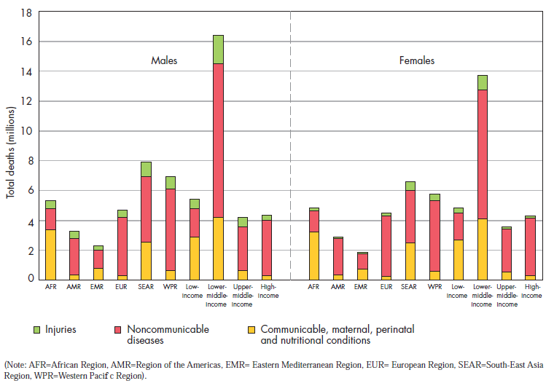
Total deaths by broad cause, region, and income group, 2008
Global Status Report on Noncommunicable Diseases 2010 www.who.int/nmh/publications/ncd_report2010/en/.
Notes:
Mortality
A total of 57 million deaths occurred in the world during 2008; 36 million (63%) were due to
NCDs, principally cardiovascular diseases, diabetes, cancer and chronic respiratory diseases (1).
Nearly 80% of these NCD deaths (29 million) occurred in low- and middle-income countries.
NCDs are the most frequent causes of death in most countries in the Americas, South-East Asia
and the Eastern Mediterranean and the Western Pacif c In the African Region, there are still more
deaths from infectious diseases than NCDs. Even there, however, the prevalence of NCDs is rising
rapidly and is projected to cause almost three-quarters as many deaths as communicable, maternal,
perinatal, and nutritional diseases by 2020, and to almost equal them as the most common causes
of death by 2030 (2).
WHO projections show that NCDs will be responsible for a signif cantly increased total number of deaths
in the next decade. NCD deaths are projected to increase by 15% globally between 2010 and 2020 (to
44 million deaths). The greatest increases will be in the WHO regions of Africa, South-East Asia and the
Eastern Mediterranean, where they will increase by over 20%. In contrast, for in the European Region,
WHO estimates there will be no increase. In the African Region, NCDs will cause around 3.9 million deaths
by 2020. The regions that are projected to have the greatest total number of NCD deaths in 2020 are South-
East Asia (10.4 million deaths) and the Western Pacif c (12.3 million deaths) (2).
With the exception of the African region, NCD mortality exceeds that of communicable, maternal,
perinatal and nutritional conditions combined. For men in the European Region, deaths from NCDs
are estimated to be 13 times higher than these other causes combined, and for men in the WHO
Western Pacif c Region, they are estimated to be eight times higher (Figure 1).
In 2008, the overall NCD age-standardized death rates in low- and middle-income countries were 756 per
100 000 for males and 565 per 100 000 for females – respectively 65% and 85% higher than for men and
women in high-income countries. Age-standardized male NCD mortality rates for all ages were highest
in the African Region for males (844 per 100 000) and for females (724 per 100 000).
cerebrovascular disease (3). These important behavioural risk factors of heart disease and stroke are
discussed in detail later in this chapter.
More than two thirds of all cancer deaths occur in low- and middle-income countries. Lung, breast,
colorectal, stomach and liver cancers cause the majority of cancer deaths. In high-income countries,
the leading causes of cancer deaths are lung cancer among men and breast cancer among women. In
low- and middle-income countries cancer levels vary according to the prevailing underlying risks.
In sub-Saharan Africa, for example, cervical cancer is the leading cause of cancer death among
women. Risk factors for cancer include the four shared behavioural factors (tobacco use, unhealthy
diet, physical inactivity and the harmful use of alcohol), but infections such as hepatitis B, hepatitis
C (liver cancer), human papillomavirus (HPV; cervical cancer) and Helicobacter pylori (stomach
cancer) also cause up to 18% of cancer burden (4). In addition, cancers are also caused by radiation
and a variety of environmental and occupational exposures of varying importance, depending on the
specif c geographical region and cancer site.
Premature death is a major consideration when evaluating the impact of NCDs on a given population,
with approximately 44% of all NCD deaths occurring before the age of 70. In low- and middleincome
countries, a higher proportion (48%) of all NCD deaths are estimated to occur in people
under the age of 70, compared with high-income countries (26%). The difference is even more
marked for NCD deaths in younger age ranges: in low- and middle-income countries, 29% of NCD
deaths occur among people under the age of 60, compared to 13% in high-income countries
Alwan A et al. Monitoring and surveillance of chronic noncommunicable diseases: progress and
capacity in high-burden countries. The Lancet, 2010, 376:1861–1868.
2) The global burden of disease: 2004 update. Geneva, World Health Organization, 2009.
3) Comparative quantifi cation of health risks: Global and regional burden of disease attributable to selected
major risk factors. Geneva, World Health Organization, 2004.
4) Parkin DM. The global health burden of infection-associated cancers in the year 2002. International
Journal of Cancer, 2006; 118:3030–3044

Slide 83
Probability of broad-cause death by age and region (men) High age-specific NCD death rates in adults in all regions
Group 1: infectious diseases; Group 2: NCDs; Group 3: injuries
Lancet 1997; 349:1269

Slide 84
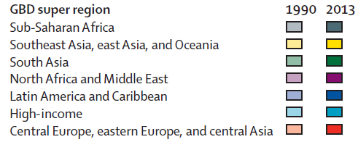
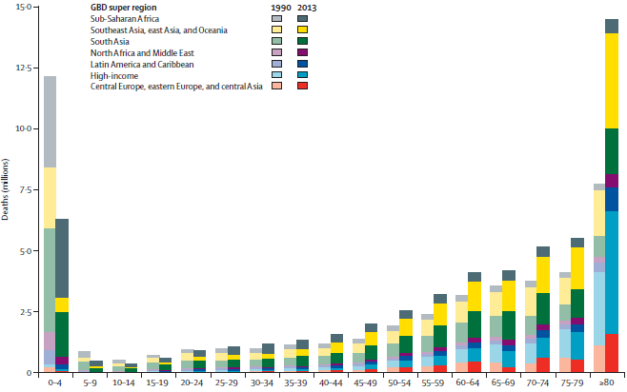
Global deaths by age and region in 1990 and 2013
Global, regional, and national age–sex specific all-cause and cause-specific mortality for 240 causes of death, 1990–2013: a systematic analysis for the Global Burden of Disease Study. Lancet 2014
Notes:
Global, regional, and national age–sex specific all-cause and
cause-specifi c mortality for 240 causes of death, 1990–2013:
a systematic analysis for the Global Burden of Disease
Study 2013
GBD 2013 Mortality and Causes of Death Collaborators*
Summary
Background Up-to-date evidence on levels and trends for age-sex-specifi c all-cause and cause-specifi c mortality is
essential for the formation of global, regional, and national health policies. In the Global Burden of Disease Study
2013 (GBD 2013) we estimated yearly deaths for 188 countries between 1990, and 2013. We used the results to assess
whether there is epidemiological convergence across countries.
Methods We estimated age-sex-specifi c all-cause mortality using the GBD 2010 methods with some refi nements to improve
accuracy applied to an updated database of vital registration, survey, and census data. We generally estimated cause of
death as in the GBD 2010. Key improvements included the addition of more recent vital registration data for 72 countries,
an updated verbal autopsy literature review, two new and detailed data systems for China, and more detail for Mexico, UK,
Turkey, and Russia. We improved statistical models for garbage code redistribution. We used six diff erent modelling
strategies across the 240 causes; cause of death ensemble modelling (CODEm) was the dominant strategy for causes with
suffi cient information. Trends for Alzheimer’s disease and other dementias were informed by meta-regression of
prevalence studies. For pathogen-specifi c causes of diarrhoea and lower respiratory infections we used a counterfactual
approach. We computed two measures of convergence (inequality) across countries: the average relative diff erence across
all pairs of countries (Gini coeffi cient) and the average absolute diff erence across countries. To summarise broad fi ndings,
we used multiple decrement life-tables to decompose probabilities of death from birth to exact age 15 years, from exact age
15 years to exact age 50 years, and from exact age 50 years to exact age 75 years, and life expectancy at birth into major
causes. For all quantities reported, we computed 95% uncertainty intervals (UIs). We constrained cause-specifi c fractions
within each age-sex-country-year group to sum to all-cause mortality based on draws from the uncertainty distributions.
Findings Global life expectancy for both sexes increased from 65·3 years (UI 65·0–65·6) in 1990, to 71·5 years
(UI 71·0–71·9) in 2013, while the number of deaths increased from 47·5 million (UI 46·8–48·2) to 54·9 million
(UI 53·6–56·3) over the same interval. Global progress masked variation by age and sex: for children, average absolute
diff erences between countries decreased but relative diff erences increased. For women aged 25–39 years and older than
75 years and for men aged 20–49 years and 65 years and older, both absolute and relative diff erences increased.
Decomposition of global and regional life expectancy showed the prominent role of reductions in age-standardised death
rates for cardiovascular diseases and cancers in high-income regions, and reductions in child deaths from diarrhoea,
lower respiratory infections, and neonatal causes in low-income regions. HIV/AIDS reduced life expectancy in southern
sub-Saharan Africa. For most communicable causes of death both numbers of deaths and age-standardised death rates fell
whereas for most non-communicable causes, demographic shifts have increased numbers of deaths but decreased agestandardised
death rates. Global deaths from injury increased by 10·7%, from 4·3 million deaths in 1990 to 4·8 million in
2013; but age-standardised rates declined over the same period by 21%. For some causes of more than 100 000 deaths per
year in 2013, age-standardised death rates increased between 1990 and 2013, including HIV/AIDS, pancreatic cancer, atrial
fi brillation and fl utter, drug use disorders, diabetes, chronic kidney disease, and sickle-cell anaemias. Diarrhoeal diseases,
lower respiratory infections, neonatal causes, and malaria are still in the top fi ve causes of death in children younger than
5 years. The most important pathogens are rotavirus for diarrhoea and pneumococcus for lower respiratory infections.
Country-specifi c probabilities of death over three phases of life were substantially varied between and within regions.
Interpretation For most countries, the general pattern of reductions in age-sex specifi c mortality has been associated
with a progressive shift towards a larger share of the remaining deaths caused by non-communicable disease and
injuries. Assessing epidemiological convergence across countries depends on whether an absolute or relative measure
of inequality is used. Nevertheless, age-standardised death rates for seven substantial causes are increasing, suggesting
the potential for reversals in some countries. Important gaps exist in the empirical data for cause of death estimates
for some countries; for example, no national data for India are available for the past decade.
Funding Bill & Melinda Gates Foundation.
Published Online
December 18, 2014
http://dx.doi.org/10.1016/
Correspondence to:
Prof Christopher J L Murray,
2301 5th Avenue, Suite 600,
Seattle, WA 98121, USA
cjlm@uw.edu

Slide 85
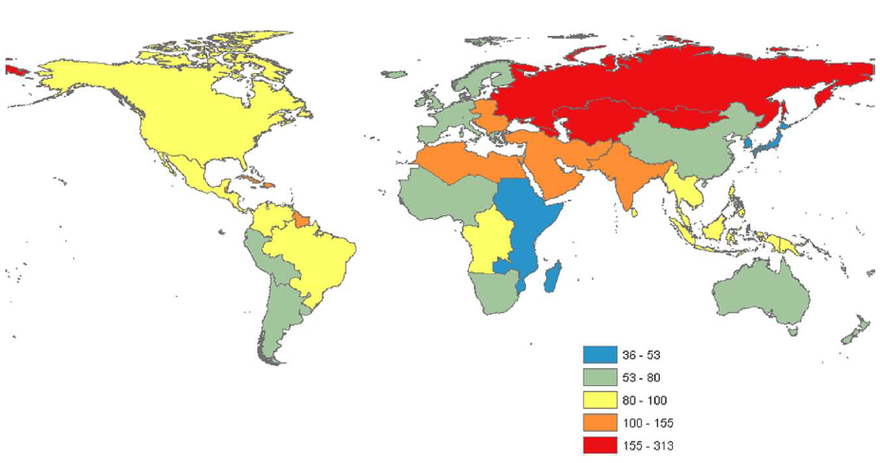
Map of age-standardized ischemic heart disease mortality rate per 100’000 persons in 21 world regions, 2010, GBD 2010
Moran AE et al Temporal Trends in Ischemic Heart Disease Mortality in 21 World Regions, 1980 to 2010. The Global Burden of Disease 2010 Study. Circulation 2014
Notes:
Temporal Trends in Ischemic Heart Disease Mortality
in 21 World Regions, 1980 to 2010
The Global Burden of Disease 2010 Study
Andrew E. Moran, MD, MPH; Mohammad H. Forouzanfar, PhD; Gregory A. Roth, MD, MPH;
George A. Mensah, MD; Majid Ezzati, PhD; Christopher J.L. Murray, MD, DPhil;
Mohsen Naghavi, MD
Background—Ischemic heart disease (IHD) is the leading cause of death worldwide. The Global Burden of Diseases, Risk
Factors and Injuries 2010 Study estimated global and regional IHD mortality from 1980 to 2010.
Methods and Results—Sources for IHD mortality estimates were country-level surveillance, verbal autopsy, and vital
registration data. Regional income, metabolic and nutritional risk factors, and other covariates were estimated from surveys
and a systematic review. An estimation and validation process led to an ensemble model of IHD mortality for 21 world
regions. Globally, age-standardized IHD mortality has declined since the 1980s, and high-income regions (especially
Australasia, Western Europe, and North America) experienced the most remarkable declines. Age-standardized IHD
mortality increased in former Soviet Union countries and South Asia in the 1990s and attenuated after 2000. In 2010,
Eastern Europe and Central Asia had the highest age-standardized IHD mortality rates. More IHD deaths occurred in
South Asia in 2010 than in any other region. On average, IHD deaths in South Asia, North Africa and the Middle East,
and sub-Saharan Africa occurred at younger ages in comparison with most other regions.
Conclusions—In most world regions, particularly in high-income regions, age-standardized IHD mortality rates have
declined significantly since 1980. High age-standardized IHD mortality in Eastern Europe, Central Asia, and South Asia
point to the need to prevent and control established risk factors in those regions and to research the unique behavioral and
environmental determinants of higher IHD mortality. (Circulation. 2014;129:1483-1492.)
Key Words: epidemiology ◼ mortality ◼ myocardial ischemia ◼ trends ◼ world health
© 2014 American Heart Association, Inc.
Circulation is available at http://circ.ahajournals.org DOI: 10.1161/CIRCULATIONAHA.113.004042
Received May 24, 2013; accepted November 4, 2013.
From the Division of General Medicine, Department of Medicine, Columbia University Medical Center, New York, NY (A.E.M.); Institute for Health
Metrics and Evaluation, University of Washington, Seattle, WA (M.H.F., G.A.R., C.J.L.M., M.N.); Division of Cardiology, Department of Medicine,
University of Washington, Seattle, WA (G.A.R.); Center for Translation Research and Implementation Science (CTRIS), National Heart, Lung, and Blood
Institute, National Institutes of Health, Bethesda, MD (G.A.M.); and MRC-HPA Centre for Environment and Health and Department of Epidemiology and
Biostatistics, Imperial College London, London, UK (M.E.).
The online-only Data Supplement is available with this article at http://circ.ahajournals.org/lookup/suppl/doi:10.1161/CIRCULATIONAHA.
113.004042/-/DC1.
Correspondence to Andrew Moran, MD, MPH, Herbert Irving Assistant Professor of Medicine, Columbia University, Division of General Medicine.
Presbyterian Hospital East room 105, 622 West 168th St, New York, NY 10032. E-mail aem35@cumc.columbia.edu

Slide 86
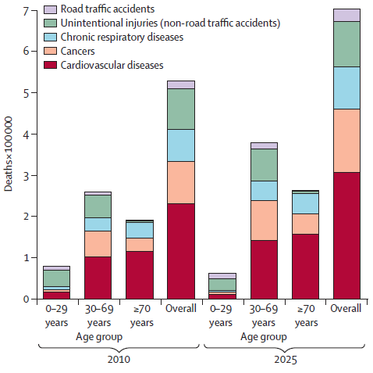
Projected deaths in Pakistan in 2010 and 2025 by age and cause
Jafar TH et al. Non-communicable diseases and injuries in Pakistan: strategic priorities. Lancet 2013

Slide 87
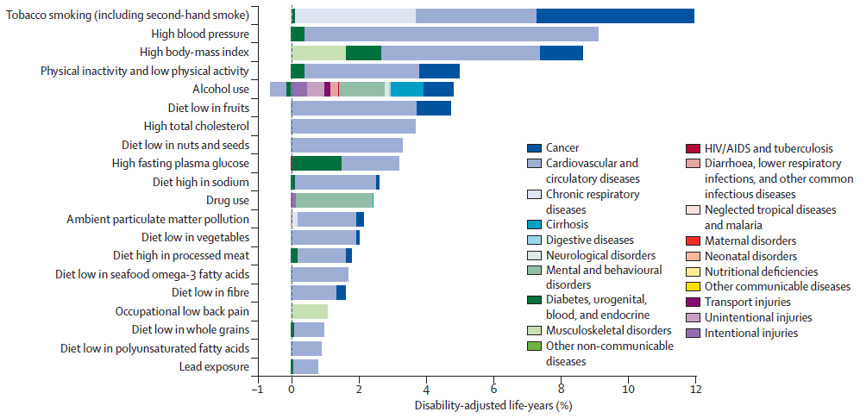
Burden of disease attributable to 20 leading risk factors expressed as % of total DALYs, UK, 2010
Murray et al. Lancet 2013
Notes:
UK health performance: findings of the Global Burden of
Disease Study 2010
Christopher J L Murray†, Michael A Richards, John N Newton, Kevin A Fenton, H Ross Anderson*, Charles Atkinson*, Derrick Bennett*,
Eduardo Bernabé*, Hannah Blencowe*, Rupert Bourne*, Tasanee Braithwaite*, Carol Brayne*, Nigel G Bruce*, Traolach S Brugha*, Peter Burney*,
Mukesh Dherani*, Helen Dolk*, Karen Edmond*, Majid Ezzati*, Abraham D Flaxman*, Tom D Fleming*, Greg Freedman*, David Gunnell*,
Roderick J Hay*, Sally J Hutchings*, Summer Lockett Ohno*, Rafael Lozano*, Ronan A Lyons*, Wagner Marcenes*, Mohsen Naghavi*,
Charles R Newton*, Neil Pearce*, Dan Pope*, Lesley Rushton*, Joshua A Salomon*, Kenji Shibuya*, Theo Vos*, Haidong Wang*, Hywel C Williams*,
Anthony D Woolf*, Alan D Lopez, Adrian Davis
Summary
Background The UK has had universal free health care and public health programmes for more than six decades.
Several policy initiatives and structural reforms of the health system have been undertaken. Health expenditure has
increased substantially since 1990, albeit from relatively low levels compared with other countries. We used data from
the Global Burden of Diseases, Injuries, and Risk Factors Study 2010 (GBD 2010) to examine the patterns of health
loss in the UK, the leading preventable risks that explain some of these patterns, and how UK outcomes compare
with a set of comparable countries in the European Union and elsewhere in 1990 and 2010.
Methods We used results of GBD 2010 for 1990 and 2010 for the UK and 18 other comparator nations (the original
15 members of the European Union, Australia, Canada, Norway, and the USA; henceforth EU15+). We present
analyses of trends and relative performance for mortality, causes of death, years of life lost (YLLs), years lived with
disability (YLDs), disability-adjusted life-years (DALYs), and healthy life expectancy (HALE). We present results for
259 diseases and injuries and for 67 risk factors or clusters of risk factors relevant to the UK. We assessed the UK’s
rank for age-standardised YLLs and DALYs for their leading causes compared with EU15+ in 1990 and 2010. We
estimated 95% uncertainty intervals (UIs) for all measures.
Findings For both mortality and disability, overall health has improved substantially in absolute terms in the UK from
1990 to 2010. Life expectancy in the UK increased by 4·2 years (95% UI 4·2–4·3) from 1990 to 2010. However, the UK
performed signifi cantly worse than the EU15+ for age-standardised death rates, age-standardised YLL rates, and life
expectancy in 1990, and its relative position had worsened by 2010. Although in most age groups, there have been
reductions in age-specifi c mortality, for men aged 30–34 years, mortality rates have hardly changed (reduction of 3·7%,
95% UI 2·7–4·9). In terms of premature mortality, worsening ranks are most notable for men and women aged 20–54
years. For all age groups, the contributions of Alzheimer’s disease (increase of 137%, 16–277), cirrhosis (65%, –15 to 107),
and drug use disorders (577%, 71–942) to premature mortality rose from 1990 to 2010. In 2010, compared with EU15+,
the UK had signifi cantly lower rates of age-standardised YLLs for road injury, diabetes, liver cancer, and chronic kidney
disease, but signifi cantly greater rates for ischaemic heart disease, chronic obstructive pulmonary disease, lower
respiratory infections, breast cancer, other cardiovascular and circulatory disorders, oesophageal cancer, preterm birth
complications, congenital anomalies, and aortic aneurysm. Because YLDs per person by age and sex have not changed
substantially from 1990 to 2010 but age-specifi c mortality has been falling, the importance of chronic disability is rising.
The major causes of YLDs in 2010 were mental and behavioural disorders (including substance abuse; 21·5%
[95 UI 17·2–26·3] of YLDs), and musculoskeletal disorders (30·5% [25·5–35·7]). The leading risk factor in the UK was
tobacco (11·8% [10·5–13·3] of DALYs), followed by increased blood pressure (9·0 % [7·5–10·5]), and high body-mass
index (8·6% [7·4–9·8]). Diet and physical inactivity accounted for 14·3% (95% UI 12·8–15·9) of UK DALYs in 2010.
Interpretation The performance of the UK in terms of premature mortality is persistently and signifi cantly below the
mean of EU15+ and requires additional concerted action. Further progress in premature mortality from several major
causes, such as cardiovascular diseases and cancers, will probably require improved public health, prevention, early
intervention, and treatment activities. The growing burden of disability, particularly from mental disorders, substance
use, musculoskeletal disorders, and falls deserves an integrated and strategic response

Slide 88
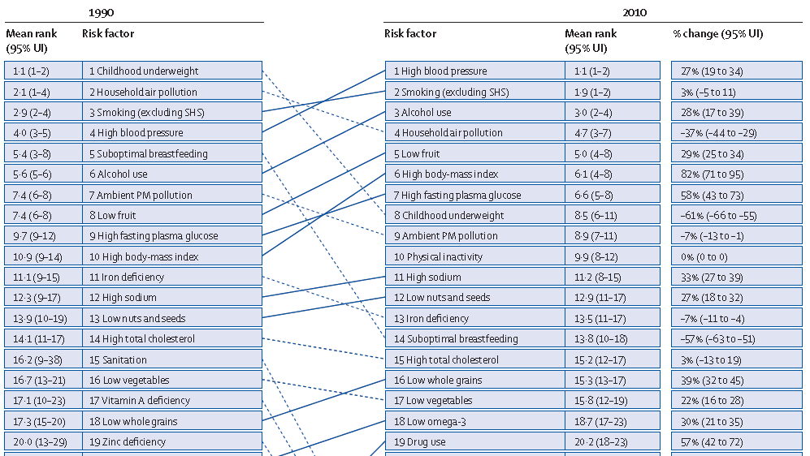
Ranking of leading risk factors in 1990 & 2010, and % change (world)
Lim SS et al. A comparative risk assessment of burden of disease and injury attributable to 67 risk factors and risk factor clusters in 21 regions, 1990–2010: a systematic analysis for the Global Burden of Disease Study 2010. Lancet 2012; 380: 2224–60

Slide 89
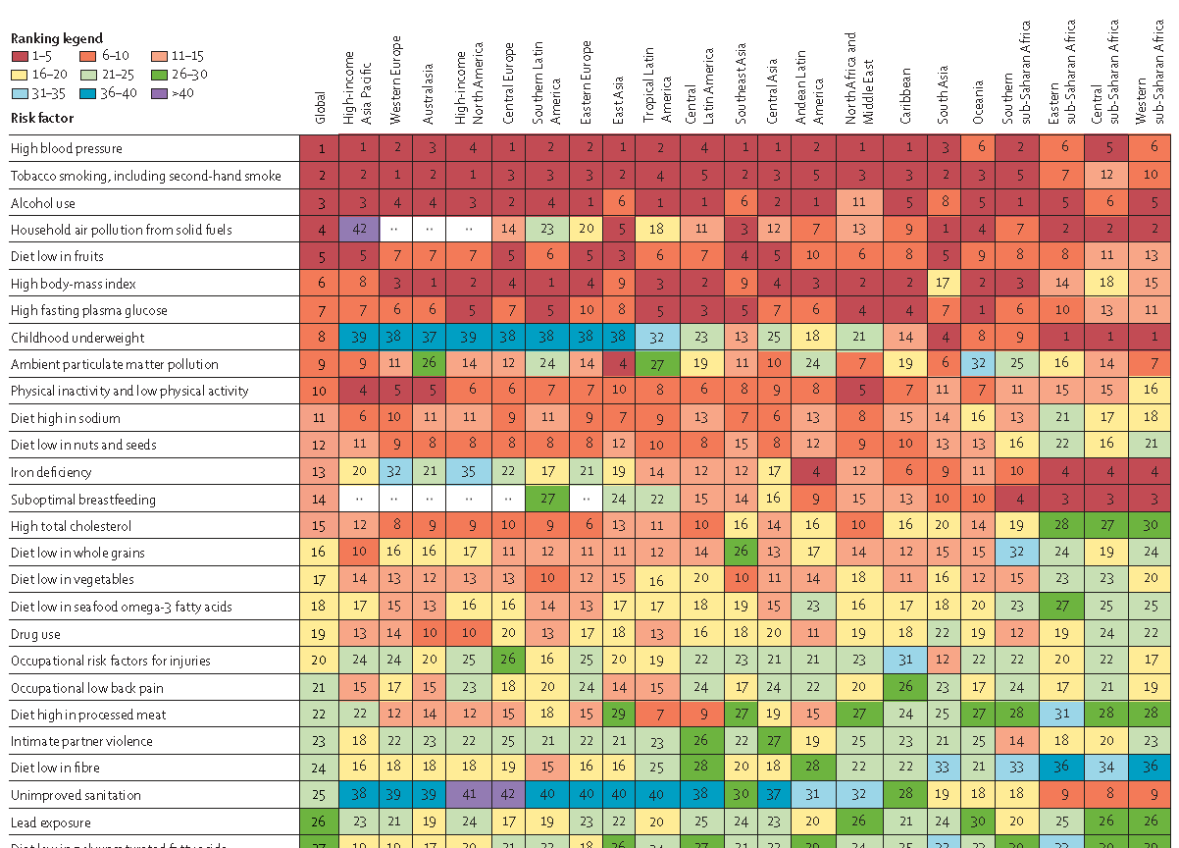
Risk factors ranked by attributable burden of disease & by country, 2010
Lim SS et al. A comparative risk assessment of burden of disease and injury attributable to 67 risk factors and risk factor clusters in 21 regions, 1990–2010: a systematic analysis for the Global Burden of Disease Study 2010. Lancet 2012; 380: 2224–60

Slide 91
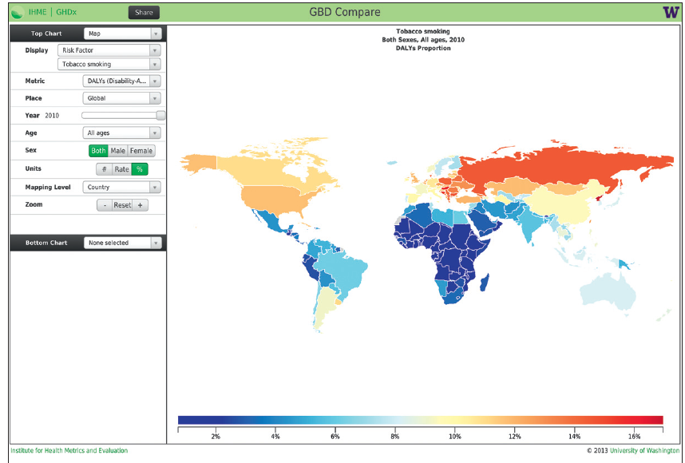
Screenshot of an output of GBD Compare showing the percentage of DALYs attributable to tobacco by country in 2010 for both sexes combined
Murray et al. Lancet 2013

Slide 93
Stages of health transition
DEMOGRAPHIC TRANSITION
EPIDEMIOLOGIC TRANSITION
NUTRITION TRANSITION
EARLY STAGES
High fertility/mortality
High prevalence infectious disease
High prevalence undernutrition
MIDDLE STAGES
Reduced mortality, changing age structure
Receding infection, poor environmental conditions
Receding famine
(Early) LATE STAGES
Reduced fertility, aging
Chronic lifestyle-related diseases (NCDs) predominate
Diet of chronic diseases predominate
(Late)
LATE STAGES
Reduced fertility, very old age
Shift to other chronic diseases
(mental, osteo-artic)
Health diet and lifestyles predominate
Adapted from Vorster et al. Nutrition Rev 1999

Slide 94
Links between health care transition, demographic transition and disease trends in populations
Large influence on the dynamics of demographic transition
  e.g. ‘delayed transition model’ in many developing countries
  large decrease of infant mortality not followed by proportionate decrease in birth (fertility) rate resulting in particularly large population increase
Access to and use of preventive and curative services
Costs and allocation of preventive and curative resources, particularly in developing countries (communicable diseases vs NVCDs)

Slide 95
Health planning: using the transition to set priorities
2 main methods of planning for budget allocation
Retrospective method: allocation of resources according to previously established priorities
Better takes in account budget limitations but tends to perpetuate existing conditions
Prospective method: starts with a definition of health needs (depends of age distribution [can be predicted], changes in prevalence rates of disease and risk factors and expectations) to then define service and resource equivalents
Better anticipates future health needs and resource requirements
Bobadilla et al. In Jamison ed. Disease Control Priorities in DC. Oxford UP, WB, 1993

Slide 96
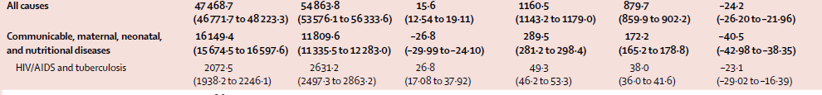
GBD between 1990 and 2013 : total burden increases in most countries but age-adjusted rates decrease in many countries,
Notes:
Global, regional, and national age–sex specific all-cause and
cause-specific mortality for 240 causes of death, 1990–2013:
a systematic analysis for the Global Burden of Disease
Study 2013
GBD 2013 Mortality and Causes of Death Collaborators*
Summary
Background Up-to-date evidence on levels and trends for age-sex-specifi c all-cause and cause-specifi c mortality is
essential for the formation of global, regional, and national health policies. In the Global Burden of Disease Study
2013 (GBD 2013) we estimated yearly deaths for 188 countries between 1990, and 2013. We used the results to assess
whether there is epidemiological convergence across countries.
Methods We estimated age-sex-specifi c all-cause mortality using the GBD 2010 methods with some refi nements to improve
accuracy applied to an updated database of vital registration, survey, and census data. We generally estimated cause of
death as in the GBD 2010. Key improvements included the addition of more recent vital registration data for 72 countries,
an updated verbal autopsy literature review, two new and detailed data systems for China, and more detail for Mexico, UK,
Turkey, and Russia. We improved statistical models for garbage code redistribution. We used six diff erent modelling
strategies across the 240 causes; cause of death ensemble modelling (CODEm) was the dominant strategy for causes with
suffi cient information. Trends for Alzheimer’s disease and other dementias were informed by meta-regression of
prevalence studies. For pathogen-specifi c causes of diarrhoea and lower respiratory infections we used a counterfactual
approach. We computed two measures of convergence (inequality) across countries: the average relative diff erence across
all pairs of countries (Gini coeffi cient) and the average absolute diff erence across countries. To summarise broad fi ndings,
we used multiple decrement life-tables to decompose probabilities of death from birth to exact age 15 years, from exact age
15 years to exact age 50 years, and from exact age 50 years to exact age 75 years, and life expectancy at birth into major
causes. For all quantities reported, we computed 95% uncertainty intervals (UIs). We constrained cause-specifi c fractions
within each age-sex-country-year group to sum to all-cause mortality based on draws from the uncertainty distributions.
Findings Global life expectancy for both sexes increased from 65·3 years (UI 65·0–65·6) in 1990, to 71·5 years
(UI 71·0–71·9) in 2013, while the number of deaths increased from 47·5 million (UI 46·8–48·2) to 54·9 million
(UI 53·6–56·3) over the same interval. Global progress masked variation by age and sex: for children, average absolute
diff erences between countries decreased but relative diff erences increased. For women aged 25–39 years and older than
75 years and for men aged 20–49 years and 65 years and older, both absolute and relative diff erences increased.
Decomposition of global and regional life expectancy showed the prominent role of reductions in age-standardised death
rates for cardiovascular diseases and cancers in high-income regions, and reductions in child deaths from diarrhoea,
lower respiratory infections, and neonatal causes in low-income regions. HIV/AIDS reduced life expectancy in southern
sub-Saharan Africa. For most communicable causes of death both numbers of deaths and age-standardised death rates fell
whereas for most non-communicable causes, demographic shifts have increased numbers of deaths but decreased agestandardised
death rates. Global deaths from injury increased by 10·7%, from 4·3 million deaths in 1990 to 4·8 million in
2013; but age-standardised rates declined over the same period by 21%. For some causes of more than 100 000 deaths per
year in 2013, age-standardised death rates increased between 1990 and 2013, including HIV/AIDS, pancreatic cancer, atrial
fi brillation and fl utter, drug use disorders, diabetes, chronic kidney disease, and sickle-cell anaemias. Diarrhoeal diseases,
lower respiratory infections, neonatal causes, and malaria are still in the top fi ve causes of death in children younger than
5 years. The most important pathogens are rotavirus for diarrhoea and pneumococcus for lower respiratory infections.
Country-specifi c probabilities of death over three phases of life were substantially varied between and within regions.
Interpretation For most countries, the general pattern of reductions in age-sex specifi c mortality has been associated
with a progressive shift towards a larger share of the remaining deaths caused by non-communicable disease and
injuries. Assessing epidemiological convergence across countries depends on whether an absolute or relative measure
of inequality is used. Nevertheless, age-standardised death rates for seven substantial causes are increasing, suggesting
the potential for reversals in some countries. Important gaps exist in the empirical data for cause of death estimates
for some countries; for example, no national data for India are available for the past decade.
Funding Bill & Melinda Gates Foundation.
Published Online
December 18, 2014
http://dx.doi.org/10.1016/
Correspondence to: Prof Christopher J L Murray,
2301 5th Avenue, Suite 600,
Seattle, WA 98121, USA
cjlm@uw.edu
An interactive fi gure with these data is available at http://vizhub.healthdata.org/le. Changes in life expectancy as a result of specific causes were decomposed from the difference between all-cause lifetables and cause-deleted lifetables (mortality set to zero for a specific cause). Because all changes in life expectancy are based on cross-sectional lifetables, the cause-specific changes add up to the total change in life-expectancy. NTDs=neglected tropical diseases.

