Slide 1
NCD Situation in Kuwait
Dr. Amaal Hussain Al-Yahia
Ministry of Health
Kuwait
March 2011

Slide 2
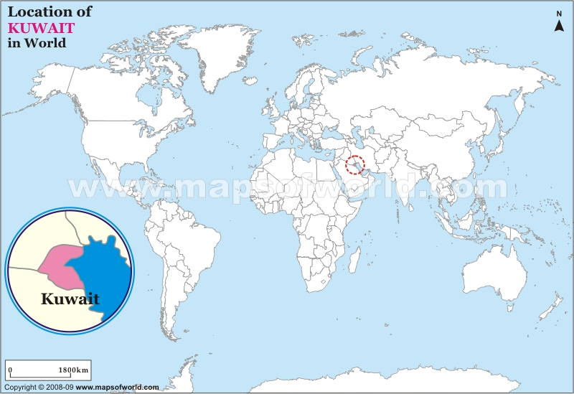

Slide 3
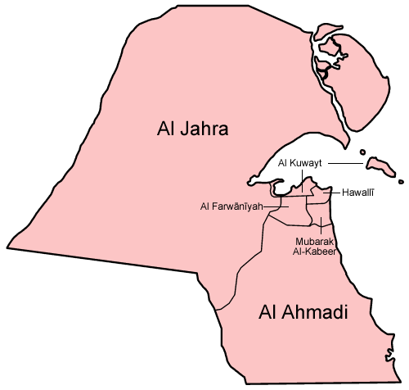
90 PHC
6 General Hospitals
10 specialized centers
23 specialized Centers
56 Diabetic Clinics
7 Smoking Cessation Clinics
15 Obesity Clinics
4 Healthy Clinics
62 with Labs
15 With Radiography facilities

Slide 4
Epidemiology of NCDs in Kuwait
The Disease | Prevalence | Mortality
Cardiovascular Disease | 46.8% | 48.8 deaths per 100000
Diabetes | 16.7% | -----
Cancer | --- | 23.7 deaths per 100,000
Hypertension | 7.9% | ----

Slide 5
Prevalence of Risk Factors to NCDs in Kuwait
Risk Factor | Prevalence
smoking | 20.6%
Overweight and 0besity | 75.4%
Lack of physical Exercise | 55.4%
Low Fruit & vegetable intake | 81%
Raised FBS | 12.4%
Raised total cholesterol | 38.6%
Easters Mediterranean Approach for control of NCDs: Survey of Risk Factors for NCDs-WHO-EMRO.2008

Slide 6
Achievements in Kuwait in tackling NCDs and their risk factors
THE CONSTITUTION OF KUWAIT
Legislations and resolutions to control smoking
Suitable infrastructure to control NCDs. Electronic file for all patients attending primary health care and connection (with hospital electronic files is under piloting at the moment)
National Plan for Control of NCDs has been drafted
National Policies and Strategies for prevention and control of NCDs currently available as well as Guidelines and Protocols for some NCDs
Health Promotion Programmes has financial support from the Ministry of health budget since 2005
Good input from NGOs ( CAN), private sector.

Slide 7
Health information system
Surveys
Surveillance
Disease Registries
International Health Survey ( Just Finished field work)
GYTS Global Youth Tobacco Survey: Conducted 3 times: 2002, 2006 & 2009.
National Nutrition Survey
Easters Mediterranean Approach for control of NCDs: Survey of Risk Factors for NCDs-WHO-EMRO.2008
Nutrition Surveillance (Annual)
Cancer
Diabetes at PHC
Vital statistics

Slide 8
Challenges facing control of NCDs in Kuwait
Socio-cultural changes, behavior and attitudes contributing to health problems by reinforcing the presence of risk factors within Kuwait Society
No separate effective department or centre that governs the activities related to the control of NCDs which make comprehensive care difficult to achieve esp. the primary prevention
Reinforcement of the resolutions, policy implementation
Researche lacks behind
National multi sectoral commities are not available or not active which hinders the multi-sectoral efforts to control NCDs

Slide 9
Main lessons learnt over past 5 yrs
We need to establish a body that is totally devoted to NCDs in order to achieve the desired change
NGOs and the private sector can play a huge role in the health education and control of NCDs and so long lasting partnerships are important than the short cooperation
We need to act as soon as possible to make the health education teams a reality by proper education and training as well as legislative support
Invest in data base systems that can provide information for surveillance, monitoring and planning

Slide 10
Future Plans to tackle NCDs
Establish NCD clinics in PHC clinics
Indorse the Kuwait National Plan for the control of NCDs
Collaborate with GCC countries on the effective execution of action plans to control NCDs through strengthening of the Gulf Committee to control NCDs

Slide 11
Thank You

